Slide 1
^{2018 – ALL CHANGE}
Investment Governance and Regulation Revamp
^{Victoria Worsfold}
^{Guildford Borough Council}
^{Dr Bob Swarup}
^{Camdor Global Advisors}
^{Roy Nolan}
^{RP Martin}
Copyright © 2018 Camdor Global Advisors All rights reserved.

Slide 2
^{Some thoughts}
When the map and the territory don’t agree, always believe the territory.
Swedish Army training
Yesterday’s bullet won’t kill you. Tomorrow’s bullet just might.
Bernie Provan
What we think, or what we know, or what we believe is, in the end, of little consequence. The only consequence is what we do.
John Ruskin
Copyright © 2018 Camdor Global Advisors All rights reserved.

Slide 3
Local authorities face numerous challenges today
Balance sheet and funding strains
Declining liquidity
The search for yield
Collateral management
Negative real returns
What about diversification?
What do you do?
Tail risks
Risk vs uncertainty
Unstable correlations
Counterparty risks
Public vs private assets

Slide 4
Chief among them, real rates today
Source: Bank of England, ONS, Camdor Global Advisors
Real rates (yields minus inflation) is the goal that councils need to beat across portfolios and commercial enterprises to generate a return in real terms, i.e. adjusted for inflation and any financing costs.
Copyright © 2018 Camdor Global Advisors All rights reserved.

Slide 5
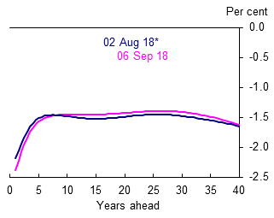
The outlook does not look promising either…
UK instantaneous implied real forward curve (gilts)
Source: Bank of England
Copyright © 2018 Camdor Global Advisors All rights reserved.

Slide 6
Treasury management is challenging today
Security, Liquidity, Yield
Security has declined, as leverage has risen and assets have tail risks hiding within (e.g. bail-in risks)
Liquidity has become more contingent, particularly in crises, as banks shrink their balance sheets and withdraw from periphery to core activities
Yield has cratered in response to macro pressures and a crush for yield amongst investors, while real yields have become highly negative
Copyright © 2018 Camdor Global Advisors All rights reserved.

Slide 7
The challenges of traditional treasury assets
Overexposure to banks and bail-in risks
Credit ratings alone are not a sufficient way of assessing risks, as evidenced by the Icelandic crash
Ratings fell post event
Councils eventually recovered 95% of all their monies…
…but it took three years and enormous opportunity cost
A lack of diversification
Most importantly, a lack of yield
Most local authorities earn -1.5% to -2.0% on their treasury portfolios after adjusting for inflation.
Even past this, how do you track evolving market dynamics to identify emerging risks?
Copyright © 2018 Camdor Global Advisors All rights reserved.

Slide 8
^{The balance sheet is changing}
The traditional treasury portfolio is fast evolving
These days, it has become a core of cash and cash-like instruments, coupled with some combination of four satellites:
Commercial property
Commercial ventures, e.g. housing companies, energy etc.
Direct sources of alternative income, e.g. renewable bonds, SME loans etc.
Investment funds of various flavours
These sometimes are explicitly part of the treasury portfolio but increasingly also sit outside it, particularly for the first two.
The core is also beginning to evolve as councils lengthen maturities and begin to explore a wider range of credit assets, e.g. covered bonds, corporate bonds, asset-backed bonds etc.
The reasons are understandable and represent an evolution of today’s balance sheets in response to external pressures
But these investments have also increased complexity and challenges, as highlighted by the recent code
Copyright © 2018 Camdor Global Advisors All rights reserved.

Slide 9
The innovation gap
The Innovation Gap
Growing economic uncertainty, regulatory and asset complexity, volatility, counterparty risks, data etc.
Ability to distil, model, allocate, manage risks, issue debt, funding solutions etc.
Source: Camdor Global Advisors

Slide 10
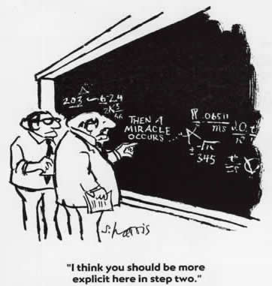
^{Hope is not a strategy}
Copyright © 2018 Camdor Global Advisors All rights reserved.

Slide 11
Local authorities need innovation to adapt
Governance and scrutiny
Investment
strategy
Culture
Risk management and funding

Slide 12
Evolving the treasury framework
Security, Liquidity, Yield
In today’s environment:
Security means considering all risks to the balance sheet – not just counterparty risk but also emerging ones such as inflation, policy uncertainty, Brexit effects etc.
Liquidity means having the money available when you need it, i.e. linking investments to funding needs, revenue and capital budgets, pension liabilities etc.
Yield requires a wider palette of investments, a holistic and dynamic approach and a focus on proactive management
Copyright © 2018 Camdor Global Advisors All rights reserved.

Slide 13
^{Always watch the downside}
Risk is a dynamic entity
Changing markets means changing risks
Many hidden risks
Market risk
Counterparty risk
Interest rates and inflation
Operational risk
Policy risk
Know them all and focus only on accepting risks you understand
Actively manage and hedge out the rest
Copyright © 2018 Camdor Global Advisors All rights reserved.

Slide 14
Addressing lack of diversification
Diversify by risk, not buckets
Please note that the above does not include any non-traditional or other investments that the councils may hold, e.g. property, alternatives.

Slide 15
^{The rise of alternative assets}
Growing emphasis on
Genuine diversification and more yield
Dynamically managing risks and protecting against the downside
The rise of private debt and private assets
Can help diversify risks away from traditional counterparties
Properly structured and analysed, can provide added security through having asset backing and covenants
Liquidity can be matched to cashflow needs so that they sit alongside the capital and revenue strategy
Offer relatively high paying coupons (especially compared to money markets) thanks to illiquidity ‘premium’
Some assets have coupons linked to inflation, providing an additional measure of protection
Many different flavours, e.g. trade finance, renewables debt, real estate financing, private real estate, SME lending, supported living transactions, etc.
Copyright © 2018 Camdor Global Advisors All rights reserved.

Slide 16
^{The challenges of alternatives}
Cannot embrace alternatives without analysis or a detailed understanding
Highly dependent on cashflow needs and current risk exposures
What are the goals for the alternatives portfolio?
Desired risk, return, volatility etc.
Where does it sit within overall portfolio and what is the purpose?
Triangulate with key factors
Organisational appetite and internal levels of knowledge
Ability to source, manage, monitor etc.
Wider macro trends
The critical importance of due diligence
How does it make money? The mechanics of the asset
Why does it make money? The key drivers and by implication, the risks within
How do you avoid losing money? Managing the downside and creating mitigants
Copyright © 2018 Camdor Global Advisors All rights reserved.

Slide 17
The broader landscape is also changing
Governance is about independent and careful thought
It is about balancing risk, return and needs
The rise of prudence as a key goal in discharging fiduciary responsibilities
The rise of commercial property and other alternative assets as a key investment focus for councils has led to a parallel focus from policymakers and regulators
Impact of new guidance
New duties arising from the changes to the CIPFA codes of practice
Subjective requirements for those electing up to professional status under MiFID II
DCLG consultation will lead to further changes
Copyright © 2018 Camdor Global Advisors All rights reserved.

Slide 18
^{A more complex balance sheet}
This all points to a more complex balance sheet and greater needs for local authorities
How do you distil the information that matters?
How do you discharge your responsibilities and maintain oversight even with delegation?
How do you evidence prudence, particularly with increased scrutiny and increased reputational risks?
How do you ensure value for money, particularly in today’s environment?
All the numbers in the world … are no substitute for action
Proactive management means timely and efficient decision-making
Resourcing and delegation of duties
The role of scrutiny
Rethinking investment and risk frameworks
Governance of alternative assets
Distilling information into actionable dashboards
Copyright © 2018 Camdor Global Advisors All rights reserved.

Slide 19
An updated investment framework
Core objectives:
Create a holistic framework that sits alongside and interplays with the council’s capital programme and revenue budget
Increase the real return of the portfolio relative to inflation, so that the drag on returns is reduced
Align portfolio to funding needs and optimise yield versus risk
Key constraints:
Needs to consider the evolving and uncertain macroeconomic environment.
Important to assess all risks to create a robust portfolio, but also account for the council’s resources.
In line with the legislative framework that the council is subject to.
Important to understand funding needs over different time horizons, in order to optimise investment strategy and align with funding needs.
Cognizant of internal resourcing, transaction costs and governance frameworks.
No appetite for reputational risk.

Slide 20
Treasury Management – A holistic framework
Risk
Tail risks
Short term & long term risks
Counterparty risks
Macro trends, maturity bucketing, new asset classes, investment & risk frameworks, etc.
Funding solutions, new structures, external borrowings etc.
Liability management
Linking investment strategy to funding needs and liability profiles is key
Liquidity management and cashflow-at-risk are important
Return
Long term expected returns
Short and medium term
horizons
Cashflow optimisation, risk appetite & goals, governance etc.
This holistic framework can easily be applied to the whole or specific parts of the balance sheet (e.g. treasury, property portfolios) and also to local government pension schemes

Slide 21
1

Slide 22
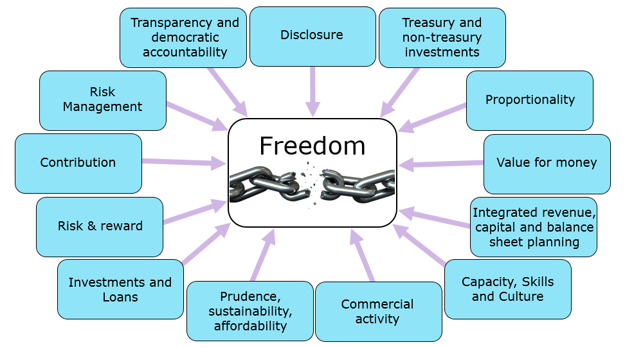
2018 Investment Changes
13

Slide 23
Risk Diversifying Investments
Green:
Renewable Energy
Waste to Energy
Business Support:
Pooled Investment Funds
Business Investment
Treasury returns:
Tenor: 3 – 7 years
Yield: 4.00% - 8.00%
Responsible:
Forestry
Carbon Reducing Tech.
Non-Treasury returns:
Tenor: 5 – 30 years
Yield: 5.00% - 12.00%
Localism:
Leisure
Fuel Poverty
Regeneration:
Crematoria
Residential Property
15

Slide 24
“Governance is an enabler, not a straight jacket”
Former CIPFA President – John Mathieson
16

Slide 25
Preparing a capital strategy
Vicky Worsfold
Financial Services Manager & Deputy CFO
Guildford Borough Council

Slide 26
Prudential Code
“In order to demonstrate that a Council takes capital and investment decisions in line with service objectives and properly takes account of stewardship, value for money, prudence, sustainability, and affordability, Councils should have in place a capital strategy that sets out the long-term context in which capital expenditure and investment decisions are made and gives due consideration to both risk and reward and impact on the achievement of priority outcomes.”
The capital strategy should form part of the Councils integrated revenue, capital and balance sheet planning.

Slide 27
What is a Capital Strategy
Long-term planning of capital investment and how it will be delivered
A document that will consider all aspects of capital expenditure which relates to corporate objectives
Asset planning and asset management plans
In reality you will all do this but by another name or form. The Prudential code now requires it to be all brought together.

Slide 28
What should a capital strategy include – Prudential Code (1)
Capital expenditure
An overview of the governance process for approval and monitoring of capital expenditure
A long-term view of capital expenditure plans
An overview of asset management planning
Any restrictions around borrowing or funding of ongoing capital finance
Debt and borrowing and treasury management
A projection of external debt and use of internal borrowing to support capital expenditure

Slide 29
What should a capital strategy include – Prudential Code (2)
Debt and borrowing and treasury management (cont)
Provision for the repayment of debt over the life of the underlying asset
Authorised limit and operational boundary for the following year
The approach to treasury management including processes, due diligence and defining the risk appetite
Commercial activity
The councils approach to commercial activities, including processes, ensuring effective due diligence and defining the risk appetite, including proportionality in respect of overall resources

Slide 30
What should a capital strategy include – Prudential Code (3)
Other long-term liabilities
An overview of the governance process for approval and monitoring and ongoing risk management of any other financial guarantees and other long-term liabilities
Knowledge and skills
A summary of the knowledge and skills available to the Council and confirmation that these are commensurate with the risk appetite.

Slide 31
What should a capital strategy include in relation to capital
All aspects of capital expenditure
Revenue implications of capital expenditure
Framework for management and monitoring of capital programme
Processes for option appraisal, prioritisation of schemes, monitoring and evaluation of schemes and corporate review of existing properties
RISK!
Flexible use of capital receipts
Should link to asset management plans and provide a framework for the operational work of asset management

Slide 32
What should a capital strategy include in relation to Risk
We are all used to explaining TM risk and it has been the forefront to our TM strategies over the years.
What other areas of risk can we discuss?
HRA – building homes, debt cap, borrowing levels, business plans
Companies – wholly owned? Asset backed? How is it funded?
Investment property purchases – governance processes, proportionality, rent, voids, lease maturities
Capital programme – risk of slippage (investment returns, available cash, borrowing too early, cost of carry, cost inflation)
Asset register – maintenance plans, risk of not maintaining – cost implication

Slide 33
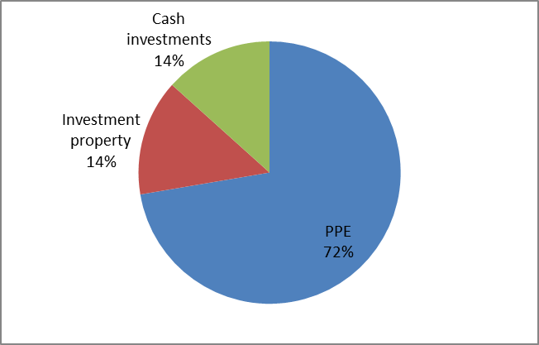
What should a capital strategy include in relation to Risk (2)
What is the total value of your investments? That is the total value at risk.
Guildford’s balance sheet is broadly equal in terms of cash investments and investment property. When you add in PPE (which includes HRA), it’s a very different picture
Notes:
Our return on cash investment is £1.8 million
Our rental income on investment property is £9.4 million

Slide 34
^{APPENDIX}
Copyright © 2018 Camdor Global Advisors All rights reserved.

Slide 35
^{On Scrutiny}
What is scrutiny?
Being a ‘critical friend’, challenging executive policy-makers and decision-takers
Understanding the current and future economic environment, and its implications for the council’s cashflow requirements and the goals set
Enabling the voice and concerns of local citizens to be heard
Undertaken by ‘independent minded governors’ who lead and own the scrutiny process
Establishing the facts about historic actions and performance
Having a clear focus of driving future improvement.
Not an audit
Key areas to look at:
Treasury management advisors and fund managers
Liquidity profile, economic scenarios and cashflow requirements
Independent assessments of investment portfolios and risk tolerances
Assessment of counterparty risk outside of just credit ratings
Successes and failures, and why?
Decision making and actions undertaken
Private assets and local investments
Copyright © 2018 Camdor Global Advisors All rights reserved.

Slide 36
AN INTEGRATED SUITE OF SERVICES
Camdor Global Advisors
Investment and Risk Advisory
Economic & Investment Research
Sourcing and Structuring of Direct Investments
Portfolio Management
Risk / Capital Management
Investment Research
Macro Commentary
Alternative Assets
Portfolio health checks
Strategic Asset Allocation
Treasury management
Investment due diligence
Risk budgeting
Scenario analysis / stress testing
Internal ratings
Capital/cashflow modelling
Borrowing advisory
Risk/return projections & key asset dynamics
In-depth studies of alternative asset classes
Ad-hoc ‘trade ideas’
Macroeconomic outlook
Investment and risk strategy implications
Data provision and analysis
Portfolio goals and construction
Structuring and origination of direct deals
Specialise in alternative income assets

Slide 37
^{CONTACT}
A:
T:
M:
E:
Dr. Bob Swarup
Holland House, 4 Bury Street
London EC3A 5AW
+44 (0) 20 7220 6550
+44 (0) 7801 552755
swarup@camdorglobal.com
DISCLAIMER
The information set forth herein is provided for informational and discussion purposes only. This publication has been prepared for general guidance on matters of interest only, and does not constitute professional advice. You should not act upon the information contained in this publication without obtaining specific professional advice. No representation or warranty (express or implied) is given as to the accuracy or completeness of the information contained in this publication, and, to the extent permitted by law, Camdor Global Advisors does not accept or assume any liability, responsibility or duty of care for any consequences of you or anyone else acting, or refraining to act, in reliance on the information contained in this publication or for any decision based on it. Neither this document nor the information contained herein may be shared with any third party without the consent of Camdor Global Advisors.
Copyright © 2018 Camdor Global Advisors All rights reserved.

Slide 38
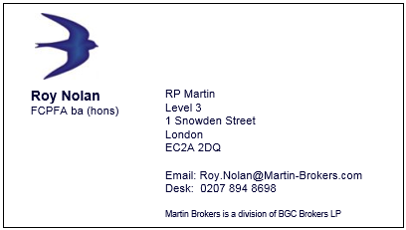
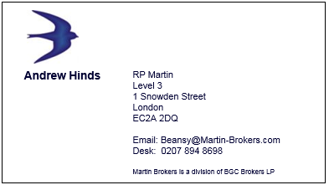
Disclaimer
This presentation including the information contained herein (Publication) is being issued by RP Martin as a division of BGC Brokers LP and affiliates, which is authorised and regulated by the Financial Conduct Authority (FCA). This Publication is issued on a strictly confidential basis and for information purposes only to a limited number of intended recipients and should not be construed as legal, tax or financial advice. It should not be distributed, published or reproduced in whole or in part, nor should its contents be disclosed by intended recipients to any other person nor should it be relied upon by such persons as the basis for investment in any of the product described herein. RP Martin and / or affiliates will not be responsible to recipients for providing protections afforded to their underlying clients nor for advising them. Any valuations contained herein are indicative only and such valuations may be subject to change without notice. Past performance is not necessarily indicative of future results and the intended recipients of this Publication should not rely on the information contained herein as it is not a guarantee or promise of future results and, where applicable, recipients should seek their own independent financial advice. Certain information contained herein is based on third party sources. RP Martin and/ or affiliates do not make any representations as to the accuracy or completeness of any valuations nor third party sources contained herein. RP Martin and/or connected persons do not accept any liability whatsoever for any direct, indirect or consequential loss arising from any actions undertaken in reliance on or from any use of this Publication. This Publication is provided on the basis that the recipients have such knowledge and experience in financial and business matters to be capable of evaluating the merits and risks of any investment business and that they will undertake appropriate, independent investigation, assessment or analysis regarding any investment. Neither the information nor any opinion herein constitutes, or is to be considered as, an offer to buy or sell investments. This Publication is not intended for private investors within the rules of the FCA and therefore should not be distributed to such investors. RP Martin does not provide investment advice. This Publication is subject to the copyright of RP Martin.
17

