Slide 1
CIPFA/CfPS Councillors Conference Mike O’Donnell Associate Director of Local Government CIPFA

Slide 2
The state of public finances
Spending on public services and benefits payments – which make up around 85% of government spending – has fallen by about 1% since 2010.
Some services more than others which have seen large spending cuts – for example prisons down 22% since 2009/10, local government nearly 50%. Meanwhile social care now accounts for 54.4% of local authorities’ total service spend, up from 45.3% in 2010-11.
CIPFA and the Institute for Government’s (IFG) Performance Tracker shows public services have become “more efficient” since the introduction of austerity measures – that is, services are managing to deliver services at a lower cost than they did eight years ago.
However the Performance Tracker also shows that adult social care cannot continue to operate at their current level of efficiency, and that local authorities risk a serious deterioration of quality.

Slide 3
A longer-term issue: ‘social spending’ spending vs the rest - 1983-84 to 2018-19
Derived from Public Expenditure Statistical Analyses 2015, H M Treasury, Table 4.2
Percentages derived from services’ expenditure as proportion of all public expenditure

Slide 4
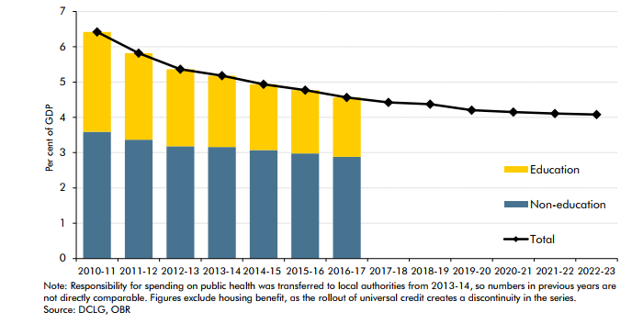
Local government expenditure as % of GDP - 7+ years of reductions as % of GDP
Source: OBR

Slide 5
Local government
Source: LGA 2017

Slide 6
Local government funding squeeze
Sustained real-term falls in government funding – 56.3% reduction by 2019/20.
Spending on local services - waste collection, road maintenance, food safety, trading standards, libraries – has fallen sharply in the last seven years. Squeezed inexorably by growing demands for social care.

Slide 7
Social care
Spending has fallen by 5% since 2009.
Although day-to-day spending on adult social care fell by nearly 10% in real terms between 2009/10 and 2014/15, levels since then have grown.
The recent increase in funding has been supported by the 2015/16 Better Care Fund and the commitment in the 2017 March Budget of an additional £2bn in funding. However, financial pressures persist.
The Government has again promised to release a Green Paper that will address (again) social care funding reform.

Slide 8
The common problems for local government to overcome
The prospect of austerity in public spending stretching into the middle of the next decade, coupled with economic uncertainty that Brexit brings.
Stark contrasts in different councils’ inherent ability to take advantage of financial sustainability. Geographical and historical determinants dictate likelihood of achieving a sustainable financial position post BRR and Fair funding.
Risks associated with regeneration projects and often unfettered ‘commercialism’ have been growing.
Growing service demand.
Impact of above varies markedly across the country and across communities.

Slide 9
The future of local government funding
Government’s Fair Funding Review and Business Rates Retention – will they bring about sustainable reform?
Northamptonshire County Council crisis has put local government funding pressures under the spotlight.

Slide 10
Tip of iceberg?

Slide 11
The financial stress warning signs – learning form CIPFA’s resilience reviews
Running down reserves – increasing rates of decline.
Shortening of medium-term financial planning horizons – perhaps from three or four years to two or even one.
Greater ‘still to be found’ gaps in saving plans – in the early days of austerity, a council might have agreed a four-year financial strategy. Now, authorities have only specified how savings will be achieved for the next financial year.
A growing tendency for departments to have unplanned overspends and/or carrying forward undelivered savings into the following year.

Slide 12
Four pillars of resilience
Getting routine financial management right – ensure basic financial management systems are working effectively.
Benchmarking – making good use of benchmarking data.
Clear plans for delivering savings – each authority needs a single, consolidated, living document that tracks its savings plans.
Reserves - to manage a clear and transparent savings programme over the medium term - not to avoid another cut in service level

Slide 13
CIPFA’s response to funding crisis
A financial resilience index.
Professional codification of budget setting and financial management.
Funding Advisory Service (FAS).
Code of ethics.

Slide 14
Importance of the role of councillors
Strength of leadership
Oversight and scrutiny
Accountability

Slide 15
How CIPFA is supporting councillors
CIPFA, in partnership with CfPS, will host further conferences for councillors.
CIPFA and CfPS are considering creating a dedicated network for councillors.
Notes:
Update from Cliff:
Current plan is to deepen our footprint as a place for councillors to come to for updates, advice and direct support. The councillor conference later this week (I am hoping) will be followed by further conferences (frequency and location) over the next 12 month, working in partnership with CfPS.
I am planning (hoping) to build sufficient interest and footfall in our events to then launch a dedicated network for councillors (again, in partnership with CfPS) and will be working something suitable into my BP.
Not intending to launch the new network in April 2019 (too much still to do to give it the best chance to succeed). More likely later that year or in time for a launch April 2020.
I’ll share more on likely timeline and planned development with you in the coming weeks, if you would like?
Cheers.

Slide 16
THANK YOU
Mike O’Donnell
Associate Director of Local Government

