Slide 1
NHS Finance Update
David Chandler
Deputy Chief Officer and Chief Finance Officer, NHS Sunderland CCG (+ friends).
CIPFA NE Conference Body – 22nd November 2019
Notes:
With a little help from the Kings Fund

Slide 2
Disclaimer
There are no conflicts of interest to disclose in relation to this presentation.
The content is the result or random thought and does not represent policy of the current Government, NHSE, NHSI, CQC, CCG, NUFC or any other responsible organisation.
Thanks are due to Jack and Daniels for facilitating the process.
I borrowed most of the content – including this disclaimer.

Slide 3
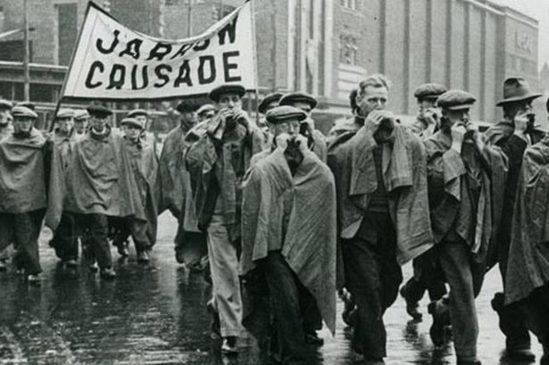
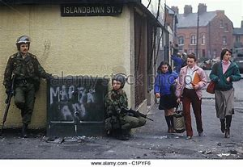
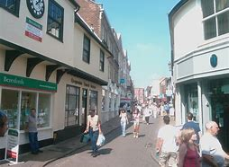
Notes:
Who are you?

Slide 4
Public Sector Resources 2010/11 to 2017/8
NHS Up 15%
Children’s Services Up 15%
Adult Social Care Down 5%
Police, CPS & Prisons Down 20-30%
Neighbourhood Services Down 25%
Source: Institute of Government Latest Performance Tracker
Notes:
Austerity Years
Lowest history – despite growing demand

Slide 5


Notes:
Political Editor BBC
Mouth
Speech at HFMA conference Nov 2017
Insight into politics – Brexit – politicans – T May – M Gove
Height of austerity – NHS lowest growth since records began – flat – but still better than rest of PS - protected
Question – Extra funding for NHS? No because. Waste / ineffiecient & black hole

Slide 6
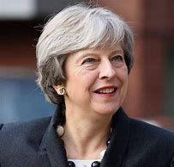

Slide 7


Slide 8

Notes:
£20b (real term over 5 years)
Brexit Dividend
Legacy – timing July 2018 – May survived votes of no confidence in Dec 2018 – gone by June 2019 – less than a year later

Slide 9
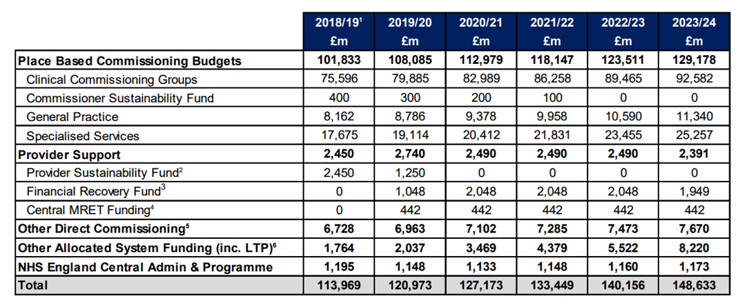
Notes:
£30bn cash over 5 years
High but still slightly lower than NHS average over lifetime (odd birthday present)
19/20 jump includes quite a lot of announved 18/19 monies – just making it recurent
Note the FRF & Note the LTP transformation funds
CCGs with programme growth of 5.7% in 19/20 and admin reduction of 20% by 2020/21
Specialised Services reflects pressures from high cost drugs.
General Practice which covers the core GP contract as well as other primary medical services higher growth in 2019/20 largely as a result of the 2018/19 DDRB pay recommendations.
Provider Support which reflects the financial reforms (discussed above)
Other Direct Commissioning, which covers public health, health and justice and armed forces reflects pay increases in 2018/19 which will flow through tariff in 2019/20 and additional public health investments.
Other Allocated System Funding reflects funding currently held centrally (inc that to deliver LTP priorities)

Slide 10
Quick Reminder of Pressures facing NHS
Demographics / Aging population
Growing Demand
Constitutional Targets
Aging Estate
Technology
Notes:
Estate – hospitals – new wing – actual hospital opened by Galdstone in 1890s

Slide 11




Slide 12

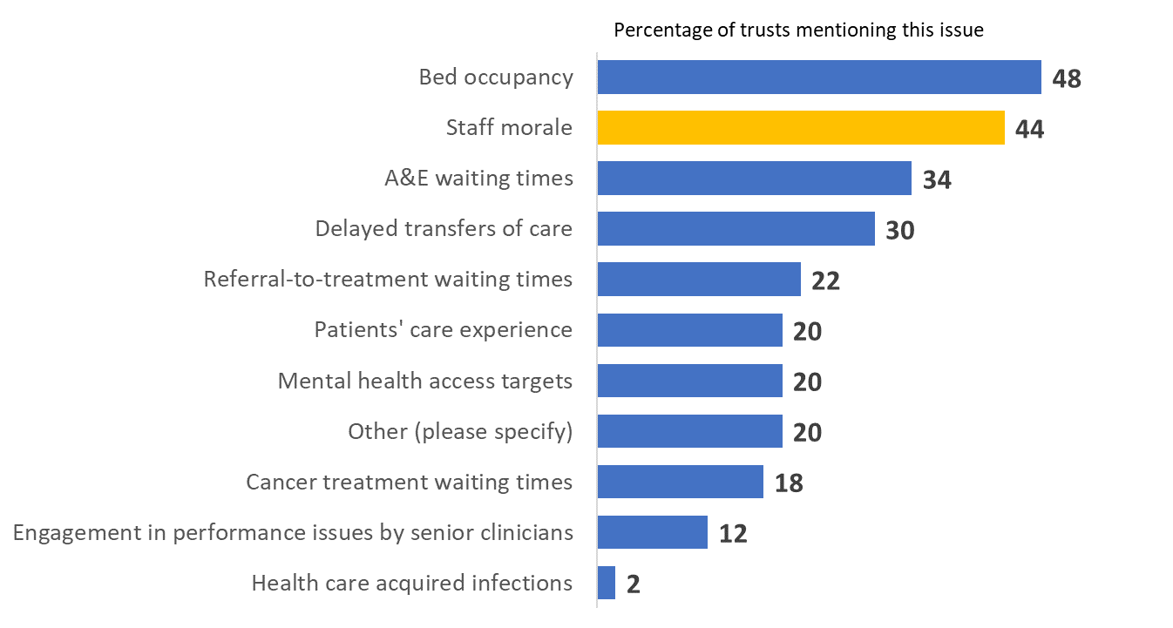

Workforce morale
Can you imagine what it’s like coming into work everyday with a backlog. Knowing you are starting every day ‘behind’. And then being having your work cancelled. Not being able to do what you were trained and paid to do.
NHS surgeon

Slide 13
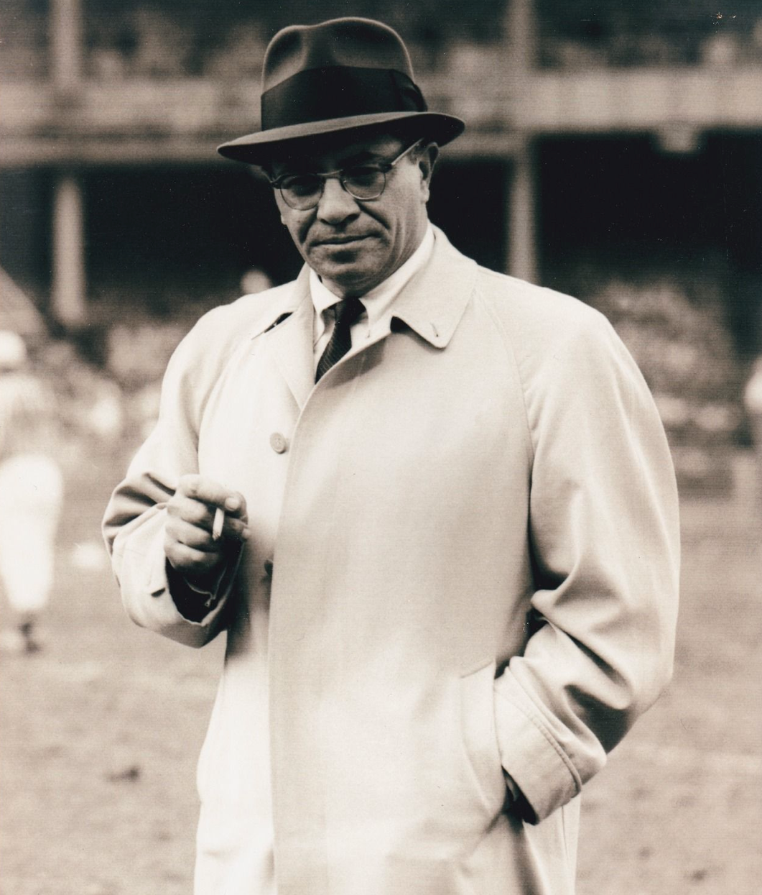
Hope is not a strategy
Vince Lombardi
http://www.ivy-style.com/all-time-super-bowl-king-of-style.html

Slide 14
In return for £20bn……. the NHS Long Term Plan
Notes:
Resisted putting a picture up of Stalin

Slide 15

The NHS Long-term Plan is part of a constellation of strategy work
NHS long-term plan
People plan
Primary care networks
Powis review of clinical standards
National patient safety strategy
NHS Assembly
Review of Better Care Fund
AfC pay deal
Spending Review
Prevention green paper
Social care green paper
Legislative changes

Slide 16

The old world
Focus: Organisation, hospital, provider
Performance: national targets
Money: does (or will) follow the patient
Energy driving the system: competition
The new world
Focus: system, place, neighbourhood
Performance: national targets and outcome measures for health and wellbeing
Money: shared and aligned incentives
Energy driving the system: collaboration
A ten-year NHS plan
A five-year NHS funding deal
A social care green paper?
A prevention green paper?
http://www.ivy-style.com/all-time-super-bowl-king-of-style.html

Slide 17
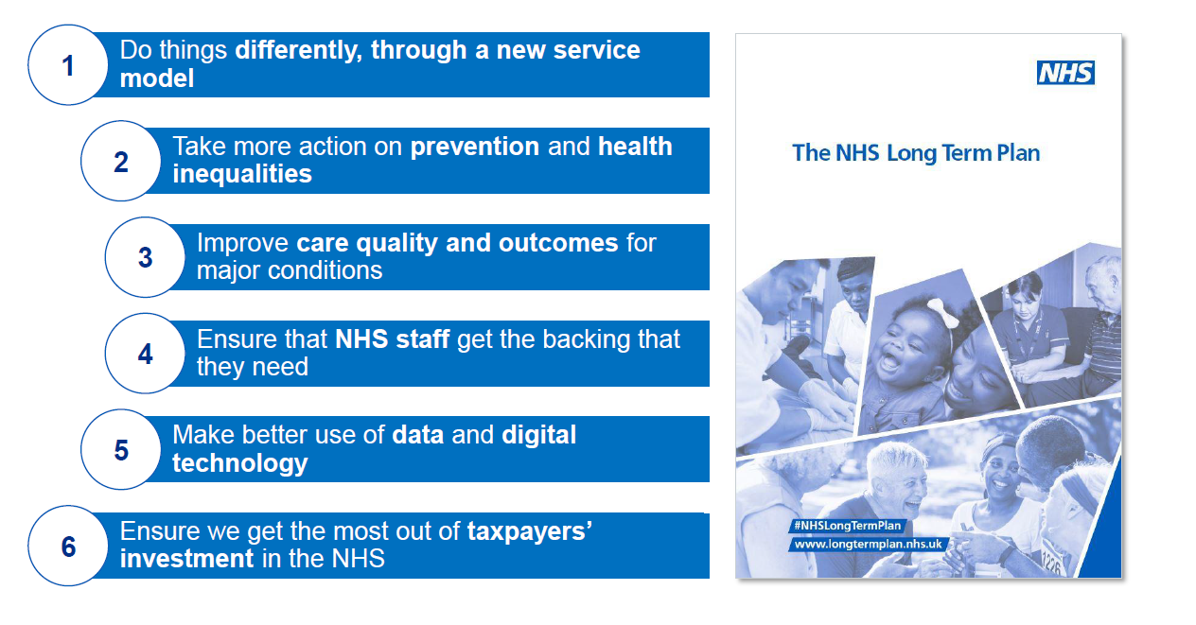
NHS Long Term Plan (Jan 2019)

Slide 18
LTP Implementation Framework – ‘What’ and ‘When’
Chapter 1 – introduction
Integrated approach to strategic and operational planning
Clinical leadership and local support
Investment to support transformation
Chapter 4 – improved care quality and outcomes
Learning disabilities and autism
Children and young people
Maternity and neonatal services
CVD, stroke and respiratory
Diabetes
Prevention
Volunteering
Research and innovation
Wider social impact
Health and the justice system
Veterans and armed forces
Health and the environment
Health and employment
Chapter 2 – foundations of service transformation
Fully integrated community based care
Reducing pressure on emergency hospital services
Giving people more control over their own health
Digitally-enabling primary care and outpatients
Improving cancer outcomes
Mental health
Shorter waits for planned care
Chapter 5 – maximising taxpayers investment
Financial and planning assumptions
Improving productivity
Chapter 3 – foundations of service development
Developing integrated care systems
Developing primary care networks
Workforce
Digitising the NHS
Optimising NHS Estates
Chapter 6 – next steps
Timetable, milestones, support

Slide 19
NHS LTP – Finance Tests
Test 1: Return NHS Orgs to financial balance.
Test 2: Savings of 1.1% year on year.
Test 3: Reduce growth in demand.
Test 4: Reduce variation in performance.
Test 5: Better use of capital investment.
Notes:
Resisted putting in a finance slide for too long – will get the shakes

Slide 20
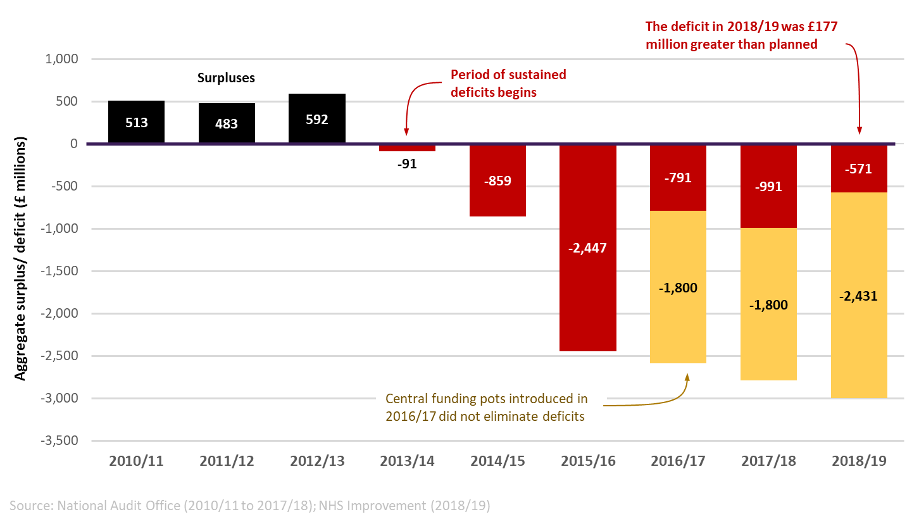
NHS provider trusts still in deficit despite record amounts of central sustainability funding support
Source: NAO and NHS Improvement (2018/19) data

Slide 21
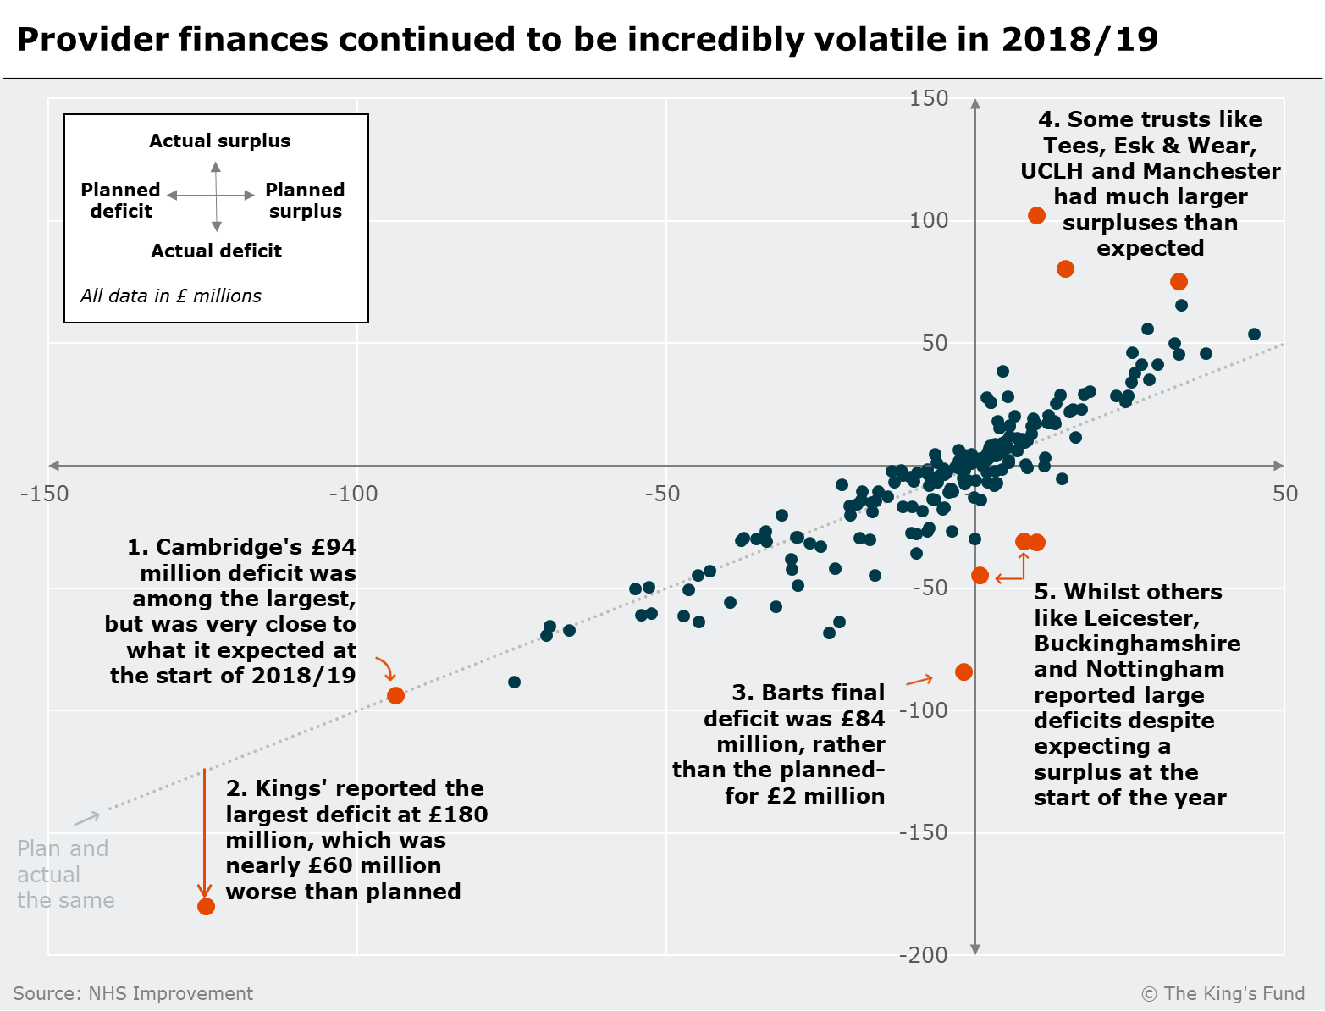
There is a lot to normalise – including £billions in sustainability funding that sits outside of ‘normal’ allocations process.
But more fundamentally, the strategy for paying and contracting for different types of activity…TBD

Slide 22
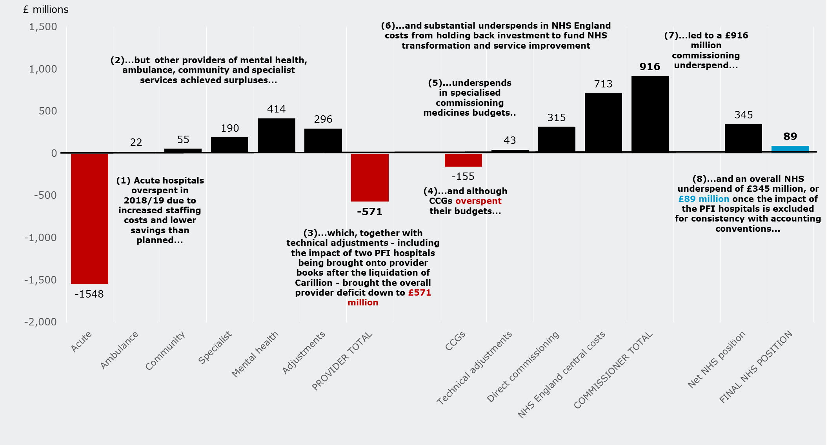
Some grounds for optimism

Slide 23
Is there enough money to deliver?
1. There is not enough growth
Narrower definition of ‘health’ spending is a false economy.
It is hard to see how the profile of funding increases links to the delivery strategy of the NHS long-term plan, where some pump-priming is needed.
2. And growth is not enough
With a workforce crisis, NHS funding is no longer the rate-limiting factor for service improvement.
Source: The Health Foundation

Slide 24
The NHS Long Term Plan
The five major practical changes to the NHS service model over the next five years will be:
Boosting out of hospital care to dissolve the divide between primary and community health services
Redesigning and reducing pressure on emergency hospital services
More personalised care to help people gain more control over their health when they need it
Digitally-enabled primary and outpatient care
Increasing focus on population health and local partnerships through Integrated Care Systems

Slide 25
1 – Out of Hospital Care & Primary Care Networks (PCNs)
‘Encourage practices to work together in ‘hubs or networks’
Localities & Neighbourhoods; Federations; Super surgeries
Multispecialty Community Providers
Primary Care Homes….
….and now PCNs… working collectively for place based care within ICSs
Extra funding for extra staffing (70%)
1259 PCNs
Notes:
Resisted putting a picture up of Stalin

Slide 26
Core characteristics: primary care home
Whole population health management. A combined focus on personalisation of care with improvements in population health planning, provision and outcomes
A multi-disciplinary workforce based on the needs of a defined local population with an emphasis on the integration of primary, community, secondary, mental health, social care and third sector
Financial and clinical drivers aligned with the health needs of the whole population. Improving outcomes through value based interventions
Focus on care to a defined registered population size of 30,000 – 50,000 people
The right size to scale and the right size to care

Slide 27


Slide 28
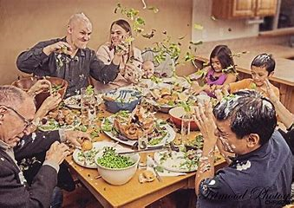

Slide 29


Slide 30
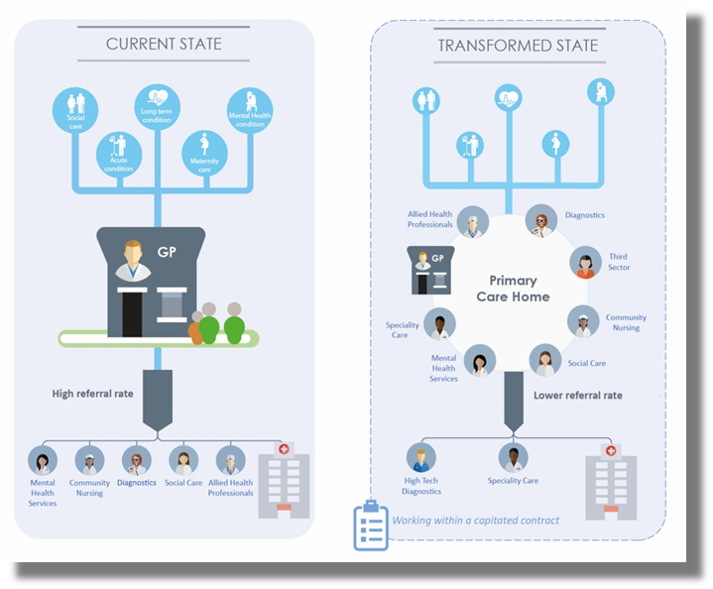
Core characteristics: primary care home

Slide 31

PCN Video

Slide 32
3 - Personalised Care
Apps - Diabetes prevention and management, asthma and respiratory conditions (my COPD app), maternity and parenting support, and online therapies for common mental health problems (KOOTH)
PCNs & social prescribing
Tailored plans and connecting people to local groups and support services
Over 1,000 trained social prescribers will be in place by the end of 2020/21 rising further by 2023/24, with the aim that over 900,000 people can be referred to social prescribing schemes
Personal Health Budgets increase
Notes:
Mention economic case

Slide 33
4 – Focus on Population Health via ICS’s
Integrated Care System (ICS) – a regional partnership between the NHS, local authorities, and others, taking collective responsibility for resources, setting strategic objectives and care standards, and improving the health of the people they serve. NHS England policy is for every part of the country to be part of an ICS
Integrated Care Partnership (ICP) - a local partnership of neighbouring NHS providers and commissioners, working with their local authorities, to deliver sustainable health and care services for the people in their area
Working with Local Authority Partners is VITAL
Notes:
Learn lessons of STPs

Slide 34
Why? Health Care System Performance Rankings
 | AUS | CAN | FRA | GER | NETH | NZ | NOR | SWE | SWIZ | UK | US
OVERALL RANKING | 2 | 9 | 10 | 8 | 3 | 4 | 4 | 6 | 6 | 1 | 11
Care Process | 2 | 6 | 9 | 8 | 4 | 3 | 10 | 11 | 7 | 1 | 5
Access | 4 | 10 | 9 | 2 | 1 | 7 | 5 | 6 | 8 | 3 | 11
Administrative Efficiency | 1 | 6 | 11 | 6 | 9 | 2 | 4 | 5 | 8 | 3 | 10
Spend GDP | 1 | 5 | 7 | 9 | 6 | 2 | 4 | 8 | 10 | 3 | 11
Equity | 7 | 9 | 10 | 6 | 2 | 8 | 5 | 3 | 4 | 1 | 11
Health Care Outcomes | 1 | 9 | 5 | 8 | 6 | 7 | 3 | 2 | 4 | 10 | 11
Source: Commonwealth Fund analysis.

Slide 35
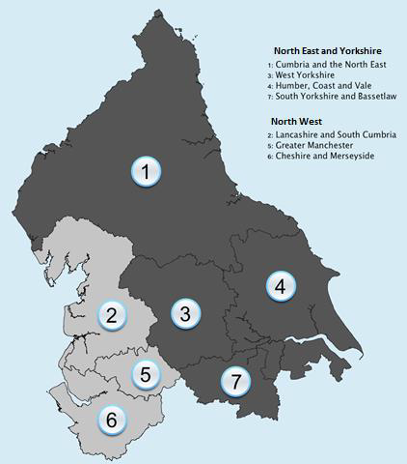
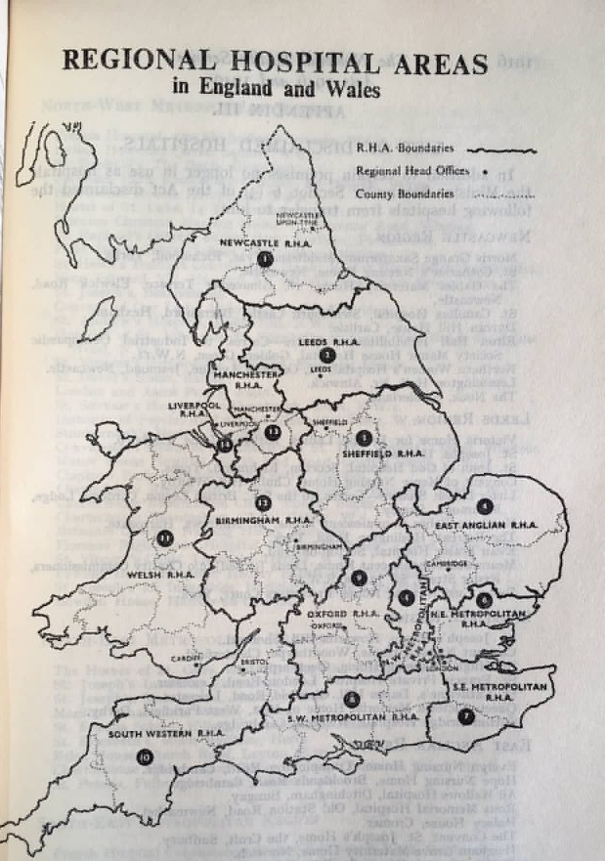
NHS in 2018
1 NHSE/I region
4 Integrated Care Systems
NHS in 1948

Slide 36
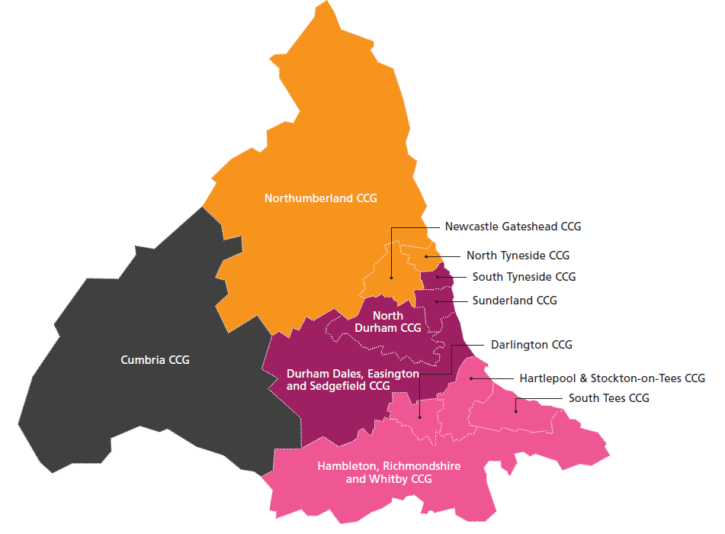
One North East and North Cumbria ICS
with four Integrated Care Partnerships (ICPs)
North East Ambulance Service FT covers North, Central &South ICPs
NTW Mental Health FT covers the North and part of Central ICP
TEWV Mental Health FT covers the South and part of Central ICP
‘North’
Population 1.025M
3 CCGs: Northumberland, North Tyneside, Newcastle Gateshead
24 Primary Care Networks
3 FTs: Northumbria, Newcastle, Gateshead
4 Council areas: Northumberland, North Tyneside, Newcastle, Gateshead
‘North Cumbria’
Shadow ICP 1 April 2018
Population 327,000
North Cumbria CCG
8 Primary Care Networks
North Cumbria Hospitals FT
Cumbria Partnership FT
Cumbria County Council
North West Ambulance Service
‘County Durham, South Tyneside and Sunderland (aka Central)’
Population 992,000
4 CCGs: South Tyneside, Sunderland, North Durham, DDES
24 Primary Care Networks
3 FTs: South Tyneside & Sunderland CDDFT
3 Council areas: South Tyneside, Sunderland, County Durham
North
‘South’
Population 847,000
4 CCGs: HAST, Darlington, S Tees, HRW
17 Primary Care Networks
3 FTs: CDDFT, North Tees, South Tees
6 Council areas: Hartlepool, Stockton on Tees, Darlington, Middlesbrough, Redcar & Cleveland, North Yorkshire
Notes:
Overall population 3,191,000

Slide 37
Key challenge:
do the right things at the right level with the right partners
People
Neighbourhoods/Primary Care Networks
(30-50,000 population sizes)
Place-based
(Local Authority/CCG size)
ICPs
(Sub-regional/Combined Authority level)
ICS
(North East & North Cumbria)
National
Regional & National

Slide 38
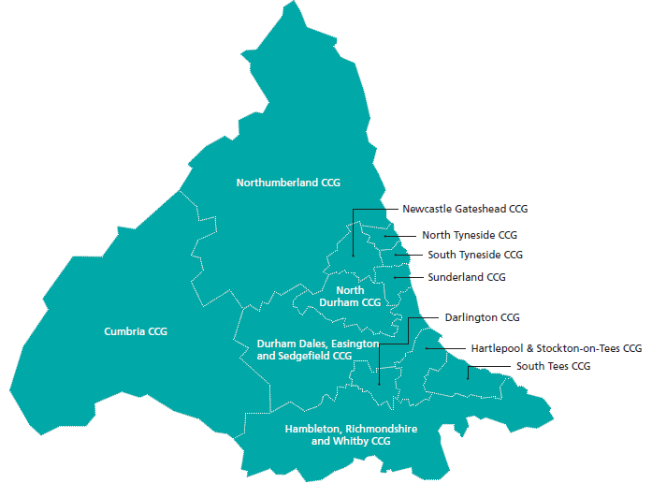


Areas of focus
Partnership working between NHS and local authorities via Health & Wellbeing Boards
Ensuring the quality, safety and accountability of local health services
Public and political engagement and consultation
Primary Care Network development
Health and Social Care Integration initiatives
Joint-working with the local voluntary sector
Places and neighbourhoods
Focus on acute services sustainability: clinical networking between neighbouring FTs and coordination of service development proposals
One streamlined commissioning hub per ICP
Work towards a single, shared approach to finances, and risk-sharing where appropriate.
Make best use of the existing premises and facilities and jointly plan capital investments
Integrated Care Partnerships
ICP
ICP
ICP
North
ICP
Overarching clinical strategy and clinical networks
Strategic Commissioning (e.g. ambulance services)
Shared policy development
Emerging ICS priority workstreams:
  Population Health & Prevention
  Optimising Health Services
  Workforce Transformation
  Digital Transformation
  Mental Health
  Learning Disabilities & Autism
Integrated Care System
ICS

Slide 39
5 – Digitally Enabled Primary & Outpatient Care
Patients will be able to access virtual services alongside face-to-face services via a computer or smart phone
As technology advances, the NHS will also trial the use of innovative devices such as smart inhalers for better patient care and remote monitoring of conditions
Over the next five years every patient in England will have a new right to choose the option of having ‘digital-first’ contact through telephone or online consultations – usually from their own practice or, if they prefer, from one of the new digital GP providers
Notes:
Learn lessons of STPs

Slide 40
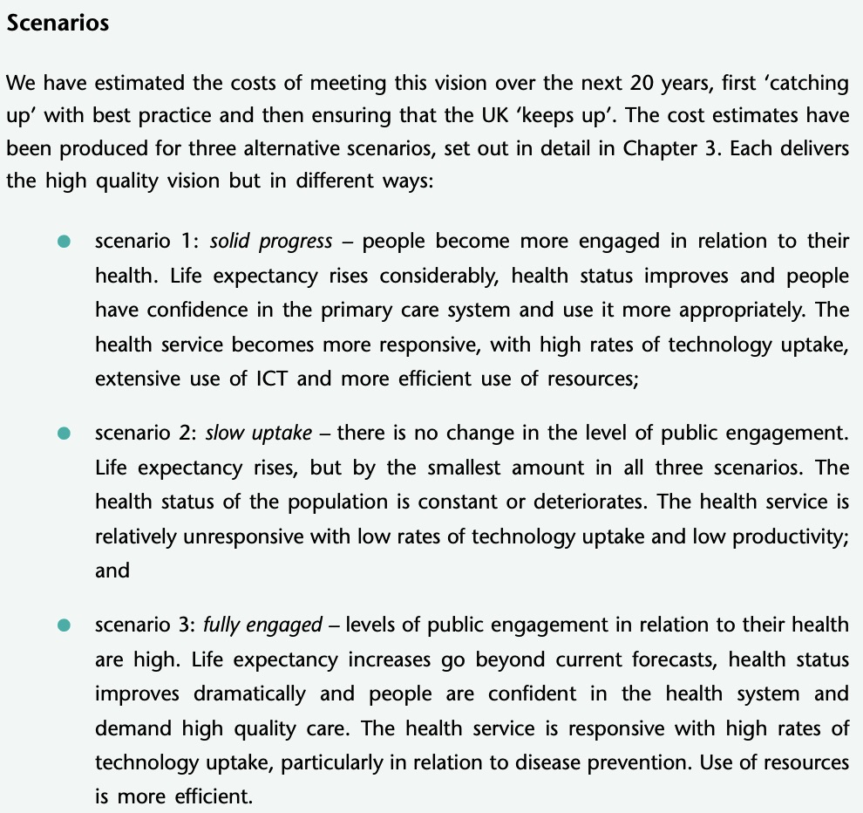
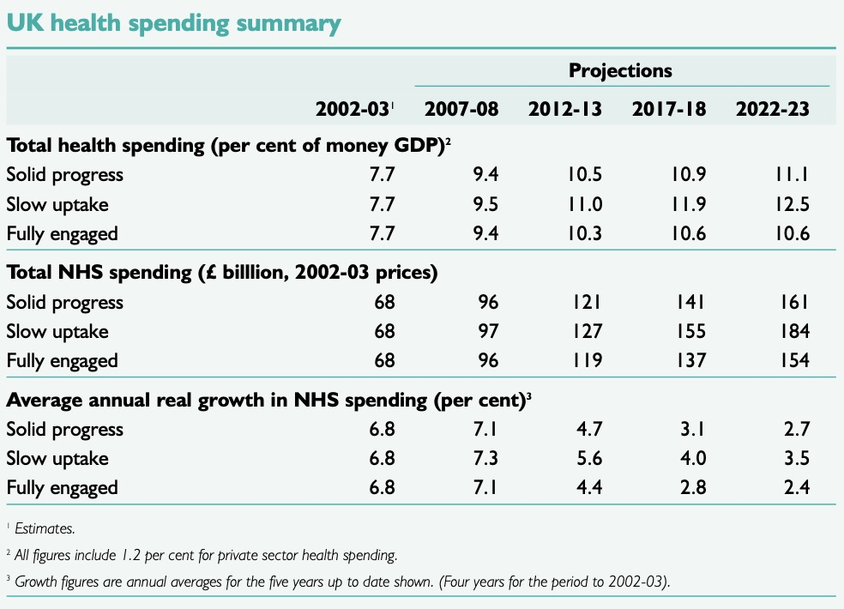
Derek Wanless: Securing our future: Taking a Long Term View
http://si.easp.es/derechosciudadania/wp-content/uploads/2009/10/4.Informe-Wanless.pdf

Slide 41
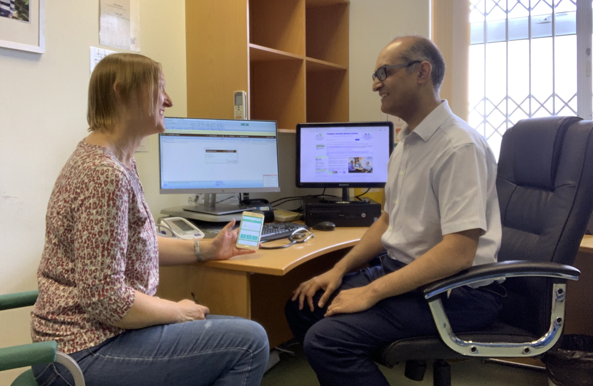
Partnership of Trust

Slide 42
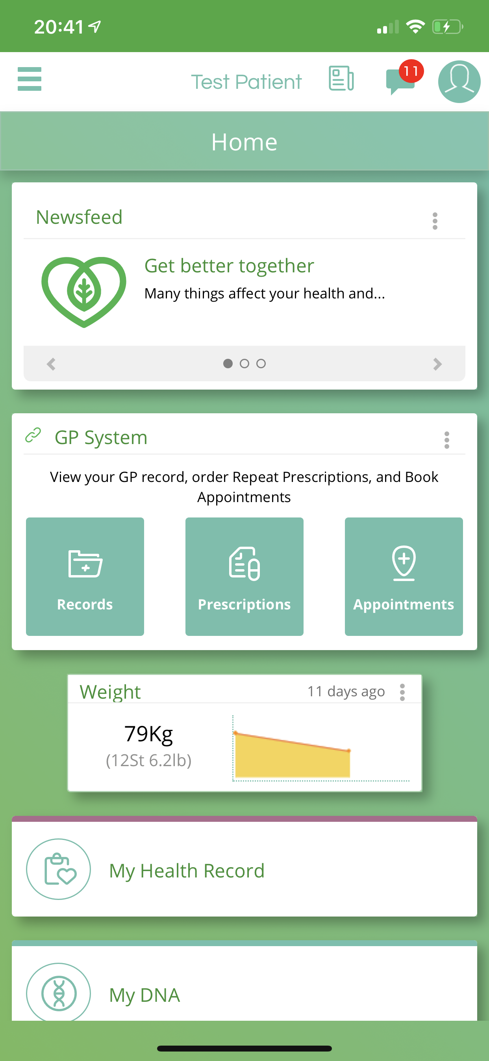
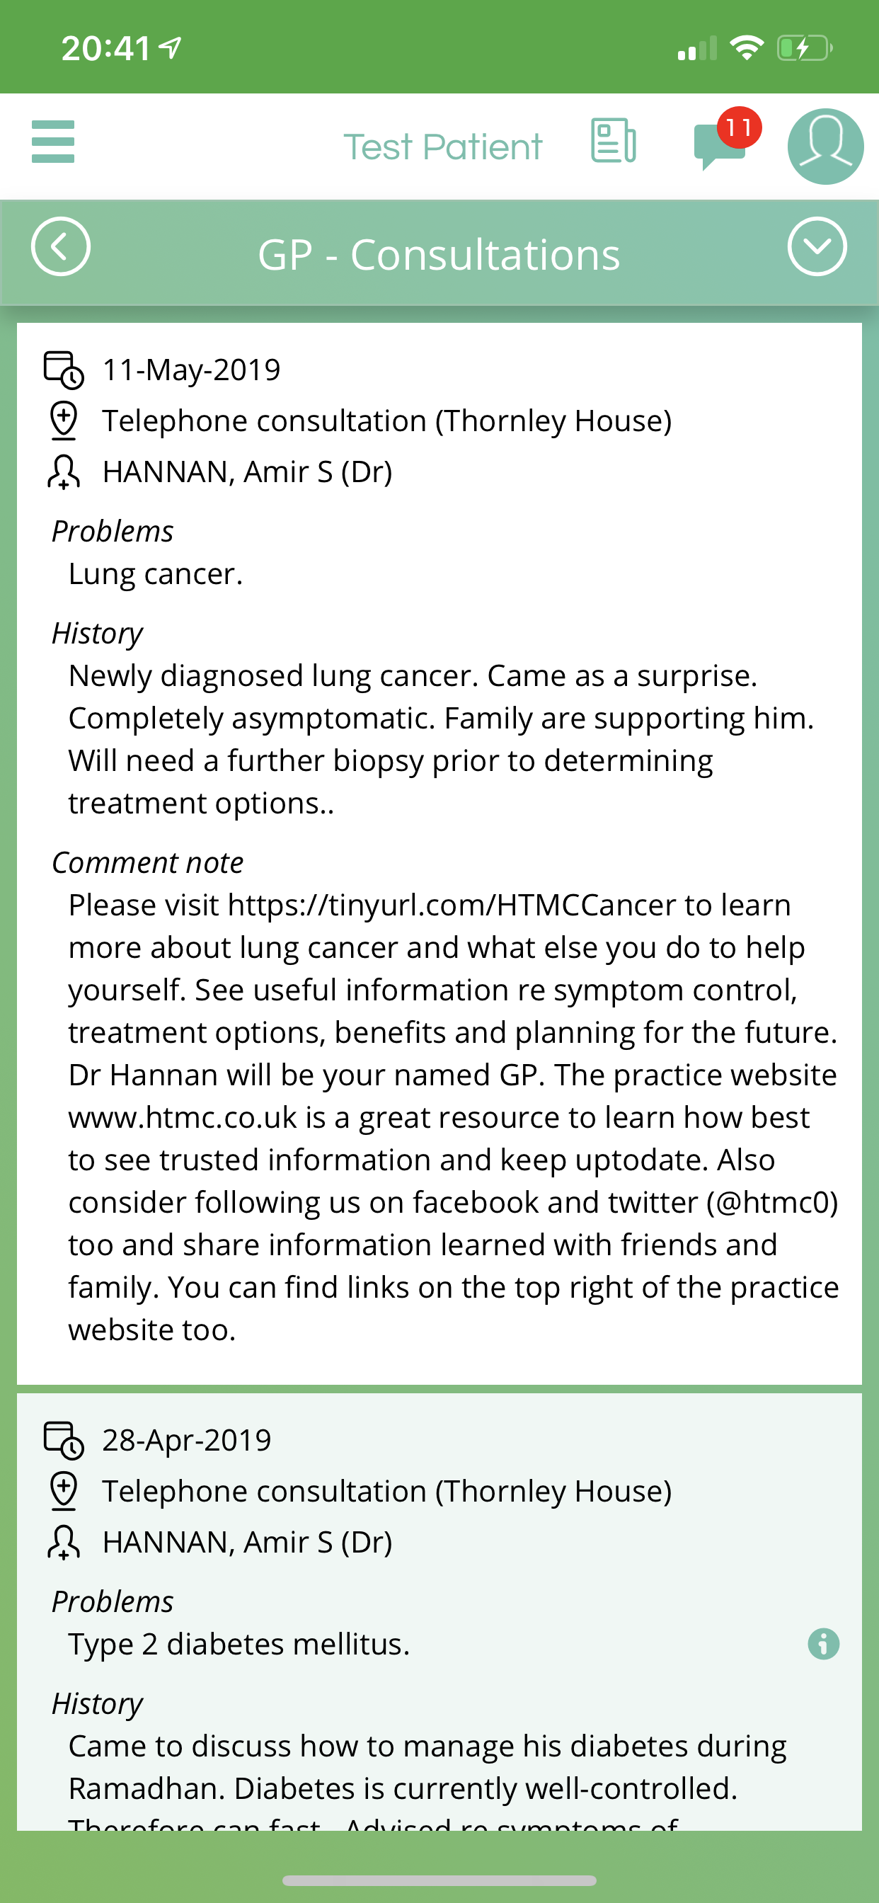
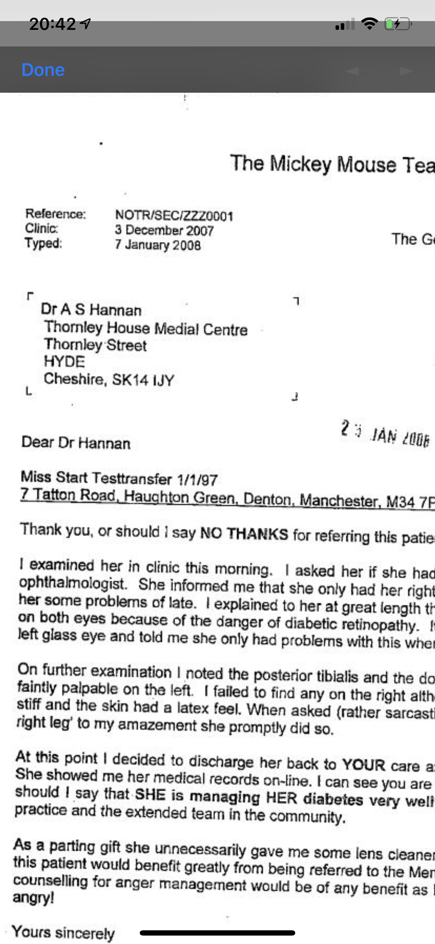
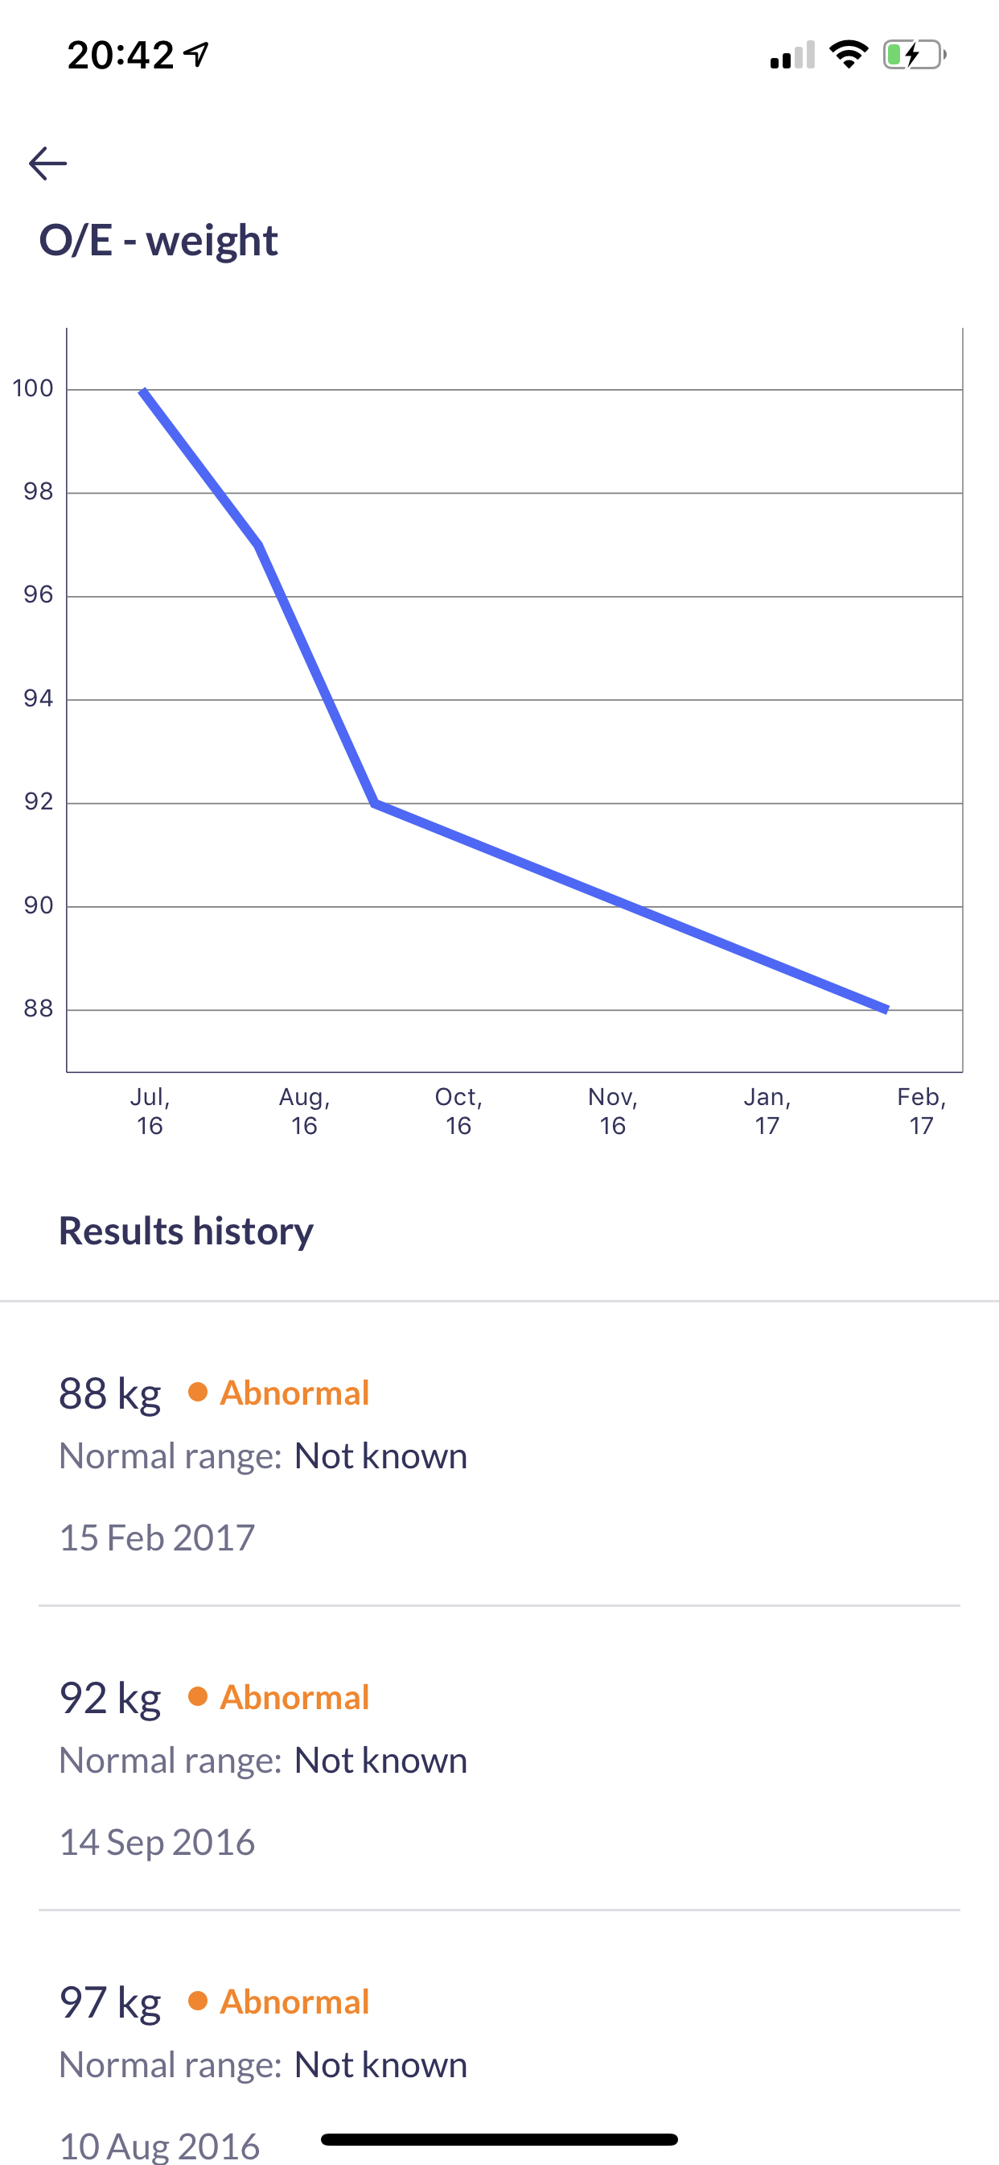
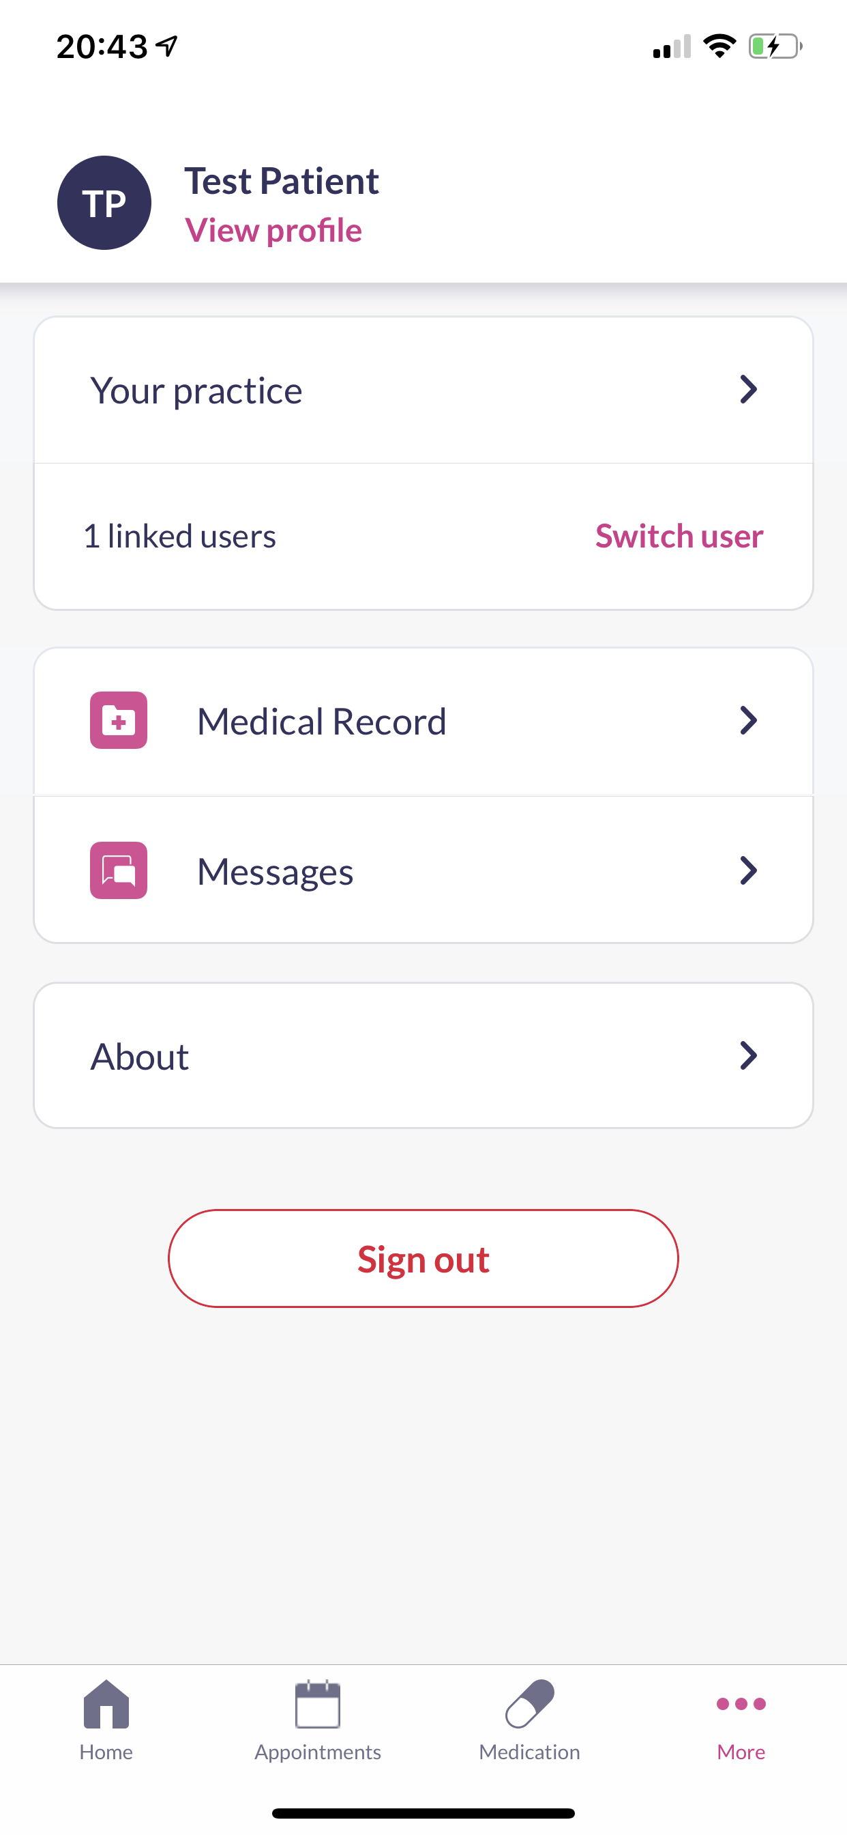
Evergreen Life PHR
Patient Access
Screenshots taken from the Test Patient record: https://tinyurl.com/HTMCTestPatient

Slide 43
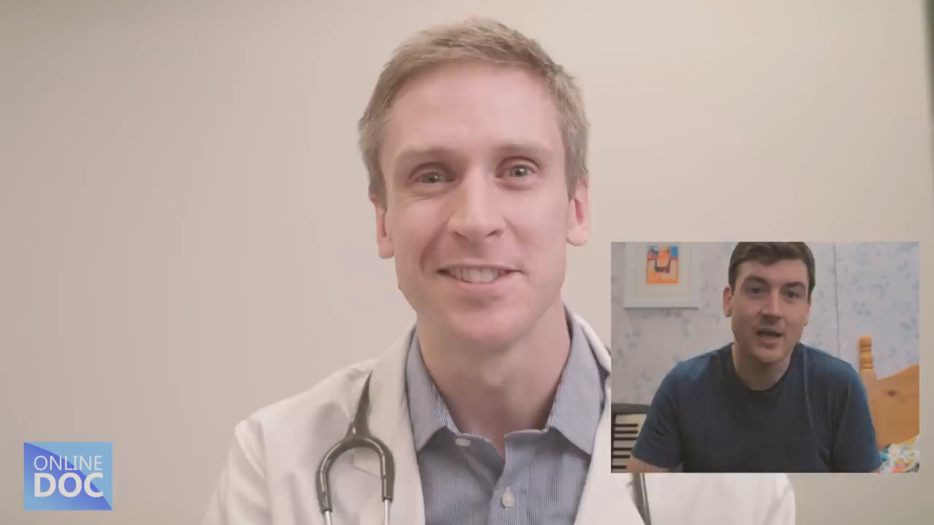
The Digital NHS in Action – Digital Primary Care is here.
Notes:
Note already you can email GPs and have video consultations – working really well – saving appointments and pateints love it.

Slide 44




