Slide 1


A short climate change journey and the role of social housing to reach Net Zero.
Claire Thompson
12th Nov 2021

Slide 2

Presentation topics
Short climate change journey
Housing and decarbonisation
Working towards for net zero at Livin
Note about the North East England Climate Coalition
Asks of the audience
Questions
Notes:
The evidence is irrefutable, climate change is happening, it is caused by humans. We have to act swiftly as we have left ourselves with little time to ensure warming does not exceed 1.5 degrees.
We can't wait to adapt and mitigate to 1.5 degrees warmer world, we need to start now.
There has been a significant shift in the public's consciousness on the climate agenda.
Governments are developing greener policies, legislating for emissions reporting and creating greener supply chains.
Most importantly communities are aware of the impact on future generations insisting on and change.

Slide 3
A little bit about me
I love environmental sustainability
Same is true for ecology and services nature gives us
Involved in many projects and partnerships that have created and delivered projects worth millions of pounds to restore nature in the North East
Spent a decade in the pharmaceutical industry honing my commercial and data skills
Notes:
The evidence is irrefutable, climate change is happening, it is caused by humans. We have to act swiftly as we have left ourselves with little time to ensure warming does not exceed 1.5 degrees.
We can't wait to adapt and mitigate to 1.5 degrees warmer world, we need to start now.
There has been a significant shift in the public's consciousness on the climate agenda.
Governments are developing greener policies, legislating for emissions reporting and creating greener supply chains.
Most importantly communities are aware of the impact on future generations insisting on and change.

Slide 4

Update on Climate Change
We are in a Climate Emergency
Climate change is one of/ the leading issues facing our world today
Human activities are the main driver behind these rapid and intensifying changes
The world is going to be at least 1.5 degrees warmer, and we need to prepare for this now
Policy is changing and funding opportunities are improving
People are demanding and taking action
Notes:
We are in a Climate Emergency and its impacts are evident and ever increasing
The evidence is irrefutable, climate change is happening, it is caused by humans. We have to act swiftly as we have left ourselves with little time to ensure warming does not exceed 1.5 degrees.
We can't wait to adapt and mitigate to 1.5 degrees warmer world, we need to start now.
There has been a significant shift in the public's consciousness on the climate agenda.
Governments are developing greener policies, legislating for emissions reporting and creating greener supply chains.
Most importantly communities are aware of the impact on future generations insisting on and change.

Slide 5
Climate change knowledge check
The recent UN International Panel on Climate Change (IPCC) report stated, ‘It is unequivocal that human influence has warmed the global climate system, with observed changes already impacting every region on the planet.’
Report is approved by 195 member states and deals with the physical science basis of climate change and outline how humans are altering the planet
U.N. Secretary-General, António Guterres described the report as “A code red for humanity. The alarm bells are deafening, and the evidence is irrefutable: greenhouse gas emissions from fossil fuel burning and deforestation are choking our planet and putting billions of people at immediate risk.”
There is hope that deep cuts in emissions of greenhouse gases could stabilise rising temperatures and avert climate catastrophe. The swift response of organisations and communities is vital if emissions are to be reduced

Slide 6
Climate Change – Timeline Summary
It is real and happening and hasn’t slowed because of COVID-19
1859 - Greenhouse gas effect first recognised in1859, Swedish scientist, Arrhenius
1950’s - Increasing concern about carbon and a warmer climate
1969 - NATO was the first organisation to real acknowledge climate change
1970’s - Scientists predicted warming
1980’s - Consensus was growing
1990’s - Research, data and impact of climate change
2000’s - Labour government introduced 2008 Climate Change Act
2010’s - Climate and environment out of favour, no action for 15 years
2020’s - Climate and Ecological Emergencies declared
2020+ - in order to have a two-thirds chance of staying under the critical threshold of 1.5°C warming, we must achieve near zero emissions in less than 6.5years.
2021 – IPCC Working Group Report – Code Red for Humanity
Notes:
Very little action or funding.
A lost decade from

Slide 7
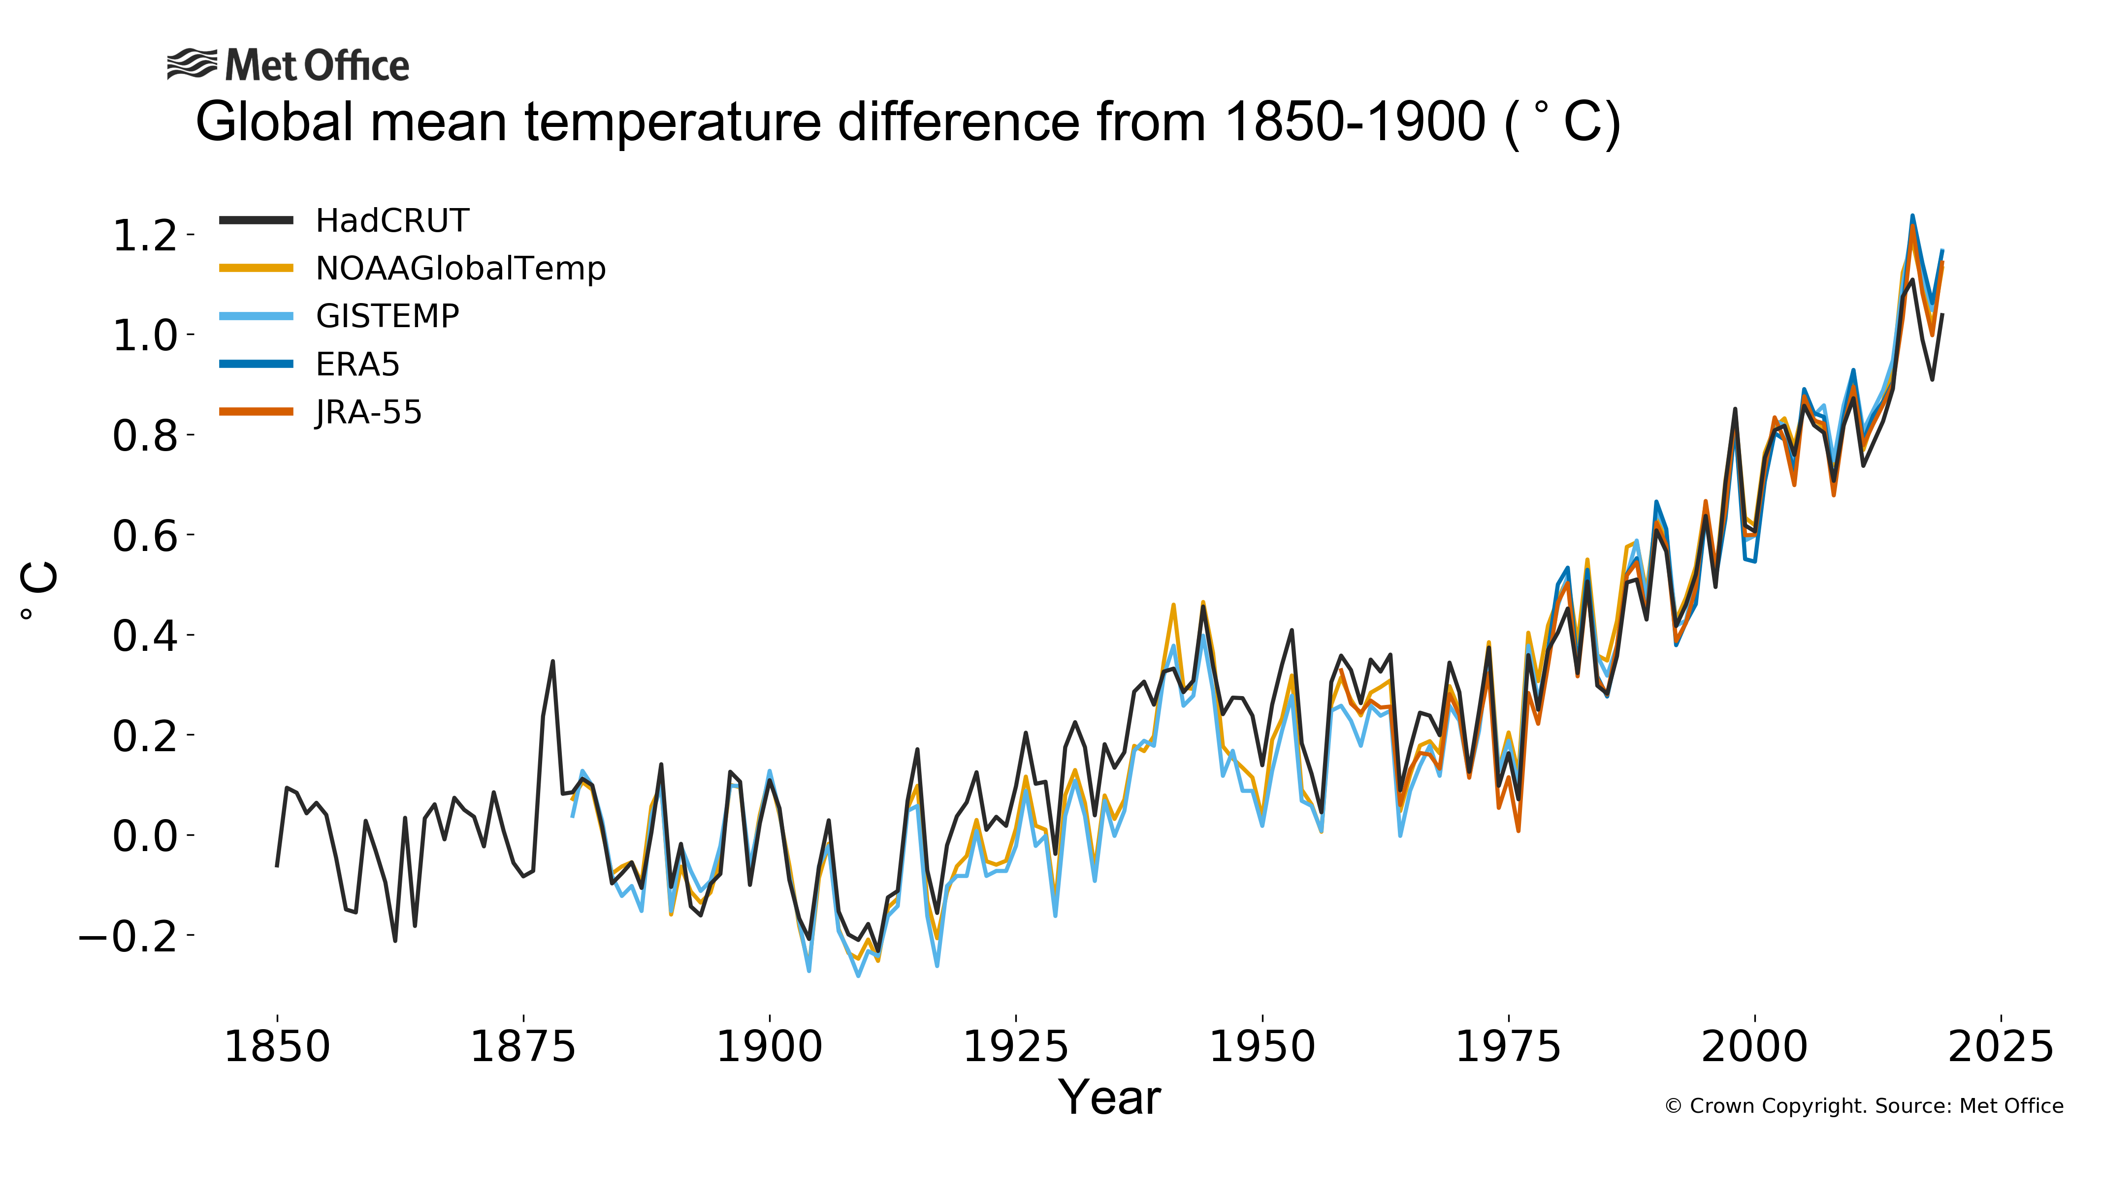
Climate Change – Timeline and Temperature

Slide 8
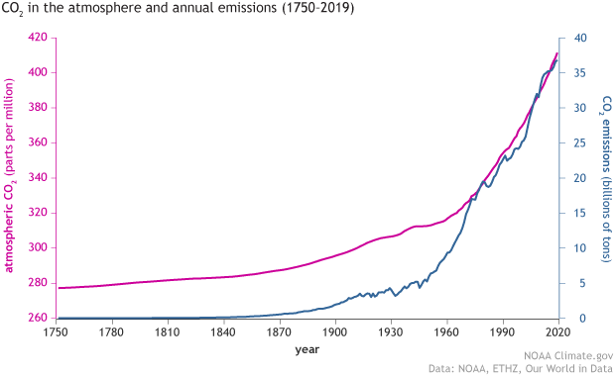
Climate Change – Timeline and Temperature

Slide 9
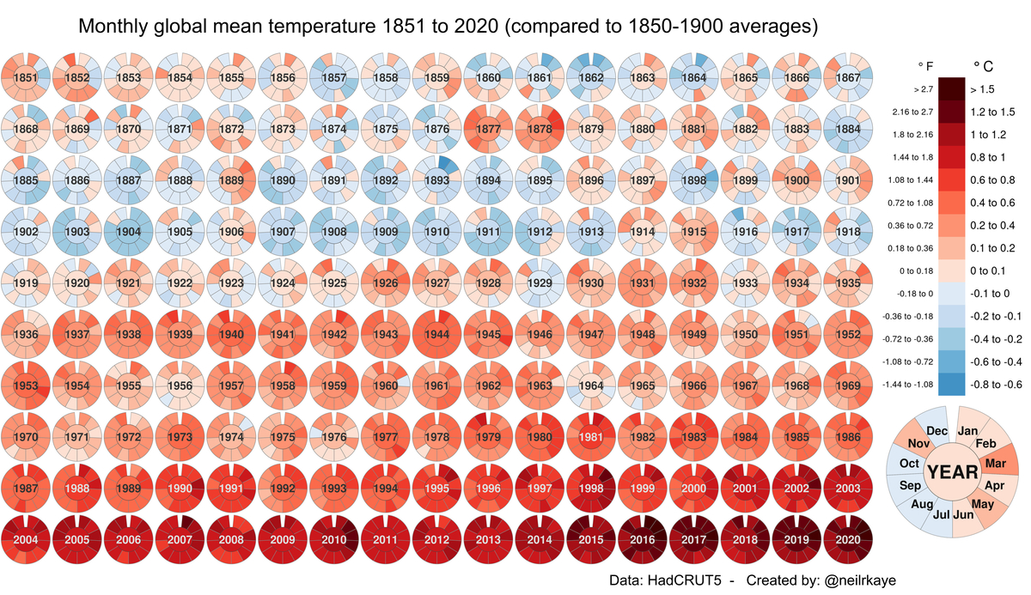
Climate Change – Timeline and Temperature

Slide 10
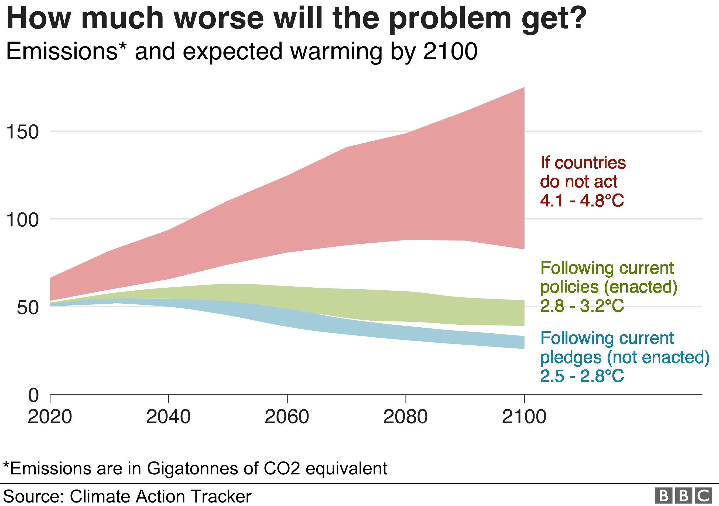
Climate Change – Urgent Action is Needed

Slide 11
Climate Change – Tipping points
A tipping point in the climate system is a threshold that, when exceeded, leads to large and often irreversible changes in the state of the system
9 Tipping Points have been identified
The tipping points come in three forms:
  Runaway loss of ice sheets that accelerate sea level rise
  Forest and other natural carbon stores such as permafrost releasing those stores into the atmosphere as carbon dioxide (CO2), accelerating warming
  The disabling of the ocean circulation system
Many scientists agree we have crossed some tipping points such as permafrost and coral reef die-offs and are very close to the others tipping over - state of planetary emergency

Slide 12


Slide 13
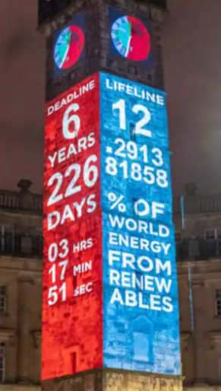
Climate Clock
1.5 degrees is the maximum compatible with human life
2020+ - in order to have a two-thirds chance of staying under the critical threshold of 1.5°C warming, we must achieve near zero emissions in less than 6.5years
2021 – IPCC Working Group Report – Code Red for Humanity
Notes:
Very little action or funding.
A lost decade from

Slide 14

Double wammy
Climate Crisis
Ecological Emergency
One driving the other
Need to reverse both
If we don’t pandemics will continue but become more frequent and we arrive a climate and ecological breakdown
There is still a chance bob and weave and duck our way out of this with 100% commitment to the right actions

Slide 15

Ecological Emergency
We are entering a period of mass extinction, with a significant loss of species and a reduction in species diversity
Rising extinction rate is due to expansion of human settlement and land use change since the Industrial Revolution
Since 1970’s there has been sharp acceleration in the degradation of nature. This is in addition to a huge loss in abundance
Climate change itself is also a driver of species loss, as migration across a landscape is hindered by fragmented ecological networks
Nature provides assets that provide ecosystem services and are essential to life and wellbeing

Slide 16
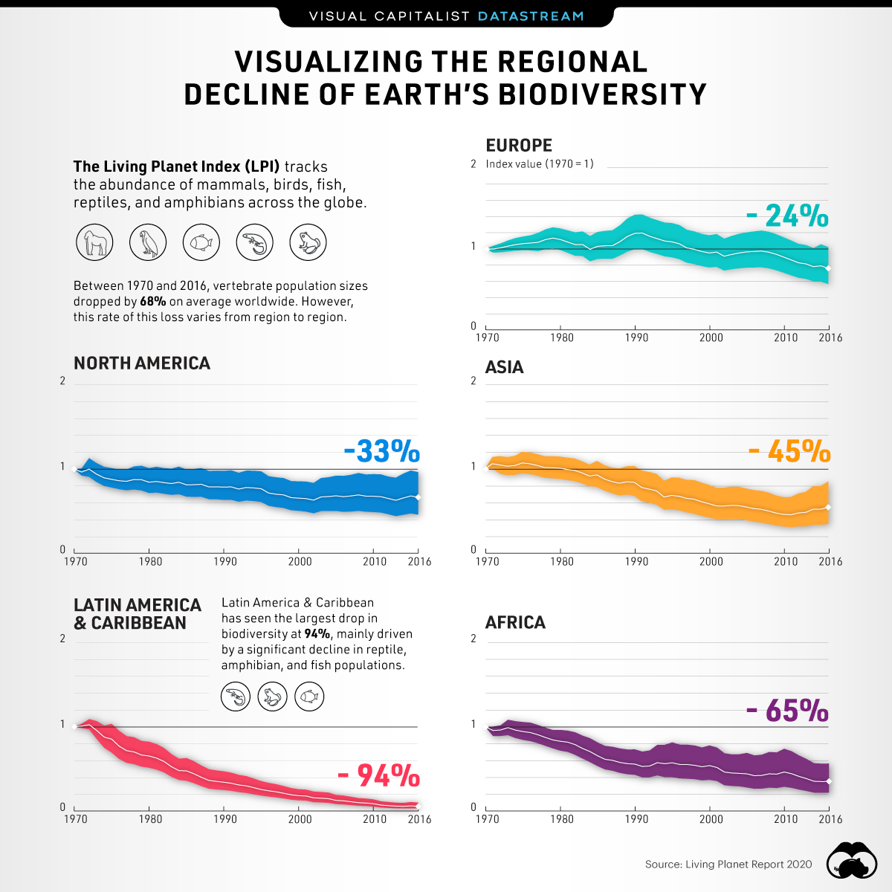
Ecological Emergency
Diversity and abundance of species is good
Habitats are our buffer against climate change
2019 State of Nature report found 41% of UK species are declining and one in 10 is threatened with extinction
Species are the KPIs for humans
In 6th (Anthropocene – human caused) extinction (includes us) is underway

Slide 17

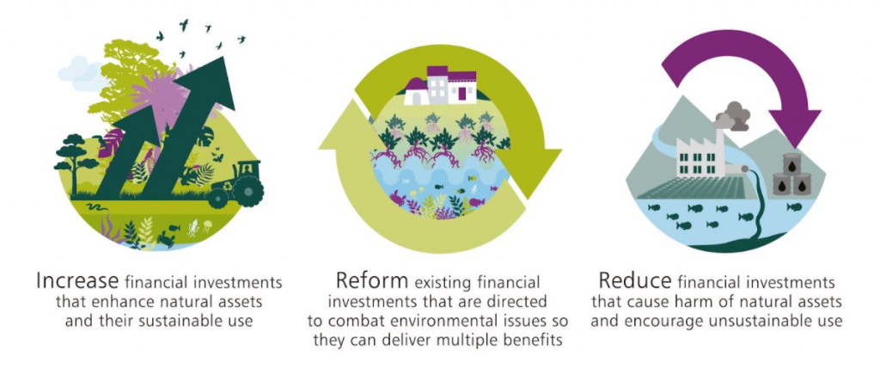
Ecological Emergency
UK Treasury commissioned The Economics of Biodiversity: The Dasgupta Review
Published April 2021
Anticipated to the same for ecology as the Economics and Climate Change: The Stern Review did for climate change (but hopefully much faster)

Slide 18
Das Gupta Report
Key findings
Our economies, livelihoods and well-being all depend on our most precious asset: Nature
We have collectively failed to engage with Nature sustainably, to the extent that our demands far exceed its capacity to supply us with the goods and services we all rely on
Our unsustainable engagement with Nature is endangering the prosperity of current and future generations
At the heart of the problem lies deep-rooted, widespread institutional failure
The solution starts with understanding and accepting a simple truth: our economies are embedded within Nature, not external to it
We need to change how we think, act and measure success
Transformative change is possible – we and our descendants deserve nothing less

Slide 19

COP26, Glasgow - Key points
Who is and isn't there - politically and from an equity perspective
More funding for developing nations/ adaptation and mitigation
Commitments to net zero CO2 and methane reduction
Commitments to end deforestation by 2030
Too many lobbyists
A joint declaration by China and USA to enhance climate action in the 2020s
Notes:
Conference of the Parties (COP26) event is happening as we speak!
The UK is hosting a summit that is seen as crucial if climate change is to be brought under control.
Up to 25,000 people are expected in Glasgow, including world leaders, negotiators and journalists.
There will be a flurry of announcements during these two weeks, including – making a faster switch to electric cars, speeding up the phasing out of coal power, cutting down fewer trees, protecting more people from the impacts of climate change.
Climate Justice – compels us to understand the challenges faced by those people & communities most vulnerable to the impact of climate change – often people on the front lines of climate change have contributed least to the causes of the climate crisis.

Slide 20

COP26, Glasgow - Points of concern
Even if all COP commitments are achieved (excluding the impact of land use change) the world will be at least 2.4 degrees warmer by the end of this century.
No USA commitment on phasing out coal by 2030. Very disappointing and more so when Vietnam, Indonesia (2040) and South Korea (2050) all signed up to phase out coal.
Commitments are still voluntary when they need to be binding.
Climate Justice not central to negotiations
Too many lobbyists
Notes:
Conference of the Parties (COP26) event is happening as we speak!
The UK is hosting a summit that is seen as crucial if climate change is to be brought under control.
Up to 25,000 people are expected in Glasgow, including world leaders, negotiators and journalists.
There will be a flurry of announcements during these two weeks, including – making a faster switch to electric cars, speeding up the phasing out of coal power, cutting down fewer trees, protecting more people from the impacts of climate change.
Climate Justice – compels us to understand the challenges faced by those people & communities most vulnerable to the impact of climate change – often people on the front lines of climate change have contributed least to the causes of the climate crisis.

Slide 21
UK Government – Net Zero Strategy
Sets out policies and proposals for decarbonising all sectors of the UK economy to meet our net zero target by 2050
Clean Electricity
  Moving away from fossil fuels for electricity entirely by 2035
  Creating 40GWh of offshore wind power by 2030
Transport
  Decarbonising public transport
  Sales of new petrol & diesel cars will be banned by 2035
  Invest in walking and cycling infrastructure
Industry
  Supporting industry to switch to cleaner fuels
  Fair carbon pricing to drive deep decarbonisation
  Carbon reporting
Notes:
The UK has set in law a target to bring all greenhouse gas emissions to net zero by 2050.
In October 2021 ministers published the UK's net zero strategy, a 400 page document detailing the future of tackling climate change and carbon emissions.
Key changes to social housing industry – new gas boilers banned after 2035, grants of £5,000 for new heat pumps, social housing decarbonisation fund (SHDF).
We have applied for Wave 1 of SHDF – we will be told in December whether our funding application was successful. 132 homes were initially put forward, however, there had to be a revision on costs with Mears - Sean asked Paul P to reduce the number of properties to keep the bid within the original cost envelope.

Slide 22

UK Government – Net Zero Strategy
Nature
  Restoring biodiversity and natural resources
  Planting 30,000 hectares of new woodland every year
  Resorting approx. 280,000 hectares of peat in England 2050
Heating
  Sales of new gas boilers banned after 2035
  Grants of £5,000 to encourage homeowners & landlords to replace gas boilers with heat pumps
  Funding to decarbonise social housing – Social Housing Decarbonisation Fund £3.8 billion/ 10 years
Notes:
Key changes to social housing industry – moving away from fossil fuels for electricity by 2035, restoring biodiversity and natural resources in our own communities, supporting the green economy through our employees and tenants.

Slide 23
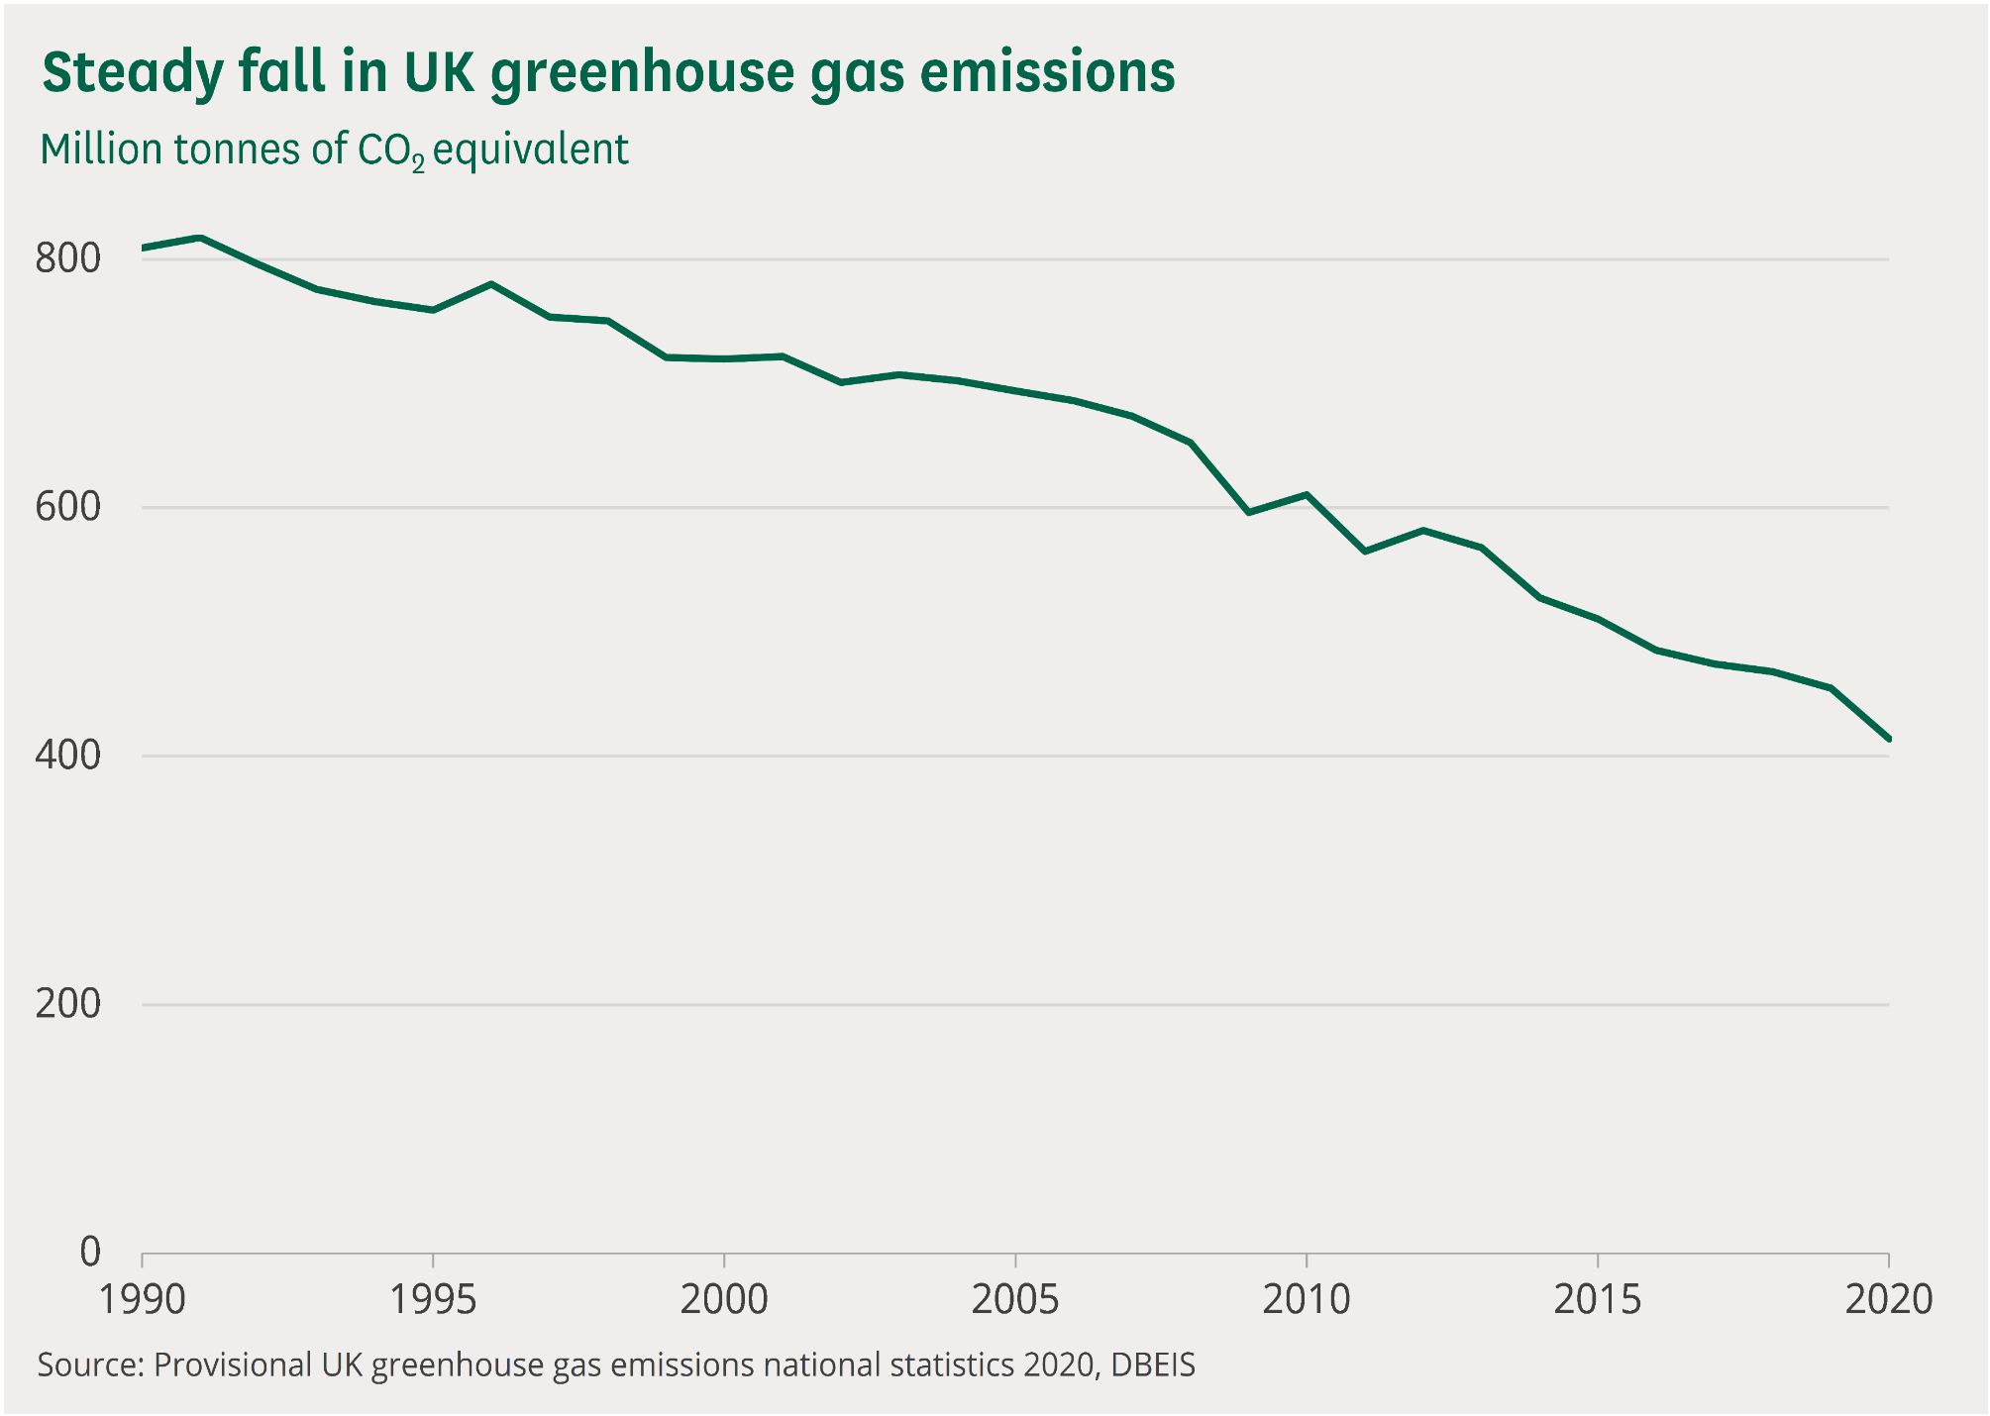
Notes:
Key changes to social housing industry – moving away from fossil fuels for electricity by 2035, restoring biodiversity and natural resources in our own communities, supporting the green economy through our employees and tenants.

Slide 24
Net zero and social housing
Notes:
Housing associations should be at the forefront of decarbonisation!
NHF developed this decarbonisation package in October 2021
Info for Decarbonisation: a guide for housing associations on next slide.
Decarbonisation the housing association sector – costs and funding options – NHF commissioned Savills to research the costings and funding options for decarbonisation of social housing stock. The cost scenarios in the report were modelled through a global business plan for the sector based on the Global Accounts published by the Regulator of Social Housing. This demonstrates that whilst associations can raise a significant amount in borrowings to cover a proportion of the costs, they will need support.
The sector plans to invest £70bn by 2050 in improving existing homes but recent analysis by Savills finds it will cost at least an additional £36bn to reach zero carbon emissions.
Decarbonisation of housing association homes – a briefing for external stakeholders - This briefing provides an overview of both papers and a summary of the partnerships we want to build to make these ambitions a reality
Developed a Decarbonisation Guide Package including:
Decarbonisation: a guide for housing associations
Decarbonisation the housing association sector – costs and funding options
Decarbonisation of housing association homes – a briefing for external stakeholders

Slide 25

Housing and net zero
Decarbonising homes is vital to achieving net zero
Heating homes and water accounted for 21% of UK emissions in 2020
Many houses in the North are old (pre 1919)
Direct emissions from housing need to be reduced by 24% by 2030 to meet the UK’s Paris Agreement commitment
Approx 880,000 properties to retrofit in North East
Notes:
Housing associations should be at the forefront of decarbonisation!
NHF developed this decarbonisation package in October 2021
Info for Decarbonisation: a guide for housing associations on next slide.
Decarbonisation the housing association sector – costs and funding options – NHF commissioned Savills to research the costings and funding options for decarbonisation of social housing stock. The cost scenarios in the report were modelled through a global business plan for the sector based on the Global Accounts published by the Regulator of Social Housing. This demonstrates that whilst associations can raise a significant amount in borrowings to cover a proportion of the costs, they will need support.
The sector plans to invest £70bn by 2050 in improving existing homes but recent analysis by Savills finds it will cost at least an additional £36bn to reach zero carbon emissions.
Decarbonisation of housing association homes – a briefing for external stakeholders - This briefing provides an overview of both papers and a summary of the partnerships we want to build to make these ambitions a reality
Developed a Decarbonisation Guide Package including:
Decarbonisation: a guide for housing associations
Decarbonisation the housing association sector – costs and funding options
Decarbonisation of housing association homes – a briefing for external stakeholders

Slide 26
Housing and net zero
Housing associations are at the forefront of decarbonisation
Adopt a fabric first approach then clean heat (Insulation - loft cavity and external wall)
ECP C 2030 fuel poor and rented/ 2035 everyone else
Sector plans to spend £70bn by 2050 on existing homes, extra £40bn needed for decarbonisation by 2035
Notes:
Housing associations should be at the forefront of decarbonisation!
NHF developed this decarbonisation package in October 2021
Info for Decarbonisation: a guide for housing associations on next slide.
Decarbonisation the housing association sector – costs and funding options – NHF commissioned Savills to research the costings and funding options for decarbonisation of social housing stock. The cost scenarios in the report were modelled through a global business plan for the sector based on the Global Accounts published by the Regulator of Social Housing. This demonstrates that whilst associations can raise a significant amount in borrowings to cover a proportion of the costs, they will need support.
The sector plans to invest £70bn by 2050 in improving existing homes but recent analysis by Savills finds it will cost at least an additional £36bn to reach zero carbon emissions.
Decarbonisation of housing association homes – a briefing for external stakeholders - This briefing provides an overview of both papers and a summary of the partnerships we want to build to make these ambitions a reality
Developed a Decarbonisation Guide Package including:
Decarbonisation: a guide for housing associations
Decarbonisation the housing association sector – costs and funding options
Decarbonisation of housing association homes – a briefing for external stakeholders

Slide 27
'Decarbonising Britain's homes is not only an essential part of tackling climate change, it also saves residents money, helps combat fuel poverty, boosts the economy and creates jobs’
Notes:
Housing associations should be at the forefront of decarbonisation!
NHF developed this decarbonisation package in October 2021
Info for Decarbonisation: a guide for housing associations on next slide.
Decarbonisation the housing association sector – costs and funding options – NHF commissioned Savills to research the costings and funding options for decarbonisation of social housing stock. The cost scenarios in the report were modelled through a global business plan for the sector based on the Global Accounts published by the Regulator of Social Housing. This demonstrates that whilst associations can raise a significant amount in borrowings to cover a proportion of the costs, they will need support.
The sector plans to invest £70bn by 2050 in improving existing homes but recent analysis by Savills finds it will cost at least an additional £36bn to reach zero carbon emissions.
Decarbonisation of housing association homes – a briefing for external stakeholders - This briefing provides an overview of both papers and a summary of the partnerships we want to build to make these ambitions a reality
Developed a Decarbonisation Guide Package including:
Decarbonisation: a guide for housing associations
Decarbonisation the housing association sector – costs and funding options
Decarbonisation of housing association homes – a briefing for external stakeholders

Slide 28
Challenges
Funding – Amount and consistency
Skills, training and staff
Early technology
Immature supply chain
Supply chain pressures
Carbon lifecycle of products
Future Homes Standard – Not legislation until 2024
Notes:
Sets out the guiding principles for decarbonising homes.
Housing associations are already acting and the homes we manage are more energy efficient on average than any other homes – but the scale of the challenge is so significant that it will require a huge programme of work at an unprecedented scale.
Highlights how we can retrofit existing social homes so they are more comfortable, cheaper to live in and emit no carbon.
States that although the approach from each organisation may differ depending on factors like stock condition, distribution and scale, it's vital that we are all aligned in our vision.
Housing associations want to work in partnership with the government, industry, society and residents to achieve full decarbonisation.
Housing associations need the government to bring forward guidance and the Social Housing Decarbonisation Fund to help them on their journey.
While the journey to decarbonisation is far from simple, the main interventions are in two key areas:
Fabric improvements - like better insulation or improving windows will be needed in many homes to keep fuel costs down and to enable clean heat technology to adequately heat the home. Making fabric improvements now brings immediate benefits – lower bills and improved comfort for residents, and lower emissions – so this investment should be front-loaded and prioritised over the next decade.
Clean heat - Decarbonising social housing will also require replacing fossil fuel powered heating systems with electric heat pumps or other forms of decarbonised heating. The switch to decarbonised heating should begin as soon as possible but to a slower timetable with the majority of the investment in the 2030s.

Slide 29
What is Livin doing?
Notes:
Sets out the guiding principles for decarbonising homes.
Housing associations are already acting and the homes we manage are more energy efficient on average than any other homes – but the scale of the challenge is so significant that it will require a huge programme of work at an unprecedented scale.
Highlights how we can retrofit existing social homes so they are more comfortable, cheaper to live in and emit no carbon.
States that although the approach from each organisation may differ depending on factors like stock condition, distribution and scale, it's vital that we are all aligned in our vision.
Housing associations want to work in partnership with the government, industry, society and residents to achieve full decarbonisation.
Housing associations need the government to bring forward guidance and the Social Housing Decarbonisation Fund to help them on their journey.
While the journey to decarbonisation is far from simple, the main interventions are in two key areas:
Fabric improvements - like better insulation or improving windows will be needed in many homes to keep fuel costs down and to enable clean heat technology to adequately heat the home. Making fabric improvements now brings immediate benefits – lower bills and improved comfort for residents, and lower emissions – so this investment should be front-loaded and prioritised over the next decade.
Clean heat - Decarbonising social housing will also require replacing fossil fuel powered heating systems with electric heat pumps or other forms of decarbonised heating. The switch to decarbonised heating should begin as soon as possible but to a slower timetable with the majority of the investment in the 2030s.

Slide 30
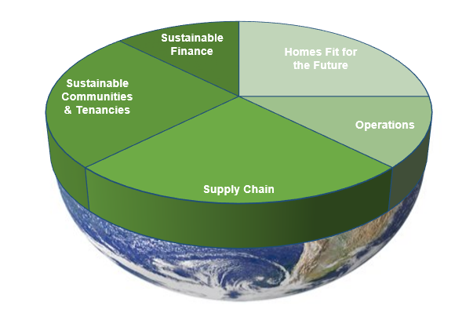
Livin – Our Planet approach
Have been working on improving the energy efficiency of our homes for a while, 60% of our stock is EPC C already
Declared a Climate Emergency
Working to embed Environmental Sustainability across the whole organisation
Notes:
We need to understand all of our environmental impacts and act strategically and as one to reduce them.
Embedding environmental sustainability into our decision making, strategy and actions is the way to achieve this.
All parts of the organisation will need to work together to reduce environmental impact/carbon emissions (the cogs in the machine slide).
That’s some of the background and learning done.

Slide 31
Planet A – Our Approach
Phase 1 - Covers next 3 years as there is a lot to work out
Net Zero 2050 across all areas of the business
Data focused – CO2 and properties
Calculating our carbon footprint for baseline, previous and current year emissions and reporting to Companies House
Using Science Based Targets to achieve net zero
Properties programme to achieve net zero
Understand and reduce supply chain emissions
Environmental Management System to reduce and report on environmental impacts
Adopting ESG reporting to achieve sustainable finance ambitions – Sustainable Finance Framework
Notes:
We need to understand all of our environmental impacts and act strategically and as one to reduce them.
Embedding environmental sustainability into our decision making, strategy and actions is the way to achieve this.
All parts of the organisation will need to work together to reduce environmental impact/carbon emissions (the cogs in the machine slide).
That’s some of the background and learning done.

Slide 32

Planet A – As there is no Planet B
All built on consultation
  Staff, tenants, partners and stakeholders
Knowledge and learning – climate and environmental sustainability
Responsive to policy and technology and understand the impact on targets
A live plan
Notes:
We need to understand all of our environmental impacts and act strategically and as one to reduce them.
Embedding environmental sustainability into our decision making, strategy and actions is the way to achieve this.
All parts of the organisation will need to work together to reduce environmental impact/carbon emissions (the cogs in the machine slide).
That’s some of the background and learning done.

Slide 33
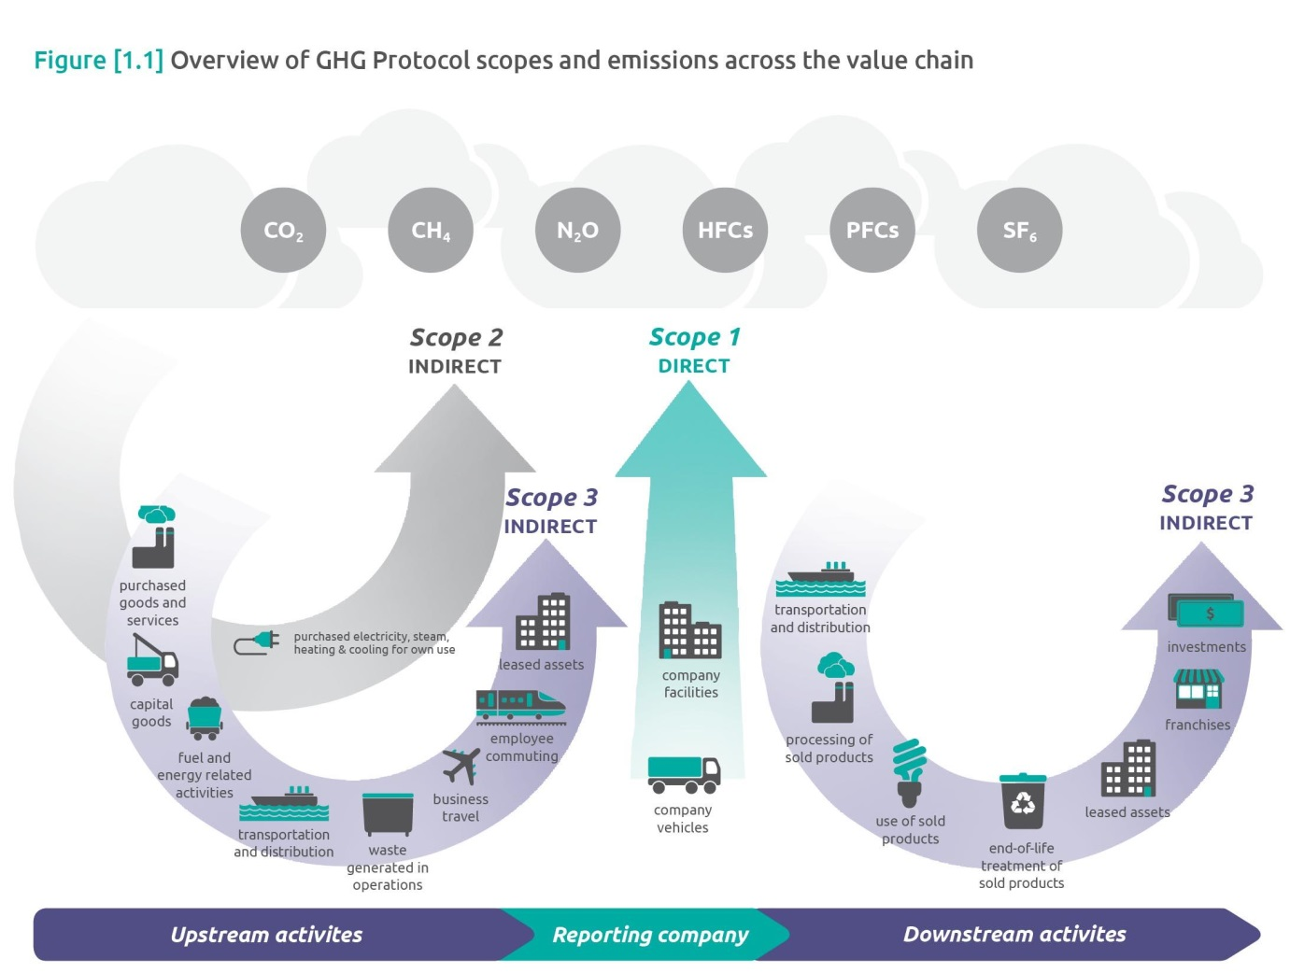
Calculating Carbon Emissions - Greenhouse Gas Protocol and Emission Scopes
- Think Direct and Indirect
- Must report scope 1 - and 2
- Work towards scope 3
- Annual mission Factors from Defra for calculations published in July – Report with Finances to AGM in Sept. - First full reporting to Companies House in 2022 with baseline year, 20/21 and 21/22 emissions and Carbon Reduction Strategy.
https://ghgprotocol.org/corporate-standard

Slide 34
Carbon Emissions Reporting
Greenhouse Gas Protocol
What is GHG Protocol? GHG Protocol establishes comprehensive global standardised frameworks to measure and manage greenhouse gas (GHG) emissions from private and public sector operations, value chains and mitigation actions.
Considered best practice.
Streamlined Energy & Carbon Reporting
The SECR scheme was launched in April 2019. SECR is a replacement for the Carbon Reduction Commitment (CRC) Energy Efficiency Scheme and requires organisations to report energy and carbon emissions in their annual report.

Slide 35
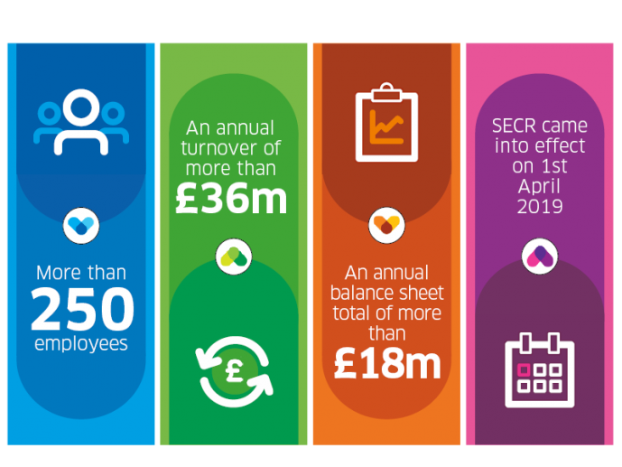
SECR criteria

Slide 36

Climate Change and Finance
Sustainable Finance
In the past investors would focus single-mindedly on obtaining the greatest financial return, leaving social justice and the environment to fall by the wayside.
Sustainable finance involves making investment decisions that consider not only financial returns but also environmental, social and governance factors.
Growing number of investors and funders that want their capital to do good and are comfortable with long time periods for returns.
Currently there are more investors than projects.
Being sustainable finance savvy is essential to deliver the net zero projects are the scale needed.

Slide 37
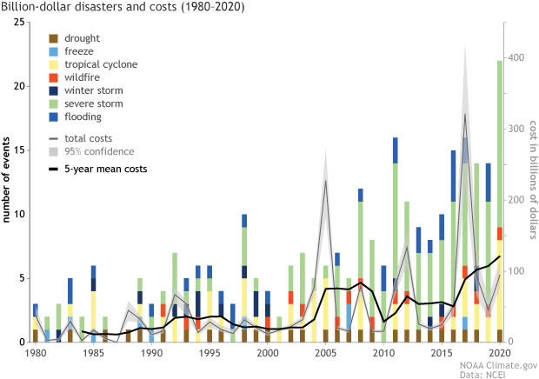
Climate Change and Finance

Slide 38
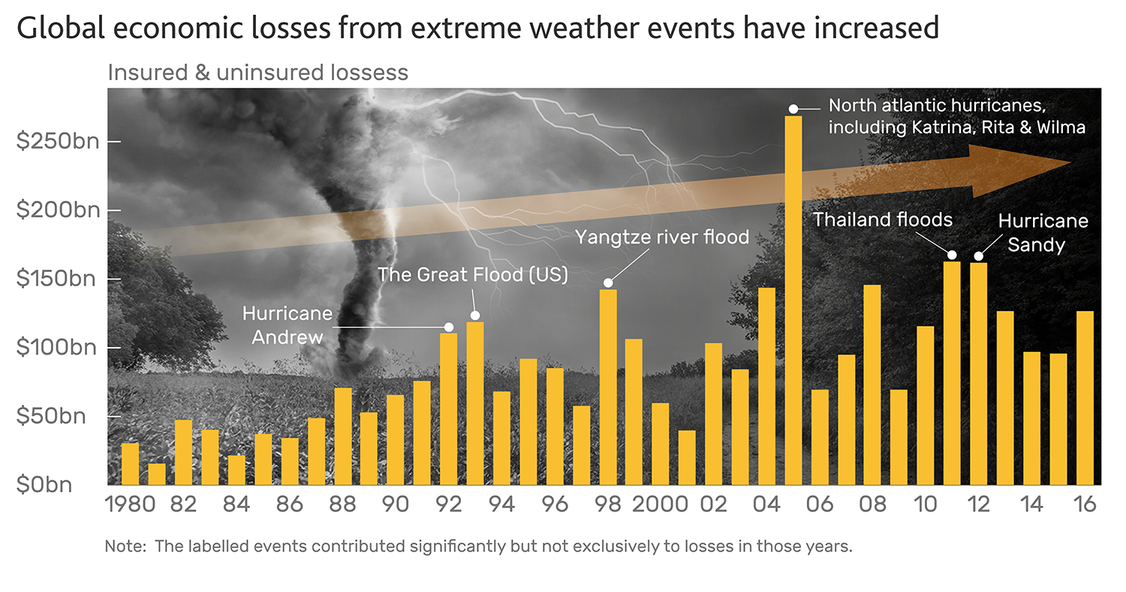
Climate Change and Finance

Slide 39
Benefits of going green
Fresh look at your business
Operational efficiency
Save money
Future proofing your business
Tendering and secure business
Requirement to access to finance
Expectation of staff and customers

Slide 40
Key points
Currently on target for at least 2.4 degrees of warming
We will experience change to how we live and work
Window of opportunity to implement actions needed to not exceed 1.5 degrees of warming
Let finance be an enabler of reducing environmental impact
Have carbon reduction targets inline with limiting warming to 1.5 degrees
Must decrease our environmental impact
Not one quick fix, work across they whole system
Growth in sustainable finance
Ecological crisis requires same focus

Slide 41
Asks of you
Make climate change action a business priority
Check if you meet thresholds for SECR
Develop plans to use sustainable finance – loans and banking
Allocate budget to get environmental impact reduction/ net zero going
Seek advice of sector professionals and collaborate
North East England Climate Coalition – NEECCo
  Sign up as an individual or business
  Make a pledge
  https://neecco.org.uk/

Slide 42

North East England Climate Coalition
We are a cross-sector initiative bringing the region together to tackle climate emergency, reverse ecological collapse and deliver an urgent and just transition.
It is our region’s contribution, on behalf of future generations, to the urgent, radical and at scale response demanded by the global climate emergency
Data and science led
Ambition to become England’s Greenest Region

Slide 43

NEECCo & Sustainable Finance
Raise £1.5bn
3 capitals
  Natural capital
  Social capital
  Economic capital
Framework based on requirements to restore nature
Match funders with projects
Payment for ecosystem services
Very exciting
Hadrian Bond – Live and funded

Slide 44
Asks of you
Make climate change action a business priority
Check if you meet thresholds for SECR
Develop plans to use sustainable finance – loans and banking
Allocate budget to get environmental impact reduction/ net zero going
Seek advice of sector professionals and collaborate
North East England Climate Coalition – NEECCo
  Sign up as an individual or business
  Make a pledge
  https://neecco.org.uk/

Slide 45
Thank you
& Questions

Slide 46
Planet A – there’s no Planet B

