Slide 1
CIPFA Northern Ireland Region & The MCS Group Lunchtime Event
Comptroller and Auditor General – Dorinnia Carville
The Local Government Auditor- Colette Kane
Monday 9 December 2024

Slide 2
Agenda
Local Government Auditor Report 2024
Compendium Report- C&AG’s Report on Financial Audit Findings 2023-2024- Central Government
PAC Reports

Slide 3
Local Government Auditor Report 2024
Published 25 October 24

Slide 4
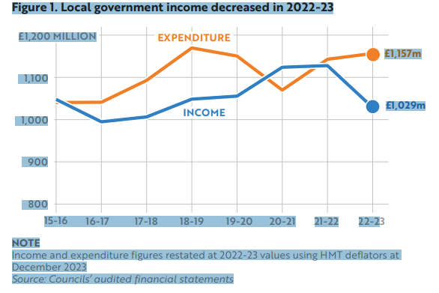
Part 1 Financial Performance
Notes:
This graph shows the gap between income and expenditure which has emerged in the 22-23 being the first full post pandemic year. If we look at income you can see a significant decrease for 22-23 in comparison to the previous 2 years. This is primarily as a consequence of the drop in central government grants to councils to support them through the pandemic. The decrease of this grant income from 21-22 to 22-23 was £77m.. In terms of expenditure you can see that expenditure levels are close to pre pandemic levels in 19-20 although further analysis shows the impact of cost of living costs across the service areas. We were unable to further analyse expenditure as the council accounts are all prepared using categories which are different.
The gap shown here is a concern if it continues this will put further financial pressure on the councils. Shortly I will look at the reserves held by councils. However in my report I encourage councils to examine the further scope for generating more income.
In terms of expenditure the largest cost for councils remains staff costs – next slide

Slide 5
Staff Costs
During 2022-23, staff costs across councils amounted to £436.2 million. These costs represented around 39 per cent of councils’ operational expenditure in 2022-23, which is consistent with the proportion of operational expenditure consumed by staff costs in previous years. In addition, councils spent a further £37.6 million on agency staff during 2022-23.
Notes:
As you can see staff costs represent about 39% of total expenditure. This is likely to increase with additional pressures such as pay settlements and employers NIC increases. Once again my report notes the amounts spent on agency staff. The % of total staff costs spent on agency staff ranges from 0% to 29% with most councils within the range 0 to 9% but 2 councils; CCG and MEA at 21% and 29%. I encourage councils spending higher amounts on agency costs to ensure these arrangements represent good value for money for ratepayers.

Slide 6
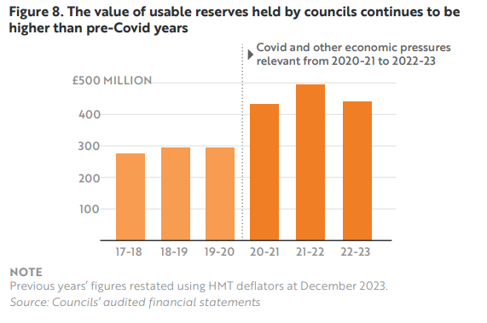
Reserves
Notes:
The table here represents the total value of usable reserves held by councils. Reserves for most councils fell slightly or remained about the same during 22-23. Overall councils held £447m in usable reserves. The increase from pre pandemic levels was mainly due to the government grants received to assist with covid and some of these remain within reserves. Our review of usable reserves held by councils found they ranged from 25-50% of total expenditure across councils. It is important that reserves are managed effectively and there are clear plans for their use.

Slide 7
Part 2 Governance Issues
Annual Audit Activity
Review of Annual Governance Statements
Review of Financial Statements
Performance Improvement
Reform of Local Government Performance Improvement Legislation Arrangements
Fraud Notifications
Managing Sickness Absence
Review of Council Restructuring
Rates Support Grant
Performance of Local Councils in Processing Planning Applications

Slide 8
Key findings
Policies:absence of policies, policies that were dated and overdue for review, or policies that were only in draft format covering various areas including.
Weaknesses in procurement and contract management
Management of land and buildings
Limited assurances in internal audit reports
Weaknesses in financial management processes.

Slide 9
Part Three: Key Challenges
Financial Resilience
…responses indicate a welcome degree of compliance with good practice around financial management. Despite this overall positive assessment, it is clear that there are opportunities for strengthening procedures in a number of councils…

Slide 10
Part Three: Key Challenges
Staff recruitment and retention
It is disappointing that …. Some councils did not have the readily available information to fully complete the questionnaire.
….. 8 councils highlighted staff recruitment and retention as a key current challenge in their annual governance statements.

Slide 11
Reports completed of interest to Local Government
Completed 2024
Major Capital Projects
Water Quality in Northern Ireland’s Rivers and Lakes
Funding water infrastructure in Northern Ireland
Review of Waste Management in Northern Ireland
Public bodies’ Response to Mispresented Soil Analysis
Developing the skills for Northern Ireland’s future
Road openings by utilities

Slide 12
Reports planned of interest to Local Government
Major IT Projects
Waste crime
Homelessness
Active Travel
Strategic review of energy efficiency

Slide 13
C&AG’s Report on Financial Audit Findings 2023-2024 Central Government

Slide 14
In the 2023-24 year I certified 131 central government accounts (i.e. central government departments and their arms-length bodies). This included 20 accounts which were delayed from earlier years. In the year to 31 August 2024, I issued qualified audit opinions on the accounts of 18 central government departments and their arm-length bodies.
Compendium Report- Qualified Audit Opinions
Table 1: Level of qualifications between years
 | 2023-24 | 2022-23
Accounts certified | 131 | 132
Accounts qualified | 18 | 13
Percentage | 14% | 10%

Slide 15
Table 2 List of Accounts Qualified in 2023-24
Organisation | Reason for Qualification
Department of Agriculture, Environment and Rural Affairs | Accounting treatment of a provision
Department for Communities | Material level of estimated fraud and error and excess vote
Department for Infrastructure | Limitation of audit scope
The Executive Office | Accounting Treatment for loans
Northern Ireland Assembly Commission | Excess vote
Business Services Organisation | Material error and limitation of scope
Child Maintenance Service Client Funds | Material errors in calculations and lack of evidence to support outstanding maintenance arrears
Invest Northern Ireland | Insufficient audit evidence
Legal Services Agency | Fraud and error in legal aid payments
Northern Ireland Environment Agency – | Omission of a provision
Northern Ireland Housing Executive | Levels of fraud and error in housing benefit

Slide 16
Table 3: List of Accounts Qualified in 2022-23
Organisation | Reason for Qualification
Department of Agriculture, Environment and Rural Affairs | Accounting treatment of a provision
Department for the Economy | Irregular expenditure
Department of Education | Excess expenditure
The Executive Office | Accounting treatment for loans
Invest NI | Treatment of Covid-19 business support schemes and insufficient audit evidence.
Land and Property Services Trust Statement | Levels of fraud and error in housing benefit expenditure.
Ulster Supported Employment Limited | No evidence of approvals for other operating expenditure and pension costs

Slide 17
Common Themes 1) -Irregular expenditure including: -excess votes; -levels of fraud and error; and -incurring expenditure not covered by the authorities which govern these organisations, such as their primary legislation. 2) The estimation of the value of provisions; and 3) A lack of evidence to support accounting judgements and assumptions made or approvals given to incur expenditure.

Slide 18
Public Interest Reports On Unqualified Accounts
Agri-Food & Biosciences Institute 2022-23-failure of a financial system upgrade
Department of Economy- other significant matters
The Executive Office (TEO) 2022-23 and 2023-24- Expenditure incurred without appropriate DoF approval
Northern Regional College 2022-23- Poor quality financial information
Sport NI Exchequer 2022-23- Issues relating to governance
Northern Ireland Judicial Appointments Commission 2020-21- Rewards and gifts made to staff and commissioners

Slide 19
Emphasis of Matter
During the year to 31 August 2024, I included the following emphasis of matter paragraphs in my audit certificates:
NI Courts and Tribunals Service Trust Statement 2021-22 – to reflect the uncertainty over future fine collection rates and the subsequent carrying value of receivables in the financial statements.
Police Service Northern Ireland Annual Report and Accounts 2023-24 - to reflect the material valuation uncertainty for the Data Loss Compensation Provision.
Department for the Economy Annual Report and Accounts 2022-23 – to reflect uncertainties inherent in the valuation of student loans.
Department of Justice Annual Report and Accounts 2023-24 - to reflect the material valuation uncertainty for Compensation Services Provisions within the Core Department and the Data Loss Compensation Provision within the PSNI.
Department of Finance Annual Report and Accounts 2023-24 - to reflect the uncertainties inherent in the outcome of a legal case taken by a contractor against the department.

Slide 20
Other Issues
Production of Annual Report and Accounts
Approval to Incur Expenditure
Control Issues
Bank and Cash Management
Contractor Payments
NIHE Supporting People Funding
Further Education Colleges Financial Challenges

Slide 21
Public Accounts Committee- NIAO Reports

Slide 22
Public Accounts Committee Inquiries
Mental Health Services in NI -Published
Public Procurement in Northern Ireland- Published
Child Poverty in Northern Ireland- Published
Major Capital Projects: Inquiry at Evidence Stage
Developing the Skills for Northern Ireland’s Future- Inquiry at Draft Reporting Stage

Slide 23
Two ‘Excess Votes’ reports 2022-23 and 2023-24- Published
Briefing provided on thirteen Ministerial Directions- Completed
Briefing on all NIAO public reports published since March 20220 – ongoing
Briefing on five Memorandum of Reply from the previous mandate

Slide 24
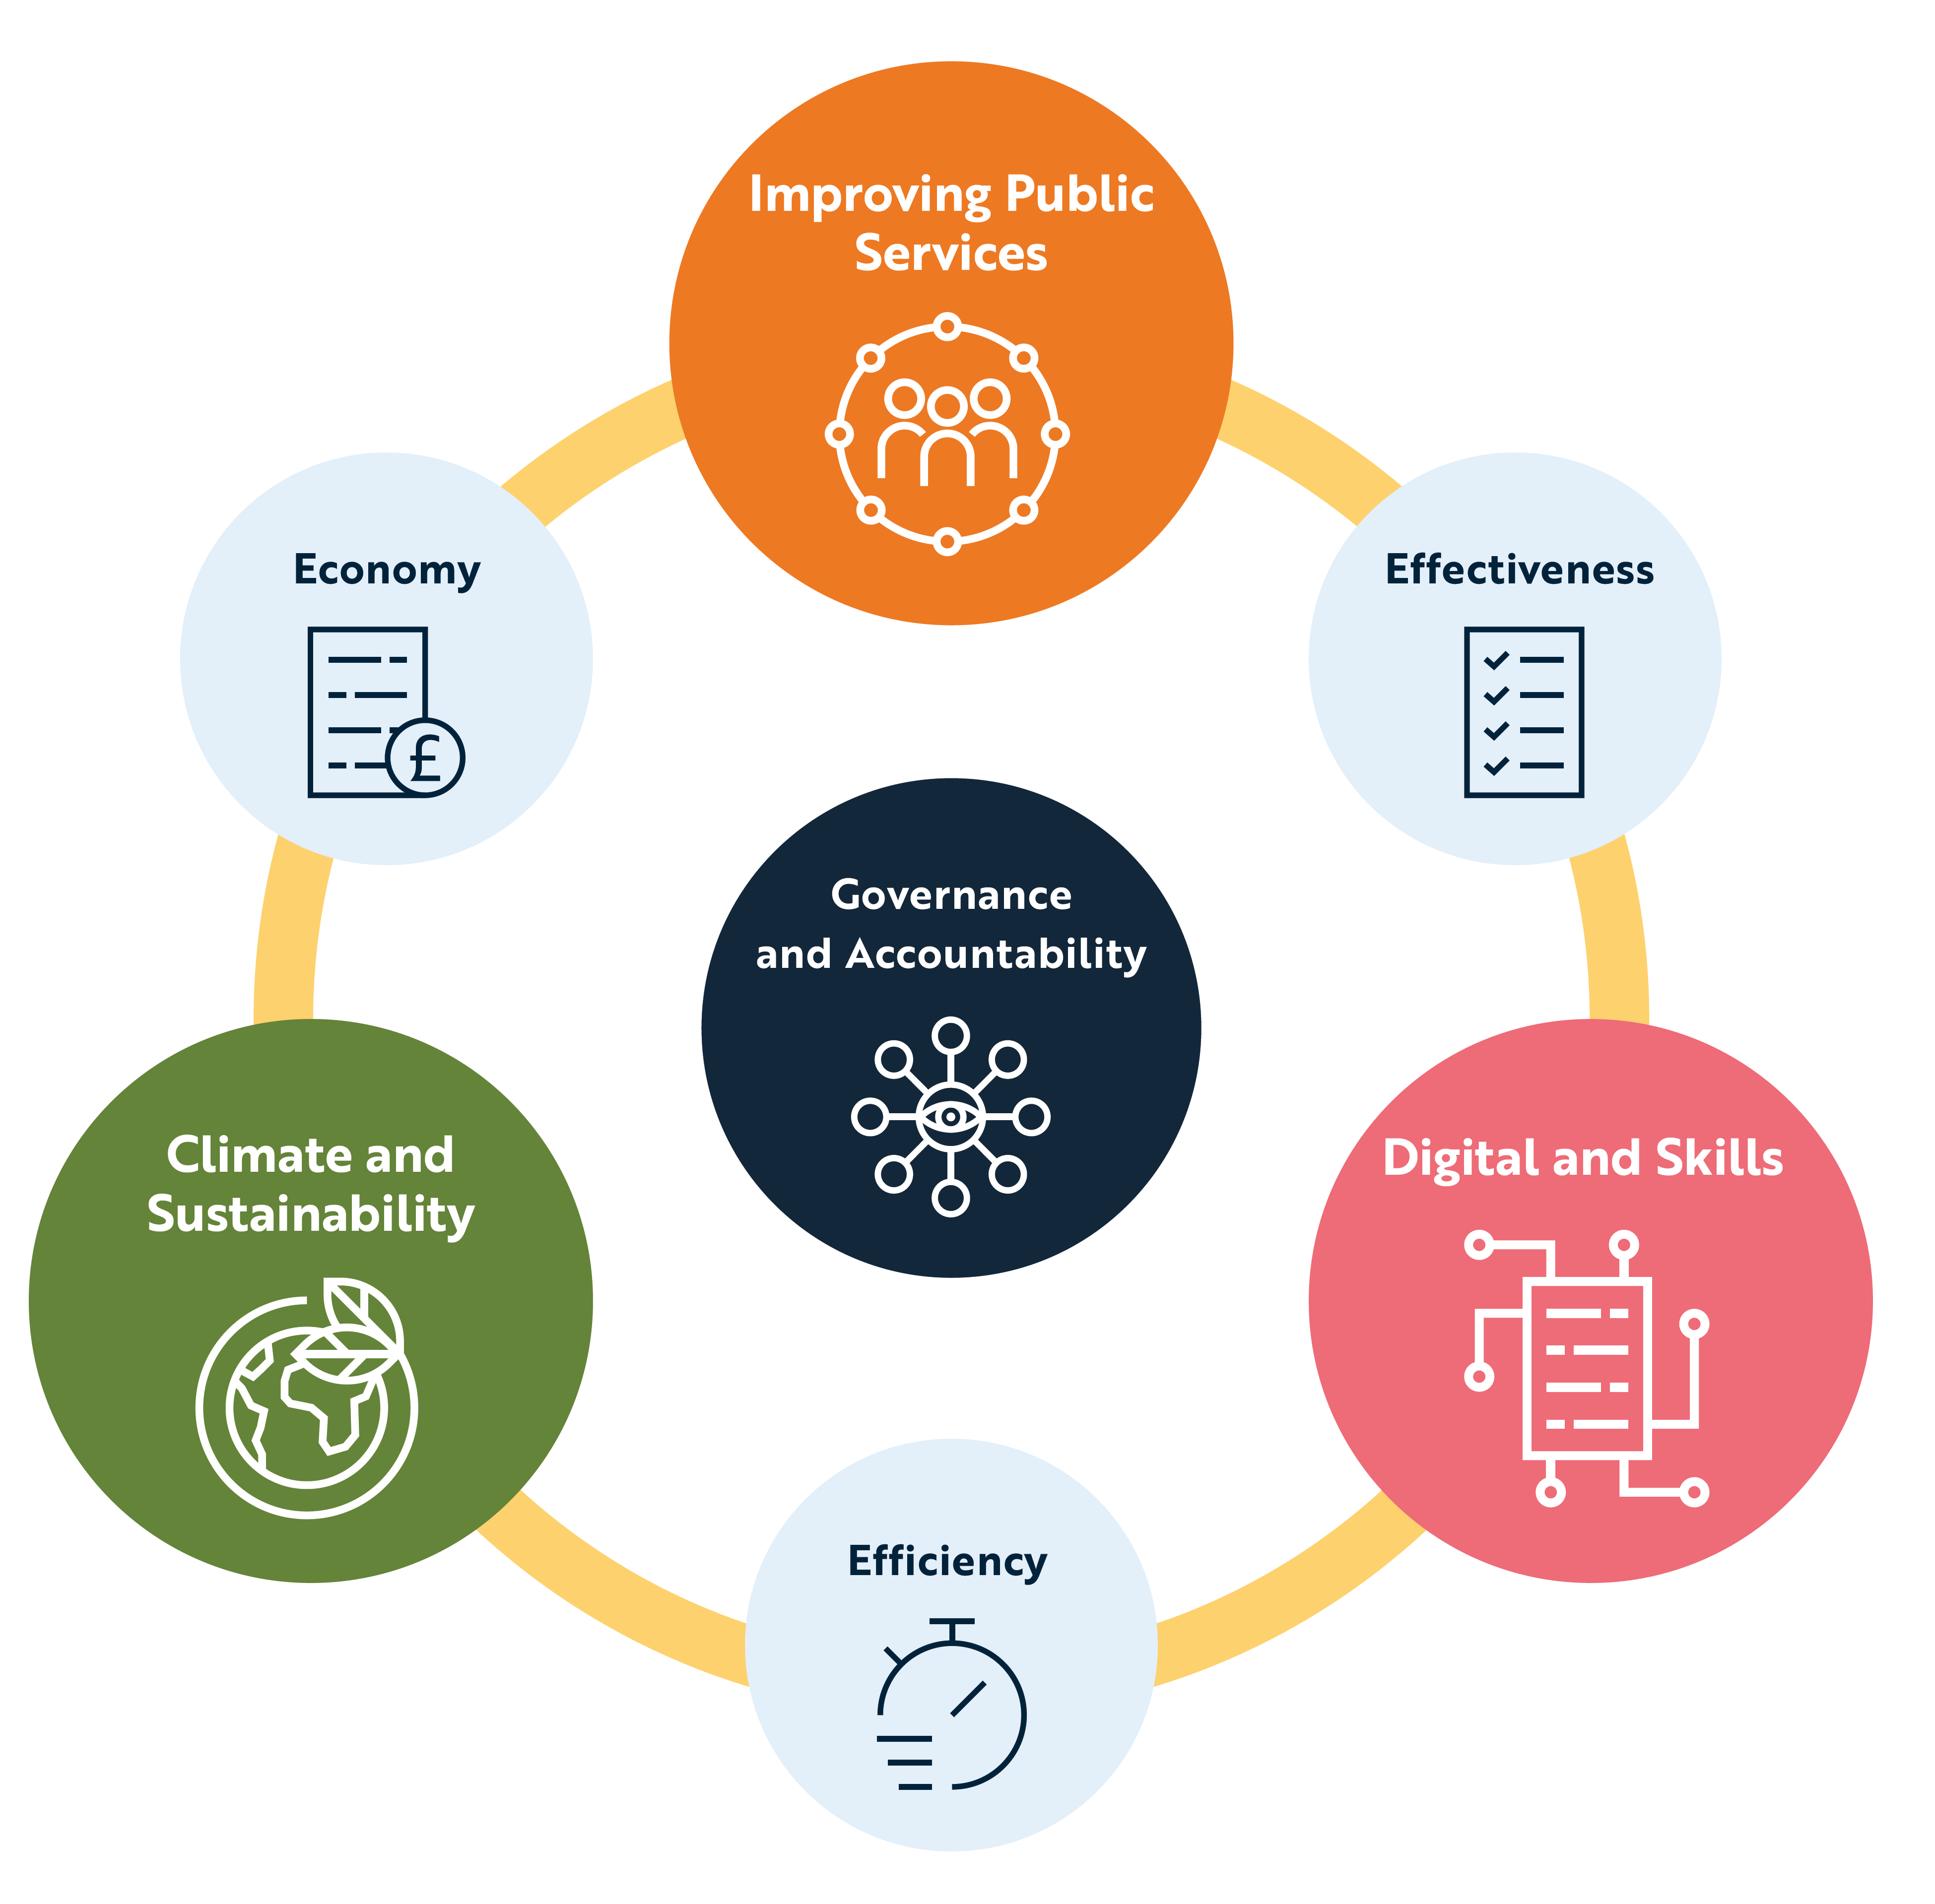
Public Reporting Themes

Slide 25
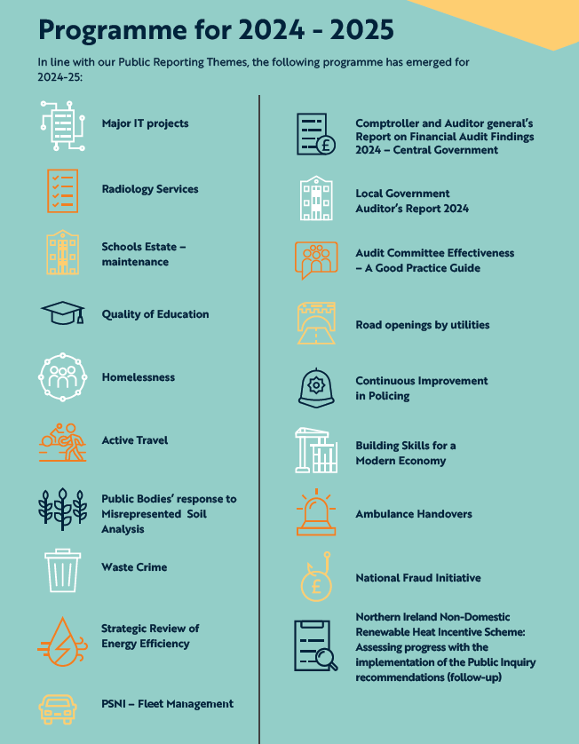

Slide 26
Questions?

