Slide 1
Portfolio Support Workshop for student members

Slide 2
What will we cover?
Key differences
How to access the Portfolio
How to Complete your Portfolio submission
Be a STAR
Editing and submitting your submission for approval
Membership Ready - How to submit your Portfolio
Q&A

Slide 3
Key differences
The technical competencies that were contained within the Statement of Expertise have been included within the situation section of your 400 day log and this has been clearly linked to the development of your personal competencies within Skills and Behaviours.
SharePoint and the use of forms have replaced the Calibrand system, to make it more user friendly and accessible
Your line manager no longer needs to register for a MyCIPFA account
You no longer need to log into a system, existing students will receive a link or can scan a QR code to create their first Student Portfolio Submission.
You will need to complete as many Student Portfolio Submissions until you reach the required number of days for membership.
Notes:
Previously you were required to submit at least ten write ups for the skills and behaviours section and then a workplace log of upto 400 days linking to an area of expertise. This has now changed and has been brought together, and your work experience will be linked to your skills and behaviours entry, highlighting where possible an area of expertise which also links to this.
SharePoint and the use of forms has now replaced Calibrand. This means yourself and line manager will no longer need to wait for log in details or password resets and your line manager will no longer need to register for a MyCIPFA account.
For each submission, you will create a new form. You will continue to do this until you have reached the 400 days.
Evidence uploads are no longer required however, our assessors reserve the right to request to see evidence.

Slide 4
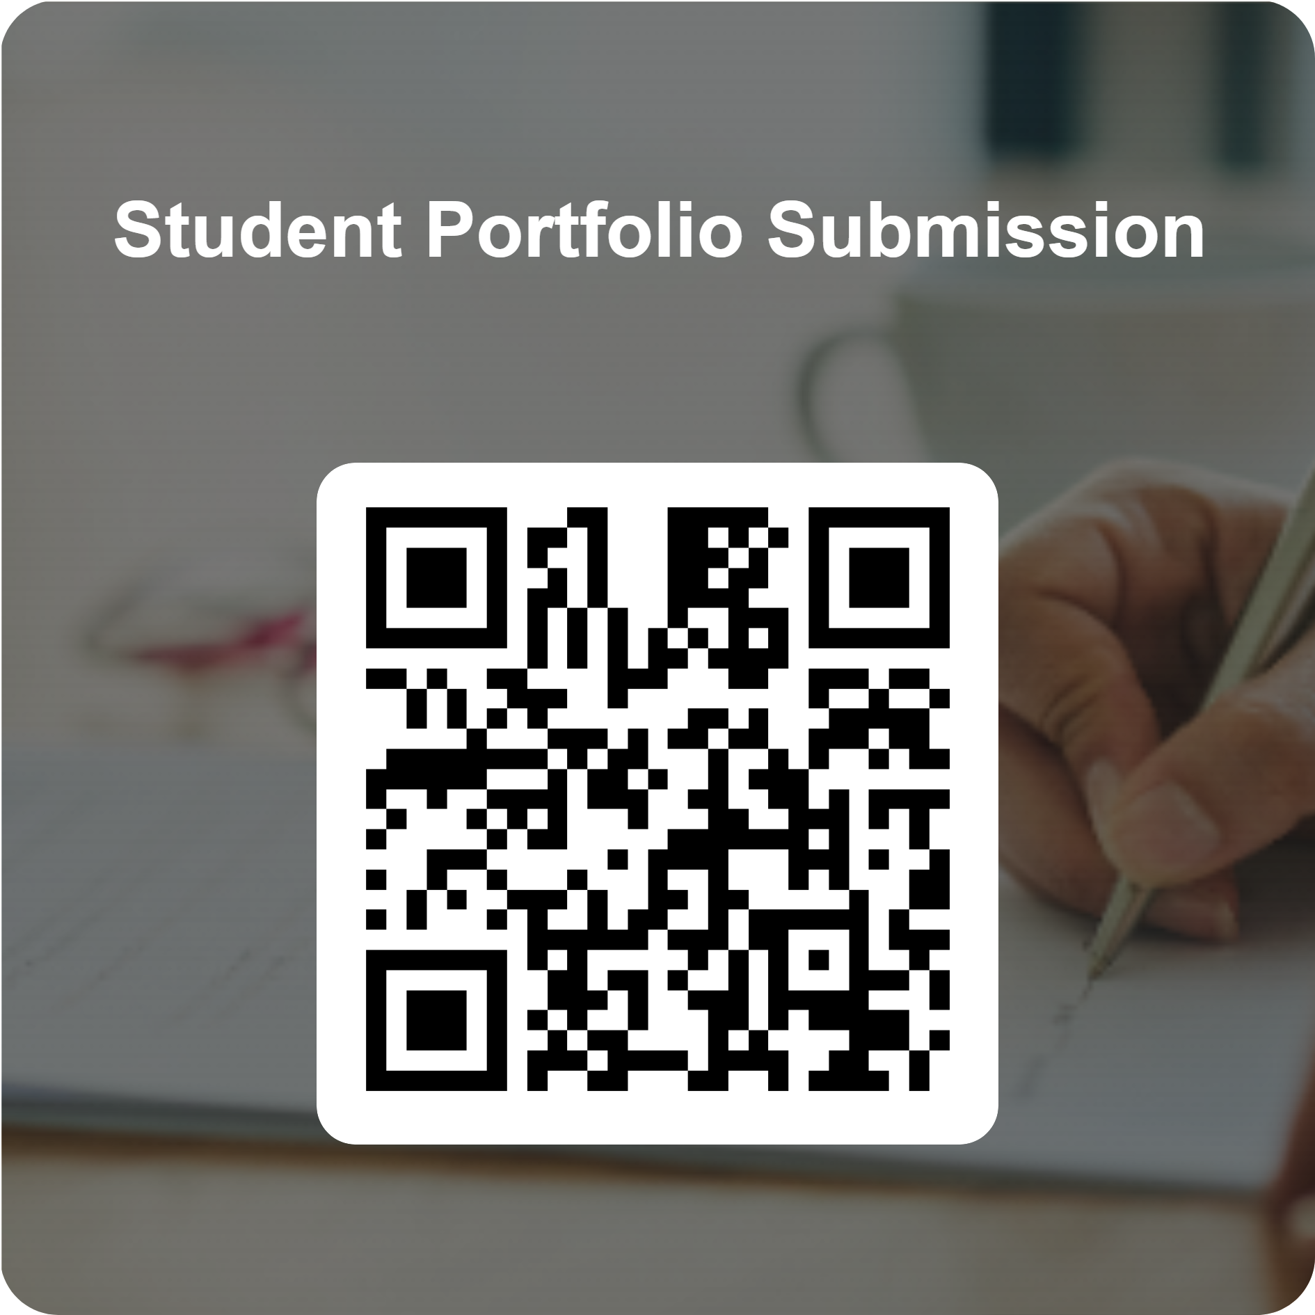
How to Access the Portfolio
The portfolio system will be accessed via your first Student Portfolio Submission
To access the first Student Portfolio Submission you can use the following QR code.
We will also be sending out e mails to all existing portfolio users with the following link. Student Portfolio Submission
Once you have completed your first portfolio submission you will receive a confirmation e mail, that will contain a different link to your overall portfolio in SharePoint.
You will be required to complete a Student Portfolio submission for each piece of work and will need to reuse this link.
Notes:
To access the Portfolio, you can do so by a QR code or by a link.
Once your first submission has been completed, you will receive a confirmation email which will contain a link to your Portfolio submissions in SharePoint.

Slide 5
How to complete your Student Portfolio Submission

Slide 6
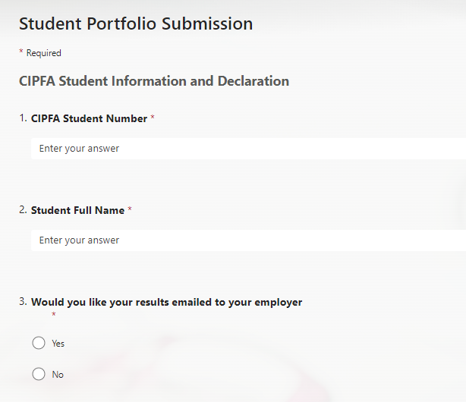
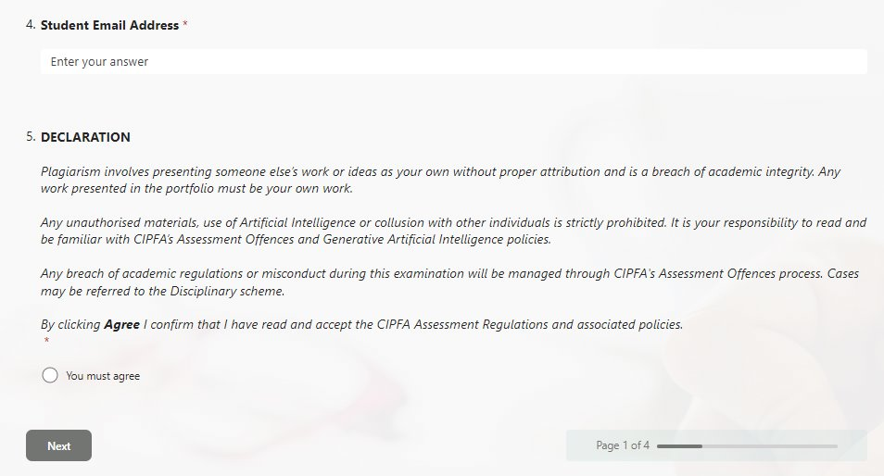
Student Details
Each submission is linked by your e mail address if you change email you MUST inform membershipadmin@cipfa.org
Students are required to confirm their details and agree to the plagiarism declaration for each submission.
Notes:
The first part of the form is completing your information. This includes your CIPFA Student number, name and email address. It also asks if you would like your results emailed to your employer- this is the overall results of your Portfolio. You will also need to agree to the declaration which states that this is all your own work.

Slide 7
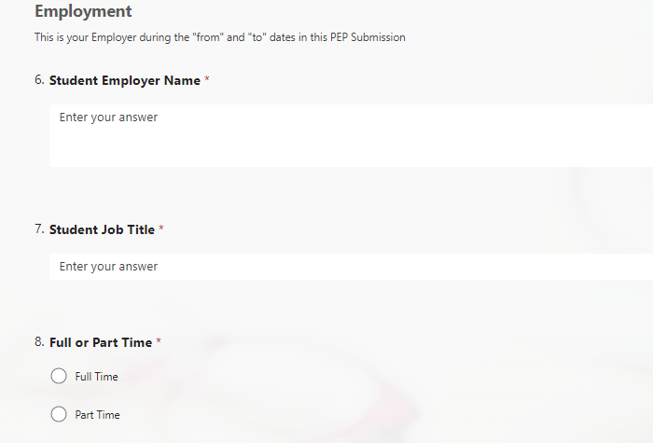
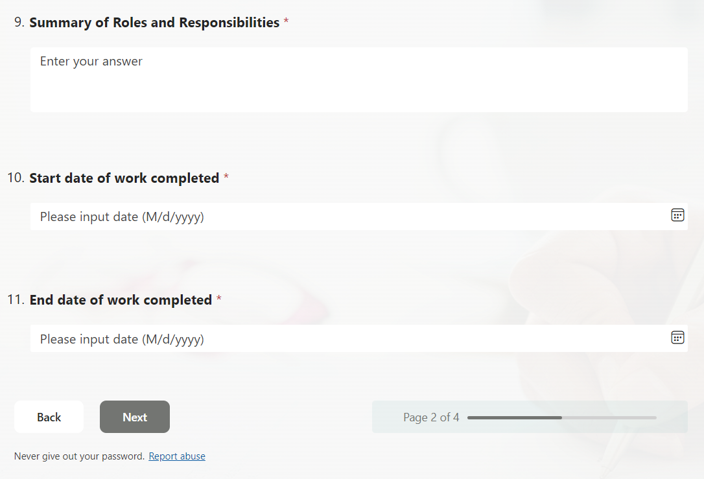
This is a summary of your roles and responsibilities of the role you are in when completing the activity, that relates to the dates below, you are going on to describe.
Employment
Details
Here you add the dates of the task linked to the Skills and Behaviours which you have met. Include your start and end date as this will work towards your 400 days.
7
Notes:
Next is inputting your employment details. This includes your employer name, your job title, whether you work full or part time, a summary of roles and responsibilities of the role you were in when completing the activity and the start and end date of when you worked on the activity. If for example you started working on an activity in January and finished this in May but spent an overall of 50 days on this, include the start and end date in this form, as you will be able to update the actual number of days in SharePoint.

Slide 8
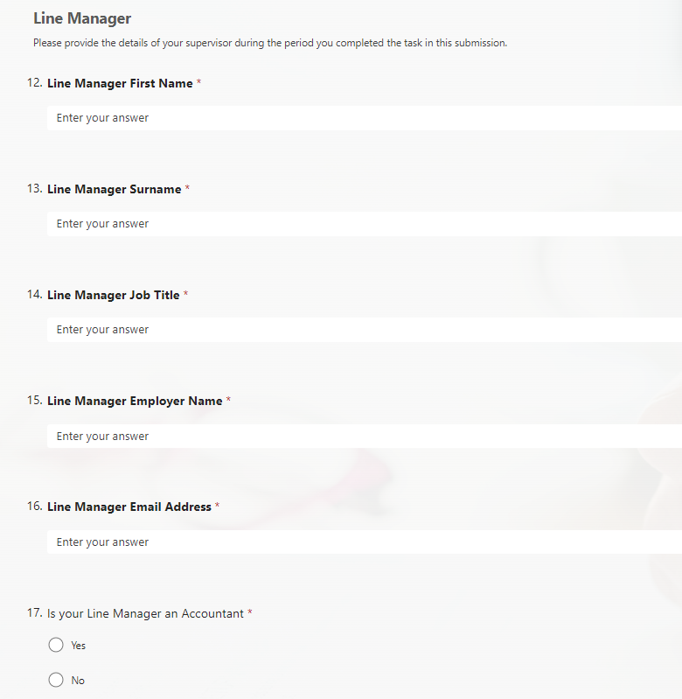
Line Manager Details
Notes:
This part you will just need to include your line managers details so there name, job title, employer name and email address. Please use their work email address. You will also need to highlight whether they are an accountant. If you say yes, a second box will pop up just asking for their accountancy body name.

Slide 9
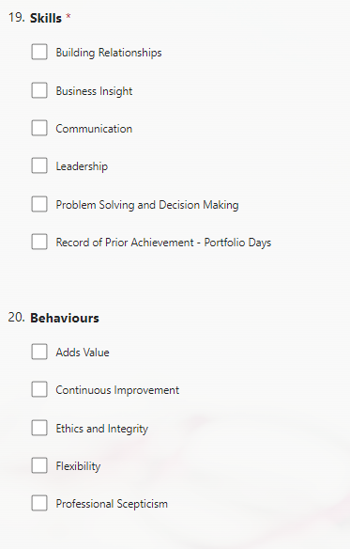
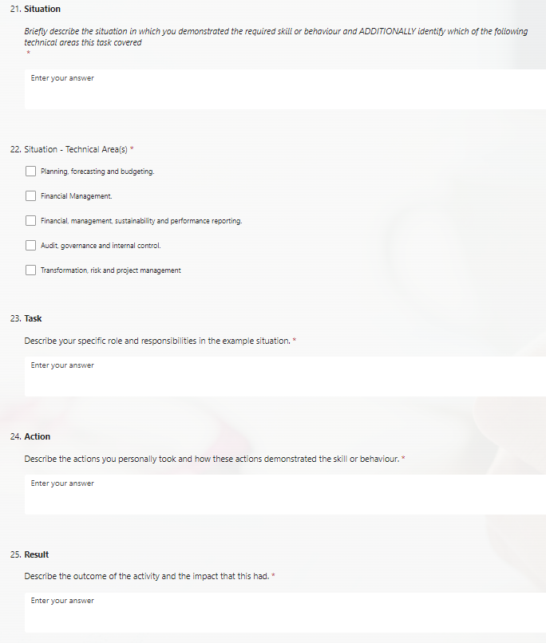
Work experience summary
This is the part of the form that will be assessed when you apply for membership.
You select a skill or behavior (you can select more than one of these for each submission) and then you follow the STAR method of reflective practice.
Across the cumulation of your submissions you need to ensure you have at least one submission for each skill and behaviour.
Within the situation section you also need to ensure each submission is linked to a technical competency. Please cover as many of these as you can but, unlike the Skills and Behaviours, there is no requirement to cover all of the technical competencies.
Notes:
This is where you will now be completing your Skills and Behaviours as well as your work place experience. For each task you are writing about, you can choose as many skills and behaviours that it links to. You are then required to write about this using the star method, linking it to a technical competency. By the time you are ready to submit, you will have needed to have covered every skill and behaviour however there is no requirement to cover all of the technical competencies.
If you have a 200 day exeption of work experience days, you would show this here by clicking the 'record of prior achievement- portfolio days' box.

Slide 10
Be a STAR

Slide 11
Completing the Work Experience Summary
S
Situation
Describe the context and background, embedding your technical competency
T
Task
What was the specific challenge or Objective?
A
Action
Result
What steps did you take to address it?
R
What was the outcome of your action?
For each skill or behaviour you have ticked, you should consider the following points in your narrative

Slide 12
Dos
Imagine the assessor as a well-informed reader – an experienced finance professional but who has no knowledge of you, your role, your Employer, its structure, ways of working etc.
Do create clear and full responses
Do ensure that you are writing “I” or “my” most of the time and not “we”, “our” or “the organisation/employer”
Do ensure your application is all your own original work
Don'ts
Don’t use acronyms, buzzwords or jargon
Don’t choose a non-finance example

Slide 13
Things you need to know
You cannot save and come back to a portfolio submission form unless it has been submitted.
When inputting information in the form, you can only enter 250 characters. However, you will be able to edit this in the SharePoint to include any additional information required which does not fit into this character limit.
Once submitted you can edit but whilst initially working on a submission you may prefer to do this in a word document and then copy it across.
When you submit the form, it does not automatically go to your line manager for approval. You need to follow the approval steps in SharePoint.
The portfolio submission form will automatically calculate the number of days into your SharePoint, this may however need to be amended. For example, you may have worked on a project over a six-month period but it was only 50% of your role and therefore you would not be counting the six months against this activity.

Slide 14
Submitting, editing and approving each entry of your Student Portfolio Submission

Slide 15
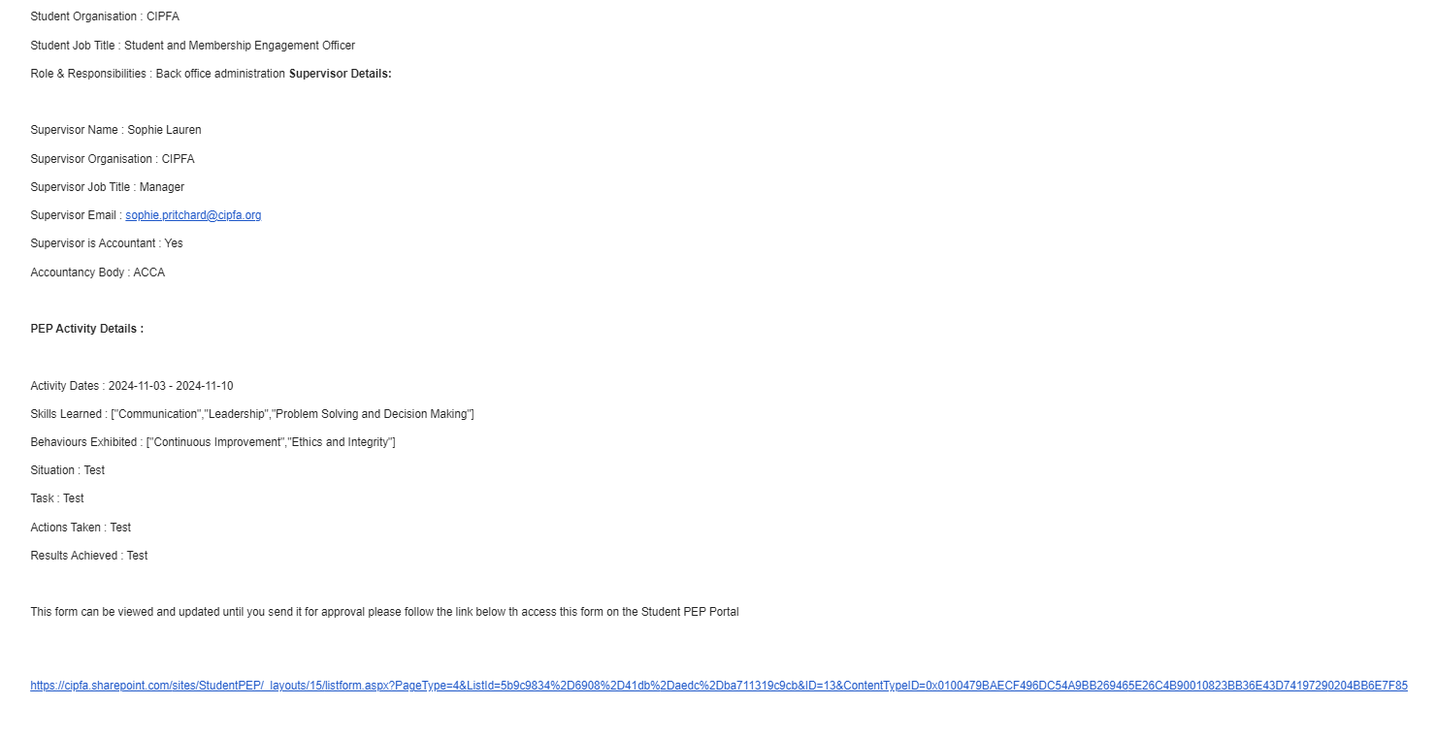
Submission and accessing SharePoint
Once you have submitted your student portfolio submission, you will receive a copy via email. At this stage it has not been submitted for line manager approval.
Please click the link at the bottom to view and edit your submission and any previous submissions in SharePoint.
You will also need this link to submit your submission for line managers approval.
Notes:
Once you have submitted the form, you will recieve an email like this which details your submission and includes a link at the bottom. You will need to click this link to review and edit your submission as well as submitting it for review with your line manager.

Slide 16
Editing Your Submissions
Within the SharePoint site once you have submitted your Student portfolio submission form, you are then able to edit your submission, prior to submitting for approval from your line manager.
To do this you will need to click on the edit button at the top of your submission, this will then allow you to edit your responses.
Whilst reviewing and editing your submission please ensure that your PEP submission days are correct for the time you have worked on the relevant task
Review your submission for spelling and grammatical errors

Slide 17
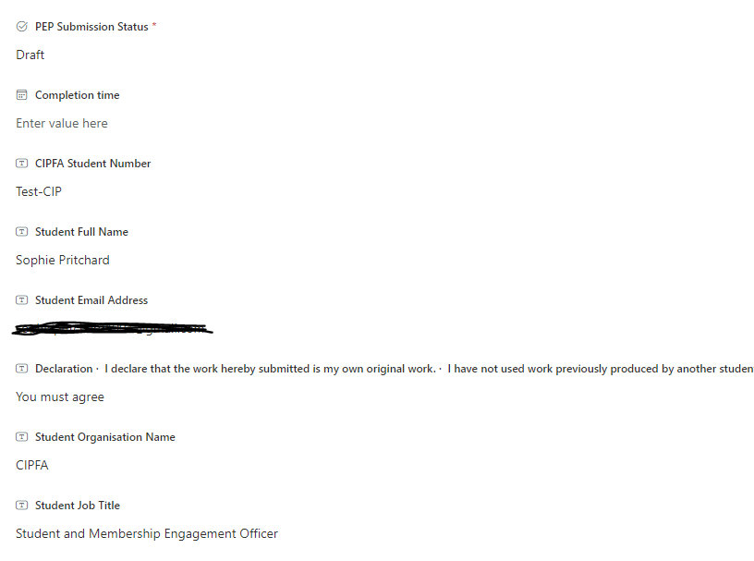
Submitting your entry for approval
When you are ready to submit to your line manager for approval, you will need to edit the PEP Submission Status section of your submission within the SharePoint site.
Once you have clicked submit for approval and saved this will send an email to your nominated line manager who will then review and either approve or reject your submission.

Slide 18
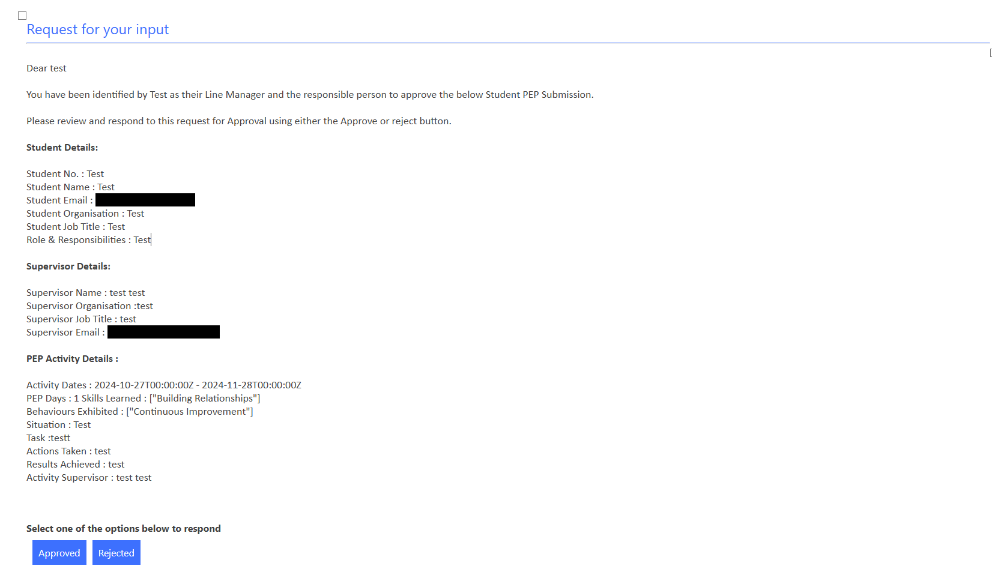
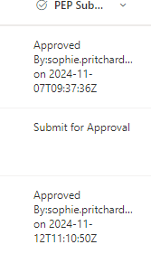
Submitting to your line manager and tracking approval
This will then update on your records
Your line manager will receive an email containing your submission. They can approve or reject the submission here.
Notes:
Your line manager will receive an email like this, with the option to approve or reject your submission. Once they have either approved or rejected it, you will be notified and it will also update on your SharePoint.

Slide 19
Membership ready

Slide 20
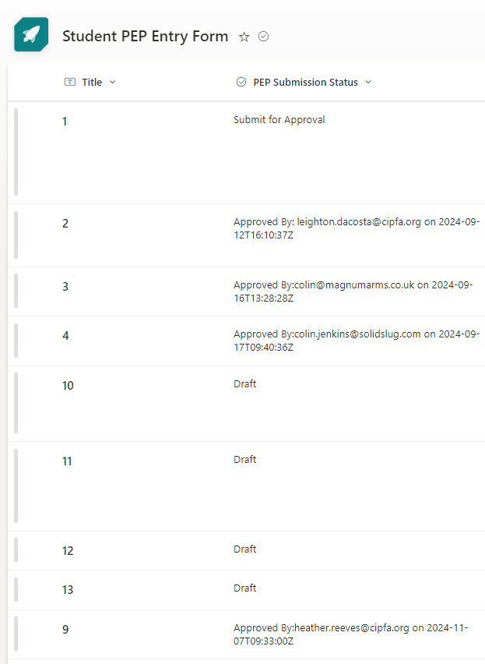
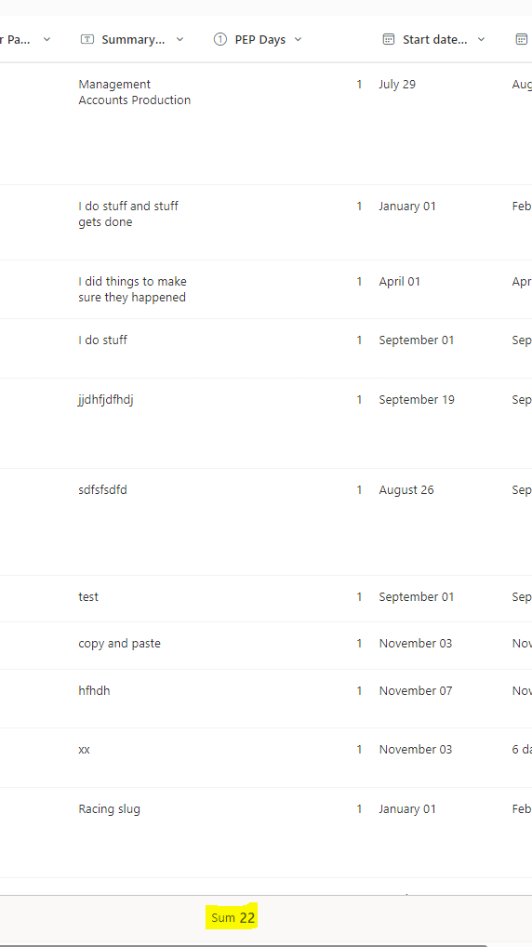
Are you ready to submit for assessment?
Checking Line Manager Sign Off
All submissions should be listed as Approved by and your line managers name and date
Before you submit for assessment you will need to check that all your submissions have been approved by your line manager and that you have reached the required number of experience days.
Checking completion of required work experience days
The sum of PEP days will show at the bottom of your SharePoint page
Notes:
Once you are ready to submit your Portfolio, we ask that you check that all of your submissions have been approved by your line manager and you have met the required number of work experience days. You will be able to see this on your SharePoint site.

Slide 21
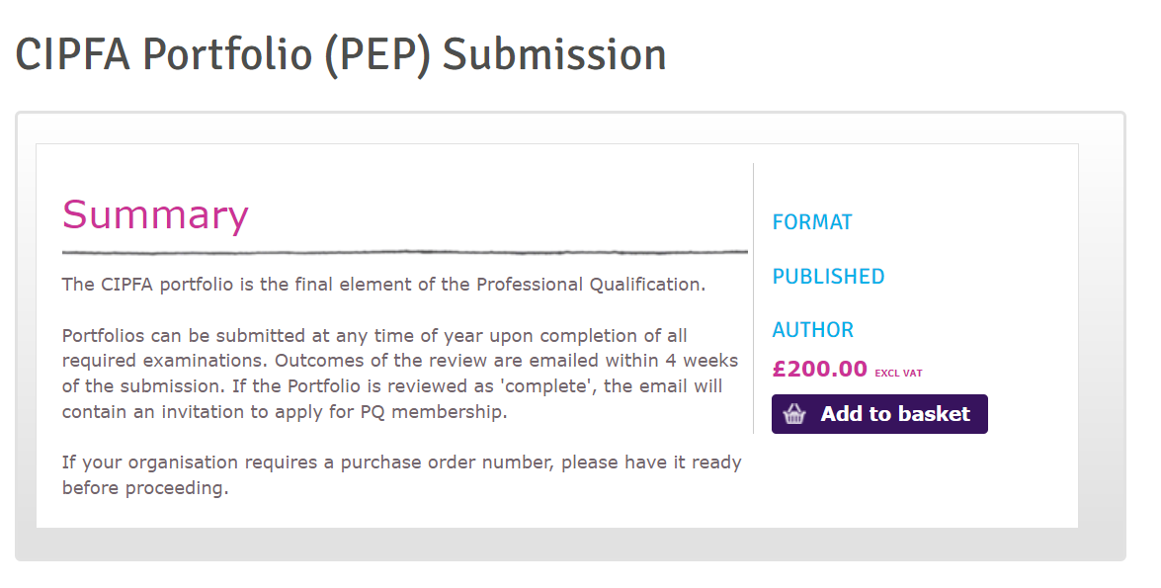
Submitting your Portfolio
To submit your portfolio for assessment you will need to purchase the Portfolio Submission via the CIPFA Website. There is no further action required within the Portfolio platform.
https://www.cipfa.org/examproducts/c/cipfa-portfolio-pep-submission
Submission of your Portfolio has a cost of £200
Once submitted you will receive the results within 4 weeks.
Notes:
Once you have made payment for your Portfolio, this will notifiy our assessors that it is ready to review.

Slide 22
Appendices

Slide 23
Build relationships | Build trusted and sustainable relationships with individuals and organisations. Consistently support individuals and collaborate to achieve results as part of a team.
Business insight | Influence the impact of business decisions on relevant and affected communities based on an appreciation of different organisations and the environments in which they operate.
Communication | Communicate in a clear, articulate and appropriate manner. Adapt communications to suit different situations, individuals or teams.
Leadership | Take ownership of allocated projects and effectively manage their own time and the time of others. Demonstrate good project management skills to deliver high quality work within the appropriate timeline. Act as a role model and motivate others to deliver results.
Problem solving and decision making | Evaluate information quickly and draw accurate conclusions. Assess a problem from multiple angles to ensure all relevant issues are considered. Gather the appropriate facts and evidence in order to make decisions effectively.
Adds value | Anticipate an individual’s / organisations future needs and requirements. Identify opportunities that can add value for the individual / organisation.
Continuous improvement | Take responsibility for their own professional development by seeking out opportunities that enhance their knowledge, skills and experience.
Ethics and integrity | Identify ethical dilemmas, understand the implications and behave appropriately. Understand their legal responsibilities, both within the letter and the spirit of the law, as well as be aware of the procedures for reporting concerns over potentially unethical activities.
Flexibility | Adapt approach to assist organisations and individuals to manage their conflicting priorities as circumstances change.
Professional scepticism | Apply a questioning mind to conditions which may indicate a possible misstatement of financial information due to error or fraud.
10 Skills and Behaviours

Slide 24
Planning, Forecasting, budgeting
Contribute to the generation of options for organisational or departmental strategy
Assess the feasibility of the identified options, using financial and non-financial
Strategic financial management
Prepare a trial balance
Prepare a selection of external financial statements for an organisation
Financial, management, sustainability and performance reporting
Audit, Governance and internal control
Transformation, risk, and project management
Monitor performance against business plan objectives
Contribute to the management of cash balances
Advise budget holders of variances against budget
Advise budget holders of variances against budget
Budget preparation
Undertake an audit of a non-financial system or service
Assist in a Value for Money audit by, for example, benchmarking the audited service
Draft the report of an audit including conclusions and recommendations
Formulate SMART business plan objectives
Audit planning for an internal or external audit
Analyse and quantify the risks associated with a proposed service or activity within an organisation
Risk and risk management
Organisational values or culture
Contribute to an evaluation of an organisation’s systems of internal control
Governance frameworks
Areas of Technical Competencies
24

