Slide 1



Economic Presentation:
Society of District Council Treasurers
Presented By
Alan George | Director
Thursday 16th March 2023

Slide 2
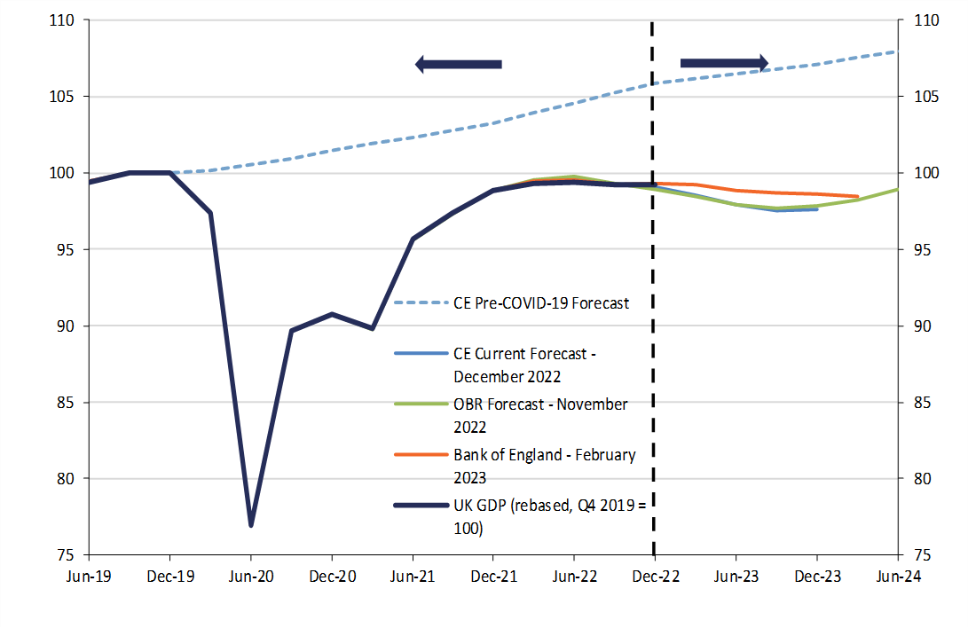
Outlook for UK GDP Growth
Actual
Forecast

Slide 3
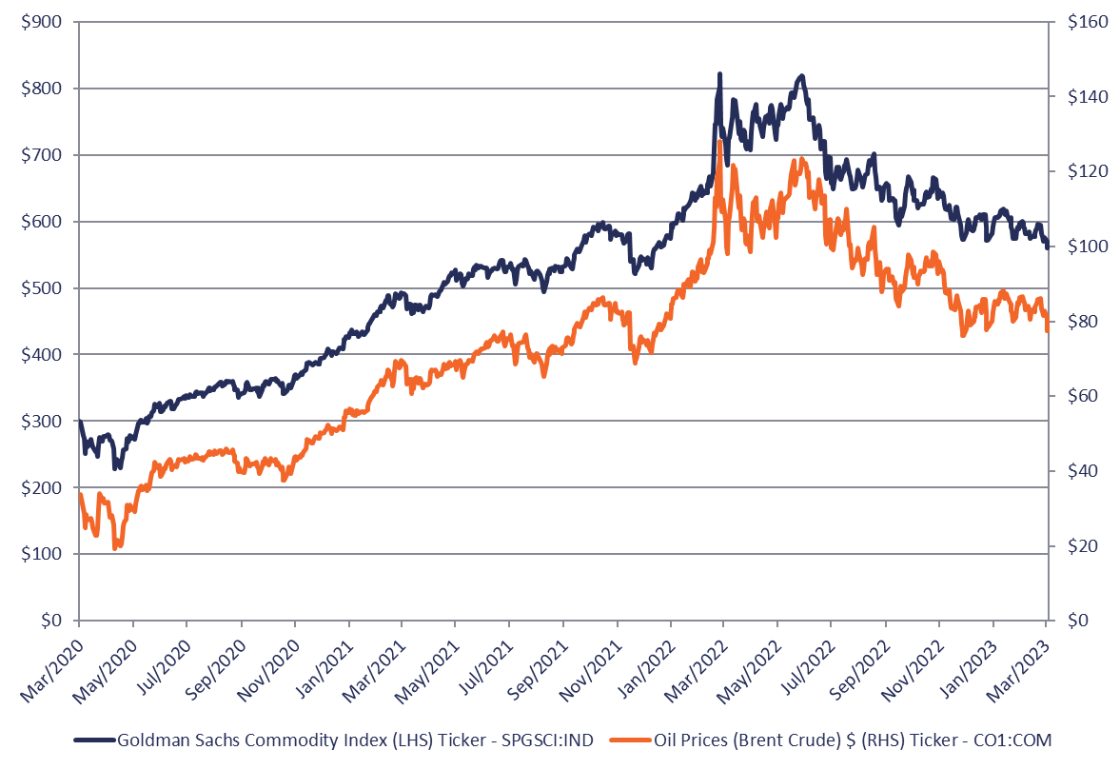
Oil and Commodity Prices

Slide 4
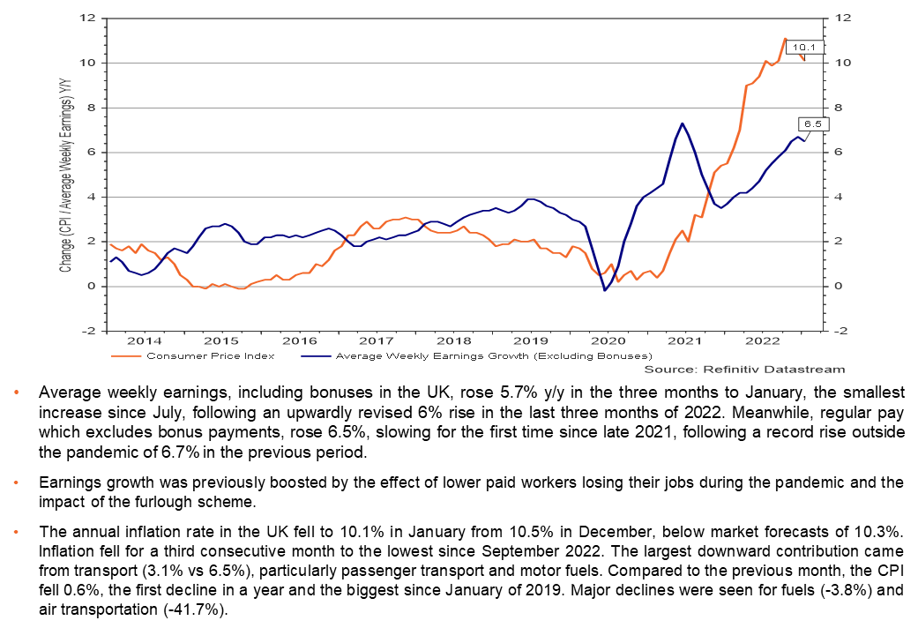
CPI Inflation v UK Wage Growth

Slide 5
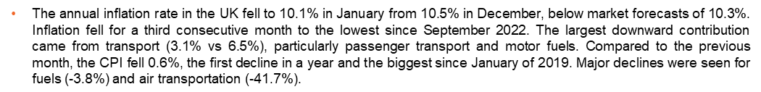
UK Inflation

Slide 6
UK Bank Rate Forecast

Slide 7
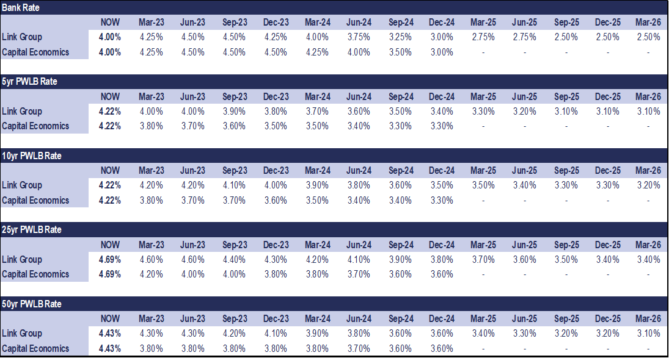
UK Interest Rate Forecasts
Please note – The current PWLB rates and forecast shown above have taken into account the 20 basis point certainty rate reduction from the new Standard Loan rate of 100bps over Gilts effective as of the 26th November 2020.

Slide 8
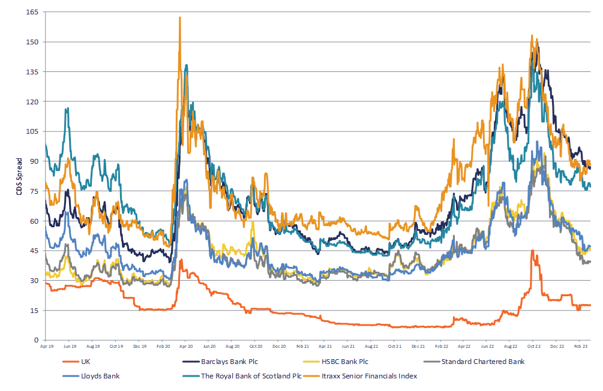
UK Banks 5 Year Senior Debt CDS Spreads

Slide 9
Banking Crisis or not…….
US banks still greatest concern
Fall in banking index still well above 2008 crisis
More of a liquidity issue rather solvency – Central banks will support
Overnight – Credit Suisse had Swiss regulators step in with support
What might now happen to forecays from central banks for bank rate movements>?
TREASURY MANAGEMENT ORGANISES CASH IN RELATION TO POLICY
9

Slide 10
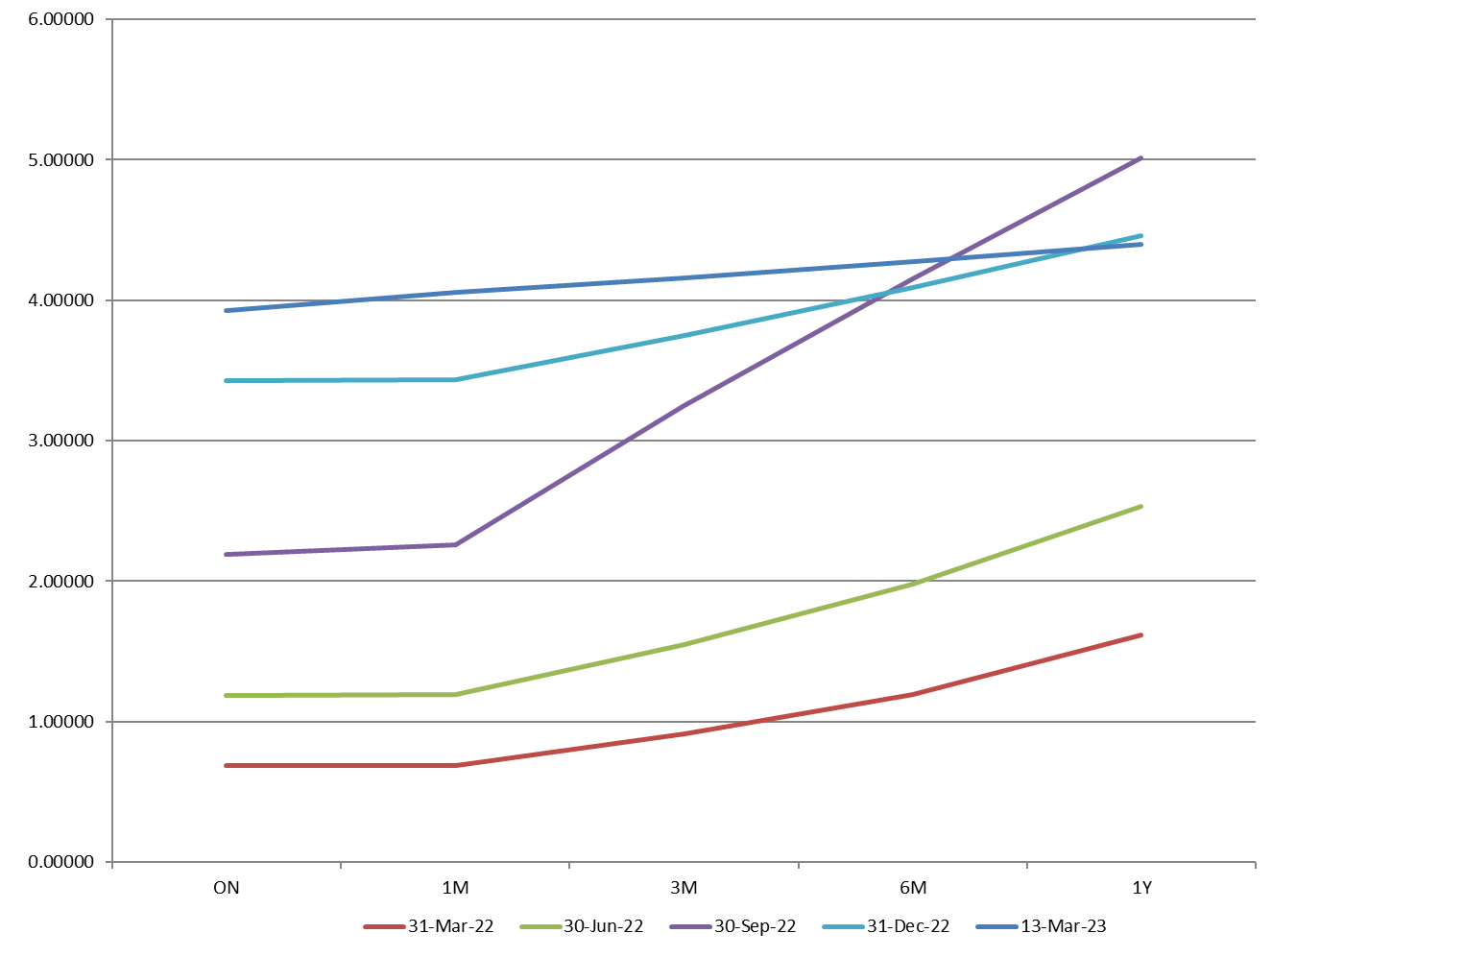
SONIA Rates 31/03/2022 – 13/03/2023

Slide 11
Few Budget Headlines
HRA New Borrowing Rate
From 1st June 2023 access borrowing for HRA of gilts plus 40bps (Currently PWLB Certainty Rate of gilts +80bps)
  In place for 1 year to be kept under review
Leisure industry support
£63m extra support for increased energy costs
Energy price Guarantee
£2500 extended to 30th June 2023
Corporation Tax
  Rise from 19 to 25% for profits above £250k
Pensions
  Abolish life Time Allowance
  Increase annual tax free pension contributions from £40k to £60k
What’s Ahead?
  Scope to cut taxes
  Increase spending
  Political motivation ahead of 24/25 general election
  No recession this year with 2024 higher growth but future years down
TREASURY MANAGEMENT ORGANISES CASH IN RELATION TO POLICY
11

Slide 12
Balance sheet financing
 | 2021 |  |  | 2022
 | Internal Borrowing £bn | UBR £bn | % | Internal Borrowing £bn | UBR £bn | %
 | 1.56 | 8.63 | 18.1 | 1.79 | 9.01 | 19.9
 | Working Capital |  |  | Working Capital
 | 1.14 |  |  | 2.37
 | Deficit cash |  |  | Surplus Cash
 | (0.42) |  |  | 0.58

Slide 13
Cash and Investments
 | 2020/21 £bn | 2021/22 £bn | % change y/y
General Fund balances | 0.56 | 0.64 | 14.3
Other reserves & balances | 3.74 | 3.97 | 6.1
Total reserves and balances | 4.30 | 4.61 | 6.7
Total cash & investments | 3.86 | 5.18 | 34.2

Slide 14
Disclaimer
Whilst Link Group makes every effort to ensure that all the information it provides is accurate and complete, it does not guarantee the correctness or the due receipt of such information and will not be held responsible for any errors therein or omissions arising there from. All information supplied by Link Group should only be used as a factor to assist in the making of a business decision and should not be used as a sole basis for any decision. The Client should not regard the advice or information as a substitute for the exercise by the Client of its own judgement.
Link Group is a trading name of Link Treasury Services Limited (registered in England and Wales No. 2652033). Link Treasury Services Limited is authorised and regulated by the Financial Conduct Authority only for conducting advisory and arranging activities in the UK as part of its Treasury Management Service, FCA register number 150403. Registered office: 6th Floor, 65 Gresham Street, London, EC2V 7NQ.
For further information, visit www.linkgroup.com.

