Slide 1
SDCT Conference
Update on Local Audit
Andrew Chappell
20 March 2025

Slide 2
What we will cover
What has been done to tackle the crisis?
The overhaul of Local Audit

Slide 3
What has been done to tackle the crisis

Slide 4
Current Local Audit Framework
MHCLG
SAAA
Smaller Bodies
NAO
Code of Audit Practice
Guidance for Auditors
Accounting Officer for Local Audit
PSAA (Appointing Person)
Opt-in national scheme
Procurement
Contract Management
LOCAL BODIES
FRC
Regulation of Local Auditors
CIPFA/LASAAC
Code of Practice on Local Authority Accounting
ICAEW
Firm and KAP registration
QAD reviews
Audit Suppliers
Other Government Departments
HO, DeFRA, DHSC/NHSEI, HMT

Slide 5
Local audit delivery decline
43% of 2018/19 opinions o/s at 31 July 2019
FRC’s report on its 2018/19 reviews was very critical
Sir Tony Redmond review commissioned in 2019
PSAA research in 2020 highlighted the fragility of supply; we called for a tailored regulatory approach and for systems leadership in evidence to the Redmond review
55% of 2019/20 opinions o/s at 30 November 2020
91% of 2020/21 opinions o/s at 30 September 2021
88% of 2021/22 opinions o/s at 30 November 2022
99% of 2022/23 opinions o/s at 30 September 2023

Slide 6
Backlog reviews and plans
NAO, PAC, LUHC Select Committee, Grant Thornton reports
Ministerial statements July 2023 & Feb 2024
NAO & DLUHC consultations in February 2024 to enable a reset up to 2022/23 by 30 September 2024, then recovery and reform of the whole system
Consultation response was being prepared, but put on hold due to the election announcement

Slide 7
New Government statements on local audit
‘…we must also reform funding for local government and sort out these inefficiencies. We will start by reforming the local audit system to support value for money for the taxpayer.’
The Rt Hon Angela Rayner, Secretary of State (MHCLG) 18 July 2024
‘Significant reform is needed to overhaul the local audit system…. I will continue to review the evidence, including considering the recommendations of external reviews to date, and will update the House in the Autumn on the Government's longer-term plans to fix local audit.’
Jim McMahon, Minister of State (MHCLG) 30 July 2024

Slide 8
The three phases, CIPFA & FRC explainers
Phase 1: Reset – clear the backlog of audit opinions up to and including 2022/23 by 13 December 2024
Phase 2: Recovery – stop a recurrence of the backlog by using backstop dates and allowing opening balance assurance to be rebuilt over multiple audit cycles
Phase 3: Overhaul – address the systemic challenges
The Financial Reporting Council has issued an Accessible Guide to the Local Audit Backlog, Rebuilding Assurance
CIPFA Audit Committee update

Slide 9
Statutory backstop dates for audited accounts
2022/23: 13 December 2024
2023/24: 28 February 2025
2024/25: 27 February 2026
2025/26: 31 January 2027
2026/27: 30 November 2027
2027/28: 30 November 2028
Likely to be modified/disclaimed opinions for several years
Published lists of bodies and auditors that do and don’t meet the backstop dates

Slide 10
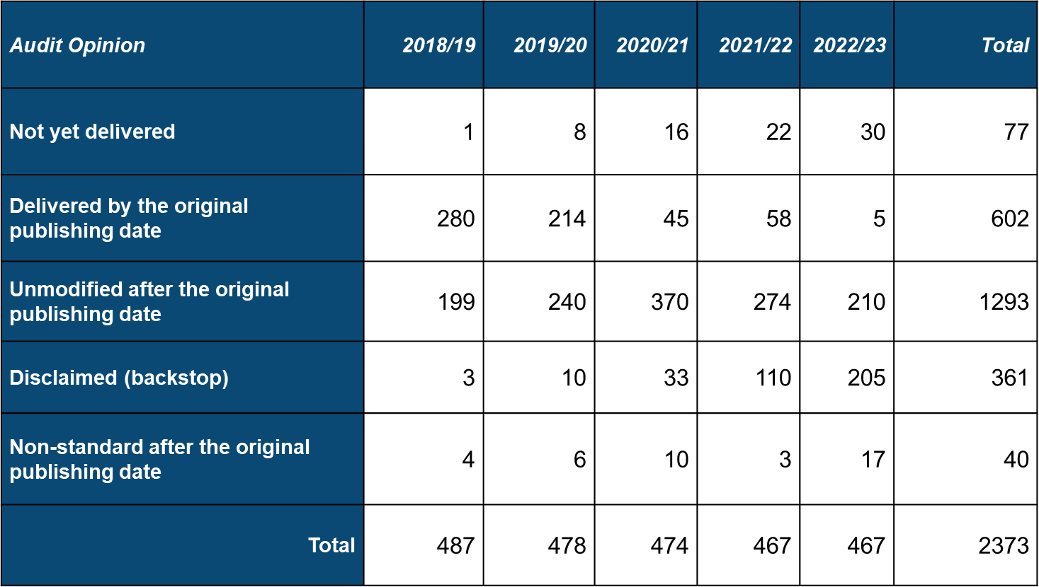
Outcome of the first backstop – 13 December 2024

Slide 11
Non-Compliance List
A Written Ministerial Statement on non-compliance with the backstop date was issued 4 March 2025 :
6 bodies exempt
47 bodies that had not met the backstop of 13 December for publishing all audited accounts to 2022/22 but had by 19 February 2025
21 bodies yet to publish all audited accounts to 2022/23 as of 19 February 2025

Slide 12
Outcome of the second backstop – 28 February 2025
Audit year – publishing date / backstop date | Number of opted-in bodies / audits | Percentage of audits complete by publishing date / backstop date | Number of audits outstanding per year at 28 Feb 2025 | Percentage of audits outstanding per year at 28 Feb 2025 | Number of incomplete audits by the oldest outstanding year
2023/24 28 Feb 2025 | 459 (533) | 90% (89%) | 48 (58) | 10% (11%) | 32 (38)
2022/23 30 Sep 2023 | 467 (540) | 1% (1%) | 16 (20) | 3% (4%) | 3 (3)
2021/22 30 Nov 2022 | 467 (540) | 12% (10%) | 13 (17) | 3% (3%) | 2 (2)
2020/21 30 Sep 2021 | 474 (547) | 9% (9%) | 11 (15) | 2% (3%) | 5 (7)
2019/20 30 Nov 2020 | 478 (552) | 45% (44%) | 6 (8) | 1% (1%) | 6 (8)
2018/19 31 Jul 2019 | 487 (561) | 57% (59%) | 0 | 0 | 0
Please note: values including Pension Fund audits are shown in brackets.

Slide 13
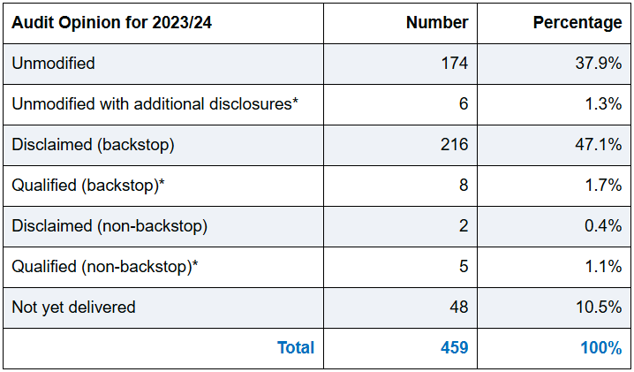
Outcome of the second backstop – 28 February 2025
*These cover modifications and additional disclosures in the auditor’s report

Slide 14
The overhaul of Local Audit

Slide 15
Overhaul of local audit
‘The challenges faced by all are insurmountable without fundamental reform to drive transparency and open the books. That is why we will streamline our fragmented system into one body, the Local Audit Office. The Office will have a focussed and clear remit to lead the required reform and to ensure that local audit, not just for local authorities but the wider system including the NHS, will provide value for money for the taxpayers now and in the future.’
Minster of State Jim McMahon
Written Ministerial Statement 18 December 2024

Slide 16
Overhaul of local audit
English Devolution White Paper Local Audit Office announced
Local audit reform consultation published 18 December 2024
MHCLG presented a summary of the consultation at the LGA Finance Conference on 9 January 2025
The consultation illustrates the extent of the change needed, which much work to do to enable the LAO to be a success

Slide 17
Local audit reform
The purpose of local audit
Local Audit Office remit
Financial reporting and accounts
Capacity and capability
Underpinning the system; relationship and audit regimes
Local audit backlog

Slide 18
Local Audit Office – Three systemic challenges
Capacity – a severe lack of auditors with a limited number of firms operating in the sector
Co-ordination – multiple organisations with a statutory role to oversee and regulate audit, across various sectors, countries and with responsibilities for different frameworks. There is no clear ownership of the system which limits the ability to align incentives and establish a single vision

Slide 19
Local Audit Office – Three systemic challenges
Complexity - financial reporting audit requirements are disproportionately complex, beyond the system’s capacity and inadvertently incentivises risk aversion. Standards are largely modelled on corporate audit rather than the needs of local audit bodies.

Slide 20
Future Framework
MHCLG
Accounting Officer for Local Audit with an enhanced early warning system for LG bodies
Other Government Departments
HO, DeFRA, DHSC/NHSEI, HMT
Audit Suppliers
including public provision?
Local Government Bodies
Local Audit Office
Code of Audit Practice & Guidance for Auditors
Regulation of Local Auditors including Registration Quality and Enforcement
Procurement and Contract Management
CIPFA/LASAAC??
Code of Practice on Local Authority Accounting
NHS bodies ?
SAAA??
Smaller Bodies

Slide 21
Questions

