Slide 1
Risk, Resilience and Innovation – Alternative Delivery Models
14th November 2014
For CIPFA North West Annual Conference
Preston, Lancashire
Craig Dearden-Phillips MBE
Managing Director, Stepping Out

Slide 2
Brief bit about me

Slide 3
My Books

Slide 4
Quick bit of context: The NHS will get all the money

Slide 5
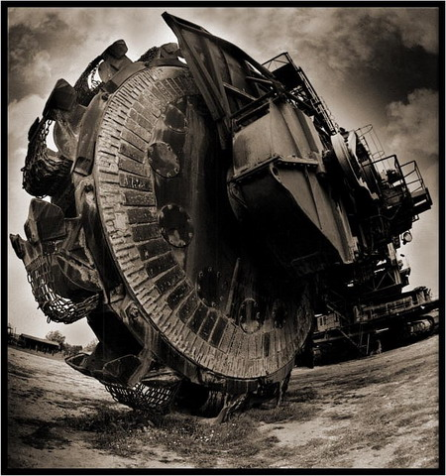
Councils cannot try to be Big Machines into the 2020s – they will become insolvent

Slide 6
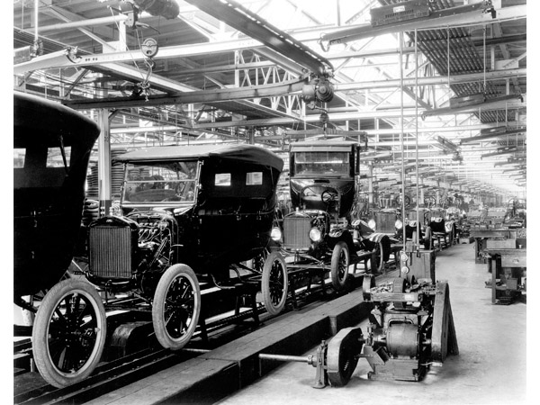
‘Fordism’ in public services no longer on!

Slide 7
Council Paternalism is Dead

Slide 8
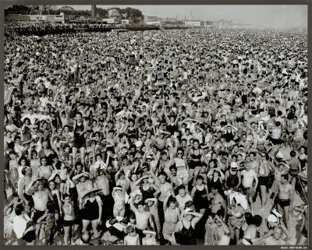
In a fragmented, multi-channel world we need diverse models of delivery.

Slide 9
The only way out is to Jump!

Slide 10
So what are our options?

Slide 11
Further scaling back

Slide 12
Wave goodbye to your wider offer

Slide 13
Give ever more to the Big Boys

Slide 14
Give Care to Health?

Slide 15
Or we do other things

Slide 16
We embrace new approaches to delivery

Slide 17
Create more dynamic organisational forms

Slide 18
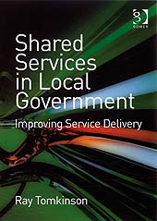
The Standard Ones are
Trading companies
Joint Ventures with the big-boys
Shared Services

Slide 19
Why I don’t think these are the Future
Trading companies generally remain in the same place and end up not saving enough money
Shared services bring a short-term benefit but not much more beyond and are generally sub-scale
Partnerships with large, global outsourcers have a lot of risk in them and are hard to change

Slide 20
Where I Think the Future Lies
Public Service Mutuals
Joint Venture Partnerships
(with smaller players)
Commercialism
(but not LATCs!)

Slide 21
Mutuals blend reduced Council £ with increased staff productivity & social capital

Slide 22
Spin-outs are more effective than public and private sector at bridging financial and social capital

Slide 23
Spin-Outs tend to grow (13% average)

Slide 24
In Suffolk we created 5 new businesses in three years – all are well-ahead of target savings
Libraries (£10m)
Social care (£12m)
Employment (£10m)
FM, Grounds, Catering (£30m)
Property Services (£5m)
Sensory Services (£3m)

Slide 25
But how do spin-outs save you money?
They can hire new staff on different terms and conditions
They are less constrained in the way they are managed
They can grow and spread costs that way
They tend to improve productivity and reduce levels of absence
They have to compete and be financially more aware
They can source their back office more cheaply
They can get rid of poor performers more easily
They can raise productivity more easily

Slide 26
If don’t believe me…Commercial Models - Growth Study

Slide 27
What are the risks/downsides?
Overspend
Reduced control
Enterprise failure
Union trouble

Slide 28
Mitigators of Risk
Get the settlement right
Ensure access to working capital
Give operational freedom
Import commercial and financial skills onto board

Slide 29
How do you create a successful business from the Council?

Slide 30
Find Your Leaders in Services (then back them)

Slide 31
Partner Wherever Possible (find complementary resources)

Slide 32
Create Commercial Boards (not packed with Members)

Slide 33
Finance issues CIPFA can help with

Slide 34
Pensions – mind the gap

Slide 35
Procurement: Is the Tail Wagging the Dog?

Slide 36
Get Real on Recharges

Slide 37
Stepping-Out: Turning good public services into great social Businesses
Setting Out
Stepping Out
Staying Out
High-level feasibility and options appraisal
ADM Readiness Assessment
‘Socialising’ the ADM idea with staff and other stakeholders
Strengthening management’s confidence
Business Planning & financial modelling
Project management
Support during contract negotiations
Powerful networks
Partner selection
Finding social investments
Executive mentoring
Planning for growth
Investment readiness
Leadership development
Social Value analysis
Interim management

Slide 38
Hope I have helped on some level…
Thank You for listening
Contact me anytime
Craig@stepping-out.biz
T – 01223 781145
M - 0776 420 3969
http://stepping-out.biz
@DeardenPhillips

Slide 39
Book Available Free http://howtostepout.com

