Slide 1
Improving income in a low interest rate environment
A focus on commercial property
John Kelly
Head of Client Investment
Notes:
1

Slide 2
What we will cover
Current interest rates and expectations
- improving cash returns
Opportunities and risks of other investments
a maturing cycle
valuations
Commercial property
return characteristics
costs and liquidity

Slide 3
Latest expectation for interest rates
Consensus expectations for Base Rate
Source: Bloomberg / CCLA as at 10.10.2014, 05.08.2014 and 20.06.2014

Slide 4
Interest rates will be slow to rise because:
Inflation is not a threat
Debt levels are still high
Strong sterling is a concern
Government policy will continue to drag on activity

Slide 5
Improving cash returns
By lending longer
Term rates are not attractive:
one year 0.5%
three years 1.1%
five years 1.6%
CPI 1.2%
Reduce opportunity and flexibility, increase risk

Slide 6
Improving cash returns II
By reducing credit quality
The asymmetry of risk for cash investors
Bail-ins – a particular threat to the sector

Slide 7
Asset classes other than cash
UK fixed interest, 10 year gilt yield
Source: Bloomberg (10.09.2014)

Slide 8
Asset classes other than cash II
Equities, 10 year returns to 30 September 2014
Sources: Bloomberg, IPD: FTSE All-Share Total Return Index, FTSE All-World Total Return Index, FTSE UK Govt All-Stocks Total Return Index, IPD Monthly Total Return Index*, 7 Day LIBID, Retail Price Index* (*lagged a month to give a contemporaneous picture).

Slide 9
Asset classes other than cash III
Commercial property
An inefficient asset class
Predictable income, based on contract
Valuations compressed by recession
Occupier markets just starting to recover

Slide 10
Long term characteristics are the most important
Property investment returns since 1970
%
Source: CCLA and IPD *Past performance is no guarantee of future returns

Slide 11
Property: prime vs secondary
Source: IPD

Slide 12
Current conditions: a building recovery
Economic and financial climate helps not hinders
Activity levels higher, valuations recovering
A gradual thaw in occupier markets?
void rates still high
rents improving in some areas
We expect positive returns for the medium term

Slide 13
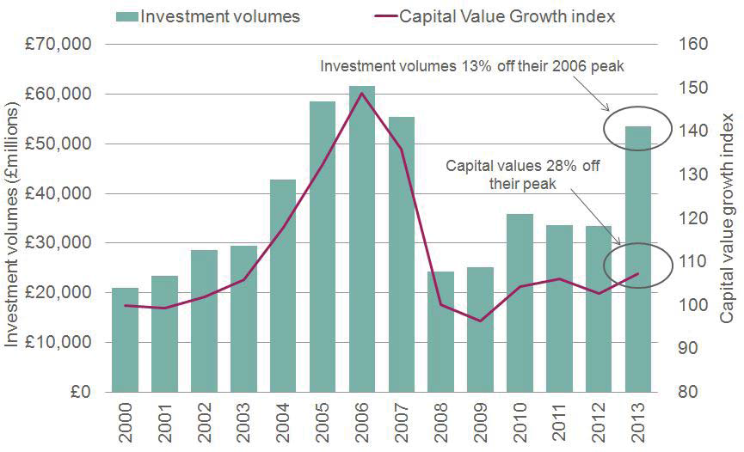
Short term trends are positive
Source: Investment Property Databank

Slide 14
How to invest:
Funds are the lower risk choice
Diversification reduces risk, improves income certainty
Costs and liquidity are important factors

Slide 15
LAPF Property Fund
Fund performance – total returns (NAV) basis
% longer term returns to 30 June 2014
Unique accounting advantages
Strong independent governance
Attractive income
Excellent performance
Source: CCLA and IPD – Annualised past performance is no guarantee of future returns. NAV basis is after the deduction of all expenses

Slide 16
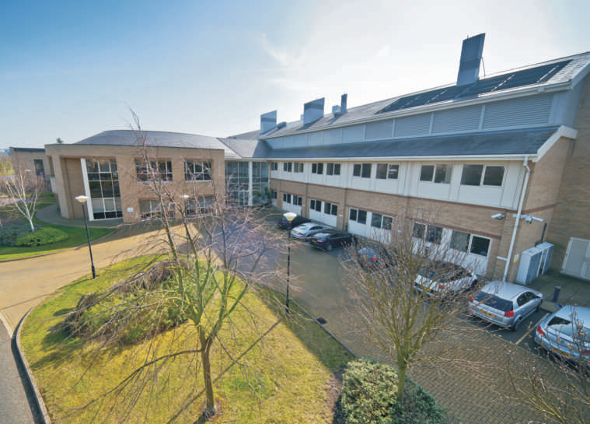
Property portfolio
Top quality office/lab facility in Cambridge let to AstraZeneca
Current yield 6.1%
Expected yield of 7.2% on renewal
Building 310, Cambridge

Slide 17
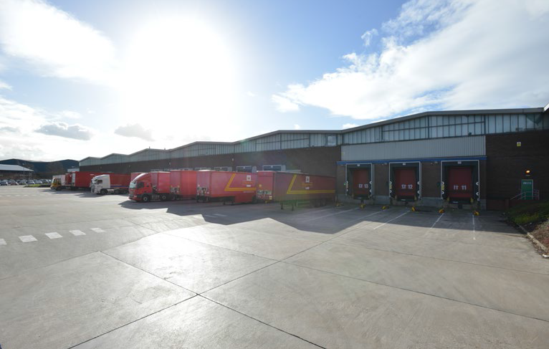
Property portfolio
Royal Mail North West Regional Distribution Centre, Winwick Quay, Warrington
Distribution warehouse let to Royal Mail
Yield 7.8%

Slide 18
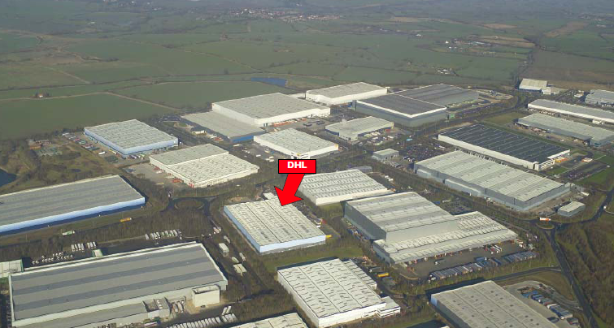
Property portfolio
3310 Hunter Boulevard, Magna Park, Lutterworth, Leicestershire
Well located and popular distribution facility let to DHL
Bought for £9 million on a 9% yield
Current value £13.5 million, 6% yield

Slide 19
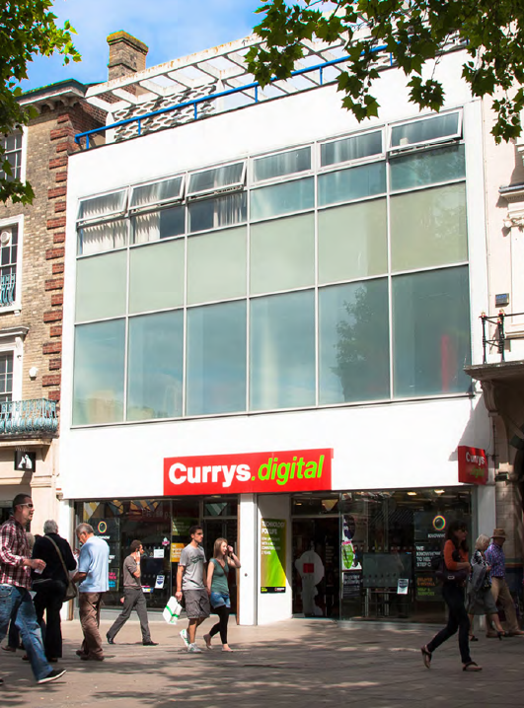
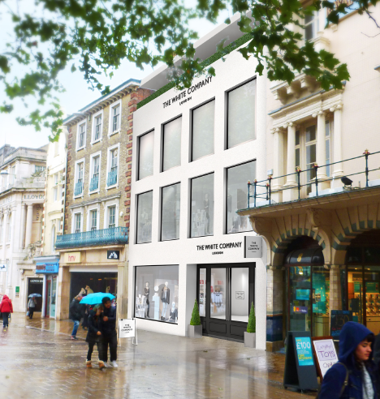
Property portfolio
22/23 Gentleman’s Walk, Norwich
Prime retail shop in dominant regional location
Refurbished and new trading floor opened
Achieved highest rent in Norwich since financial crisis

Slide 20
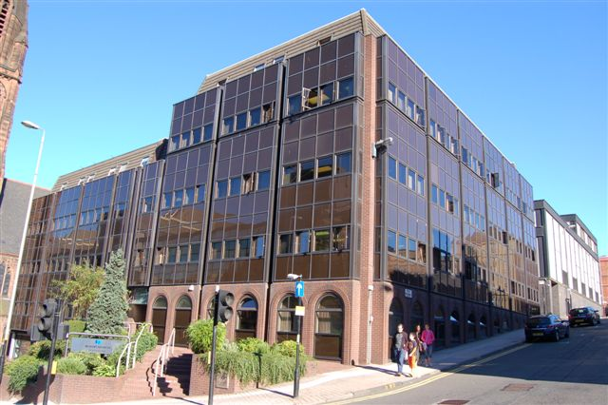
Property portfolio
292 St Vincent Street, Glasgow
Current value £2.7m and initial yield 10.0%
Income secured by extending lease to February 2019
Prime Glasgow office street
Significant office development opposite will further enhance the location

Slide 21
Regulatory information and risk warning
We do not represent that this information, including any third party information, is accurate or complete and it should not be relied upon as such. Opinions expressed herein are subject to change without notice.
The services described are provided by CCLA Fund Managers Limited (CCLA), a firm authorised and regulated by the Financial Conduct Authority. This document is issued for information purposes only and is not a solicitation to buy or sell any investment. Nothing in the document should be deemed to constitute the provision of financial, investment or other professional advice.
Past performance is not an indication of future performance. Values of investments, and any income derived from them, may fall as well as rise and you may not get back the amount you invested. Exchange rate changes may have an adverse effect on the value, price or income of investments. The levels and bases of, and relief from, taxation may change. You should obtain tax advice where appropriate before proceeding with any investment. Investments in higher yielding bonds issued by borrowers with lower credit ratings may result in a greater risk of default and have a negative impact on income and capital value. Income payments may constitute a return of capital in whole or in part. Income may be achieved by foregoing future capital growth. There may be additional risks associated with investment in emerging and developing markets.
Where reference is made to COIF Funds CCLA Fund Managers Limited is the appointed Manager and these may be Unregulated Collective Investment Schemes. The Funds may deal infrequently and may limit redemption. Share values may reflect fluctuations in property and share prices. Fund charges may be applied to capital which may result in capital erosion.
Any forward-looking statements are based upon our current opinions, expectations and projections. We undertake no obligation to update or revise these. Actual results could differ materially from those anticipated.

Slide 22
Senator House, 85 Queen Victoria Street, London EC4V 4ET
www.ccla.co.uk
Notes:
22

