Slide 1
Donna Hall, CBE
Chief Executive

Slide 2
What Is The Deal?

Slide 3
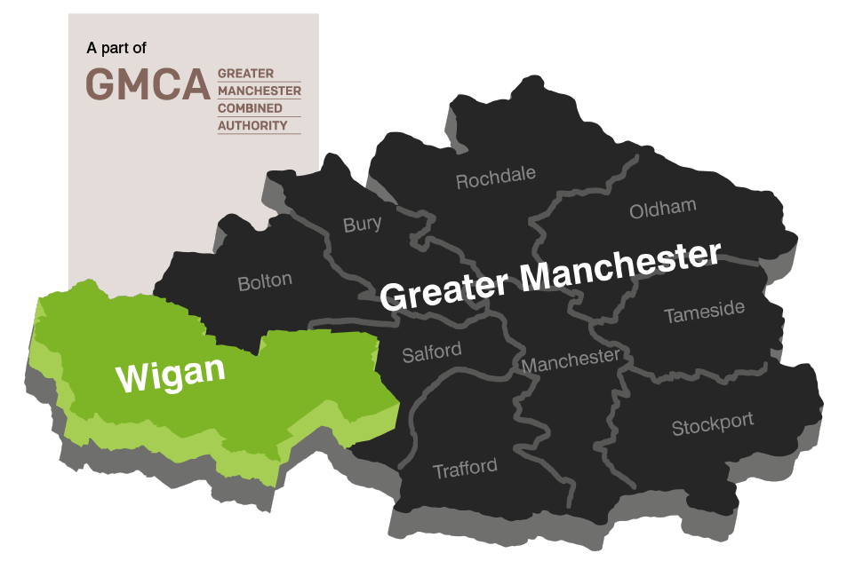
Wigan
Population of 322,000
70% green space
140,000 households
85th most deprived

Slide 4
The story so far…
Since
we have saved
whilst continuing to improve outcomes for the people in the borough

Slide 5
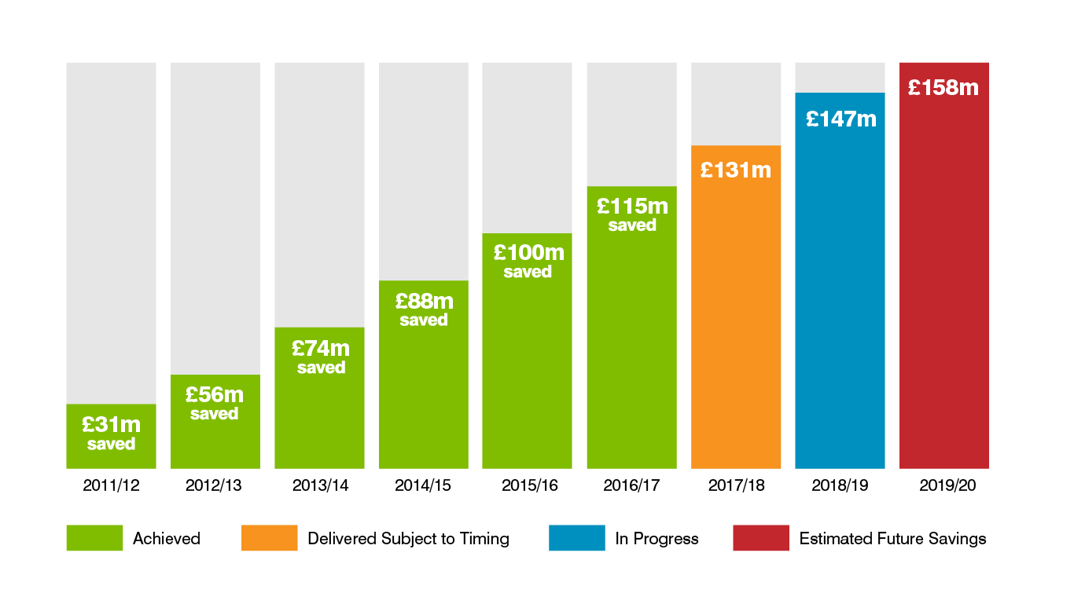
The story so far…

Slide 7
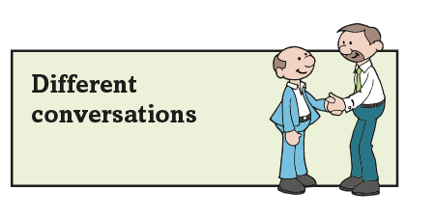
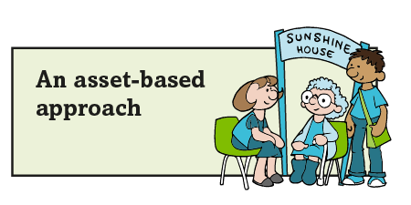
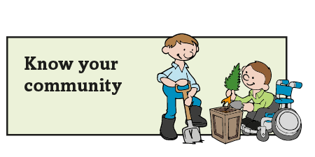
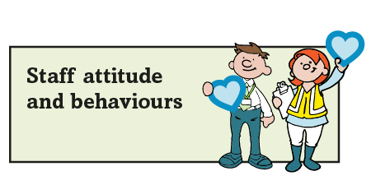
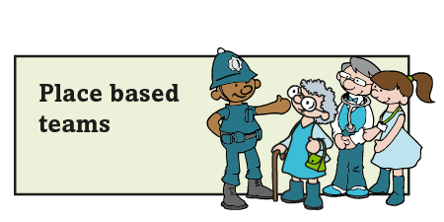
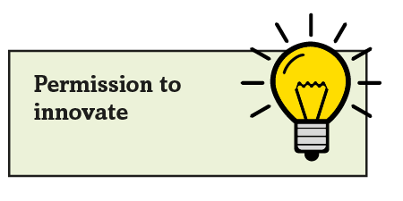
The Deal principles

Slide 8
The Deal for the future
A radical plan:
To transform traditional council services and deliver in new ways
To grow the borough
To form new relationships with residents
To maintain and protect service for the future

Slide 9
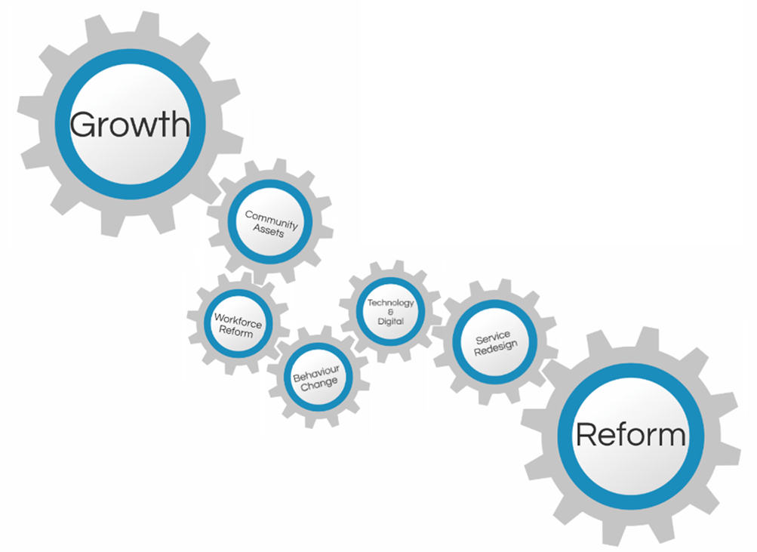
How we deliver - Growth and Reform

Slide 10
How we deliver – Asset Based

Slide 11
How we deliver – Community Investment
59
big ideas
£2.9m
external funding leveraged
£1.26m
recurrent savings
Social and economic benefit of
£5.6m

Slide 12
How we deliver – Be Wigan
Be Positive… take pride in all that you do
Be Accountable… be responsible for making things better
Be Courageous… be open to doing things differently
Because how we do things is just as important as what we do

Slide 13
Achievements
Satisfaction with the council increased to 65%
Increased staff engagement – best council to work for
Growth
£70m Poundland and Nice-pak investment
Highest Employment rate in Greater Manchester
Reform
Alzheimer's Society dementia friendly community town of the year.
Reablement service rated as outstanding by CQC
Childrens services rated Good by Ofsted
Significant improvement in school readiness
Enablers
@
£
Digital Council of the year
£7.5m invested into the community
Notes:
Resident satisfaction with the way the council runs things has increased by 59% since 2008
Two thirds (65%) of residents stated that they are satisfied with the way Wigan Council runs things in 2016, compared to 41% in 2008. Residents satisfaction in comparator authorities is lower at 52%
Perceptions that the Council provides value for money has increased from 30% in 2008 to 50% in 2016. Higher than the LG Inform average of 47%
Highways – 4% (march 16/17) of principal roads need maintenance (a slight increase from 3% in 15/16), we are in the top quartile nationally. Received recognition for Highways were recognised by APSE for their work, especially their Winter Maintenance programme.
Services users who receive self-directed support is 16/17– (building self reliance within a vulnerable cohort) improved 11% since 2015/16. Above the north west average which is 84.99% and in the top quartile for the NW
7.5 million has been invested in community groups over the last four years.

Slide 14
Through The Deal, we aren’t just saving money…
… we are changing lives

Slide 15
‘The Deal’ Commercial Offer
Sarah Palmer

Slide 17
USP
Products
Competition
Business Model
Business Plan

Slide 18
Option 1
Independent Consultancy: Establish consultancy with dedicated staff
Option 2
WMDC: Utilise existing council company
Option 3
Enhanced Business as Usual A: Event Co-ordinator or Commercial Manager
Option 4
Option 5
Enhanced Business as Usual B: Charging model no additional staff
Do Nothing: But better co-ordination

Slide 19
Option 4:
Enhanced Business as Usual
- Charging Model but No Additional Staff

Slide 22
