Slide 1
CIPFA North West The Guild Hall, Preston
Mike Nuttall
Local Service Partners

Slide 2
Guild Hall, Preston
Preston Guild 1972
Concert Hall – capacity 2,700
Theatre – capacity 800
Shopping arcade – c20 units
Bus Station
Multi-storey car park

Slide 3
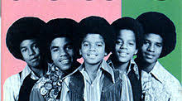
Guild Hall, Preston
Nationally recognised venue
Top acts
Gateway into Preston
Significant footfall

Slide 4
Guild Hall, Preston – fortunes change
Competition from other venues
Footfall reduction
Shopping arcade – vacancies
Major works required
Council subsidy c£1.2m p.a.
Risk appetite reduced

Slide 5
Guild Hall, Preston – what next?
Mounting Council budget pressures
High profile site
Long term solution needed
Mothball/demolish the venue being considered – 2013
Market the site – “last throw of the dice”

Slide 6
Guild Hall, Preston – a way forward
Rigby Organisation proposal - local entrepreneur
Leasehold (999 years) Oct 2014
Reinvigorate the venue
Capital investment c£5m
Compliment wider regeneration aspirations
Remove the Council subsidy…..quickly

Slide 7
Guild Hall, Preston – rises from the ashes
Rigby Organisation – determined to make an immediate/bold statement
Venue facelift
New “dining experiences” and bars opened
Greater utilisation of space
Increased/complimentary occupancy of retail units

Slide 8
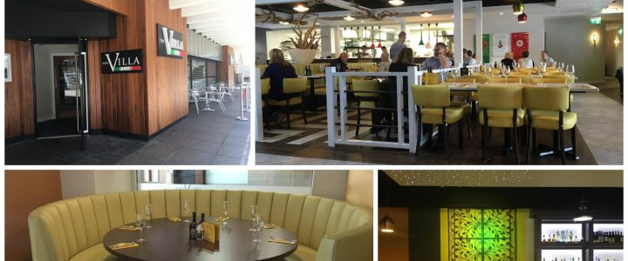
Guild Hall, Preston

Slide 9
Guild Hall, Preston – achievements/next?
Savings/investment delivered
Investment continues….
Over 100 additional jobs created…..more to come
Quality of shows/events on offer improved
Prompted others to invest in surrounding facilities
Creation of a multi-entertainment complex in large derelict retail unit
Conference venue

Slide 10
Guild Hall, Preston – some reflections
Partner selection crucial
Pace of decision making
It’s an ongoing relationship
Managing risk
Revenue generation
Ability to respond to changing tastes

Slide 11
The Rigby Organisation

Slide 12
Local Service Partners – our offer to you
Diverse and experienced team
Discuss issues you may be facing
Explore possible solutions
Pragmatic and practical
Ability to make things happen

Slide 13
Local Service Partners
Mike Nuttall
Executive Advisor
Local Service Partners
Mike.nuttall@localservicepartners.co.uk

